Slide 1


Discussion Materials
April 2025
1

Slide 2


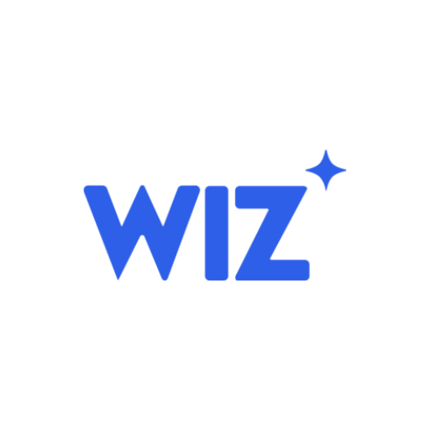
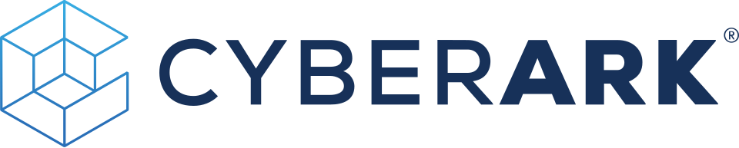
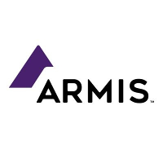
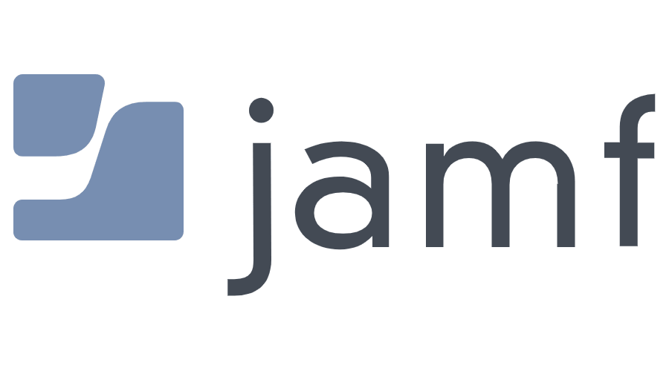


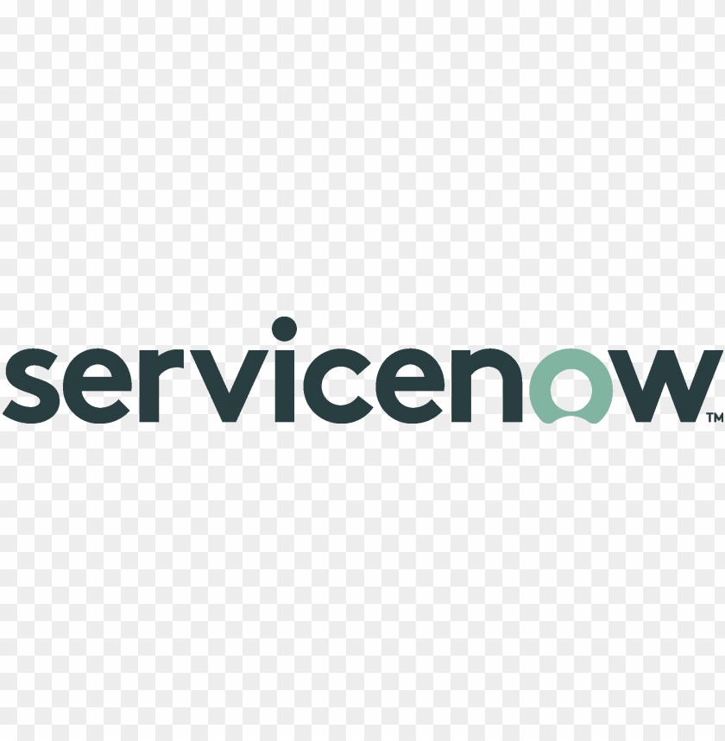




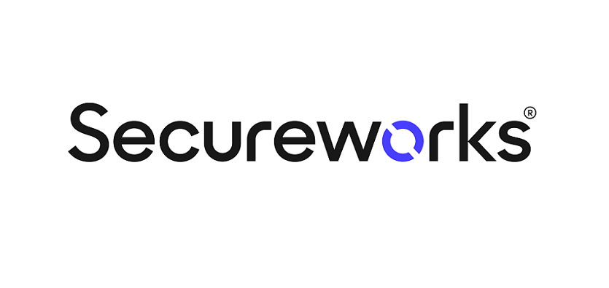
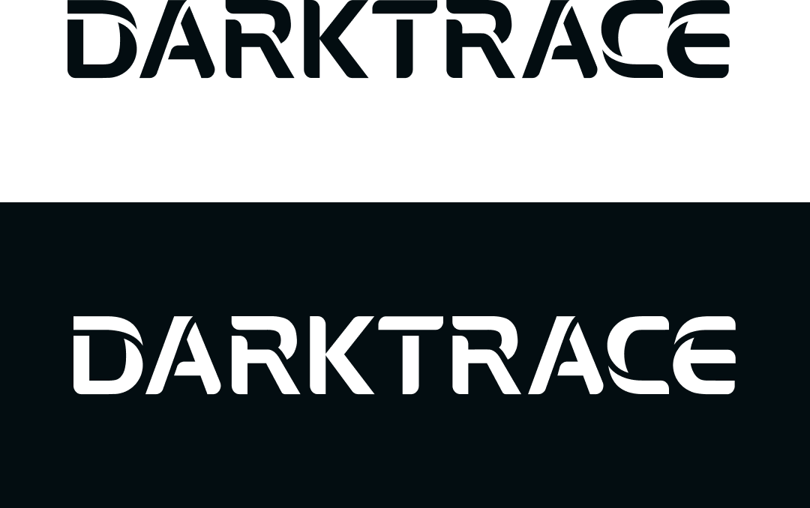

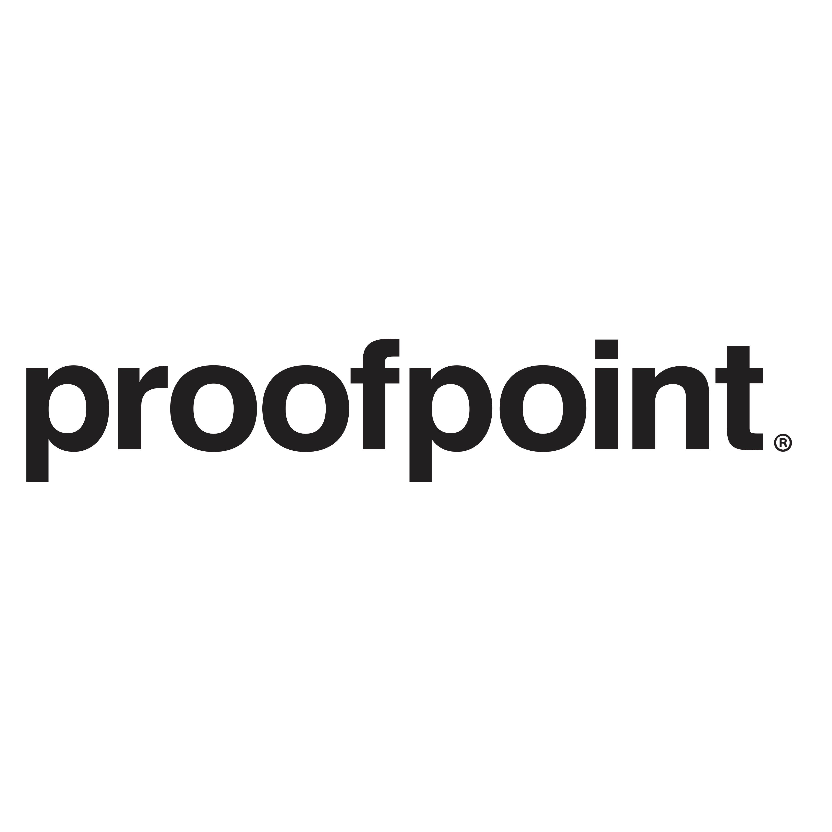



DiceBot Capital Investment Banking
DiceBot Capital leverages industry knowledge and relationships to execute transactions for founder-focused clients
DiceBot Capital by the Number
Technology Practice Areas
500+ transactions completed
$5B in
transaction value
Enterprise SaaS
Cybersecurity
Consumer Internet
SaaS, ERP, CRM, B2B platforms
Endpoint, cloud, network
security, MDR, XDR
Marketplaces, social
platforms, apps, media
8 industry practice groups
30+ investment
bankers
FinTech
Hardware & Semi
IT Services
Payments, lending,
wealth, insurtech
Semiconductors, IoT, embedded systems, sensors
Managed services, cloud,
staffing & tech
Representative Transactions
Technology Team
Wiz
CyberArk
Armis
Jamf
Alex Harmon
Managing Director
15+ years experience
James Weller
Managing Director
15+ years experience
Acquired by
Acquired by
Acquired by
Acquired by
2025
2025
2025
2025
Sara Chen
Senior Associate
6+ years experience
Maya Okafor
Associate
3+ years experience
Hornetsecurity
Secureworks
Darktrace
Recorded Future
Acquired by
Acquired by
Acquired by
Acquired by
2025
2025
2024
2024
* Includes transactions completed by current employees while at previous firms.
2

Slide 3





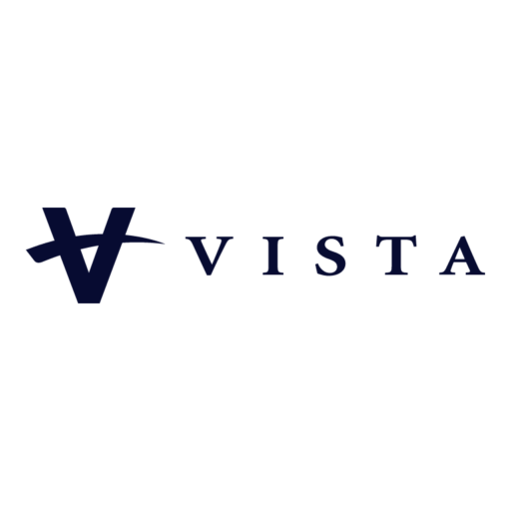
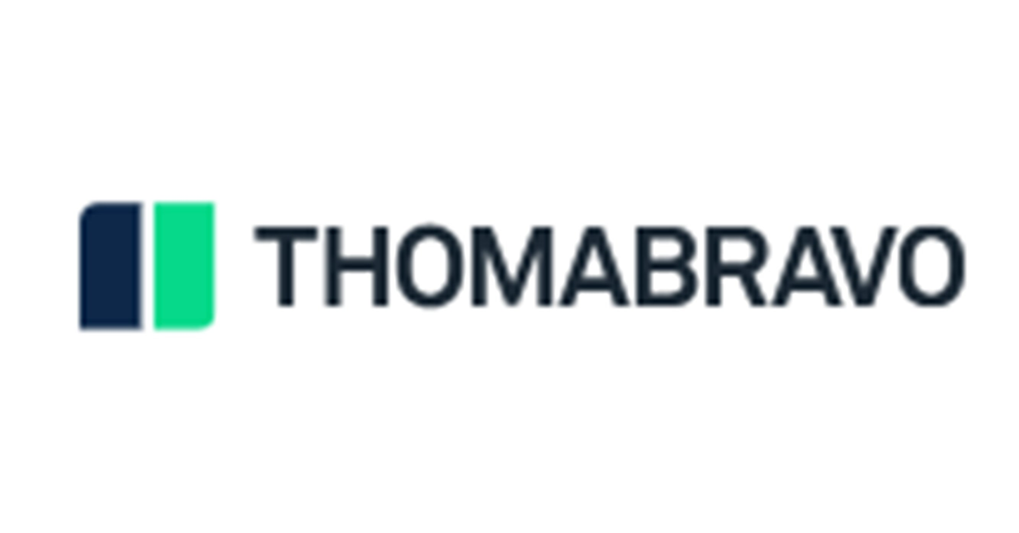


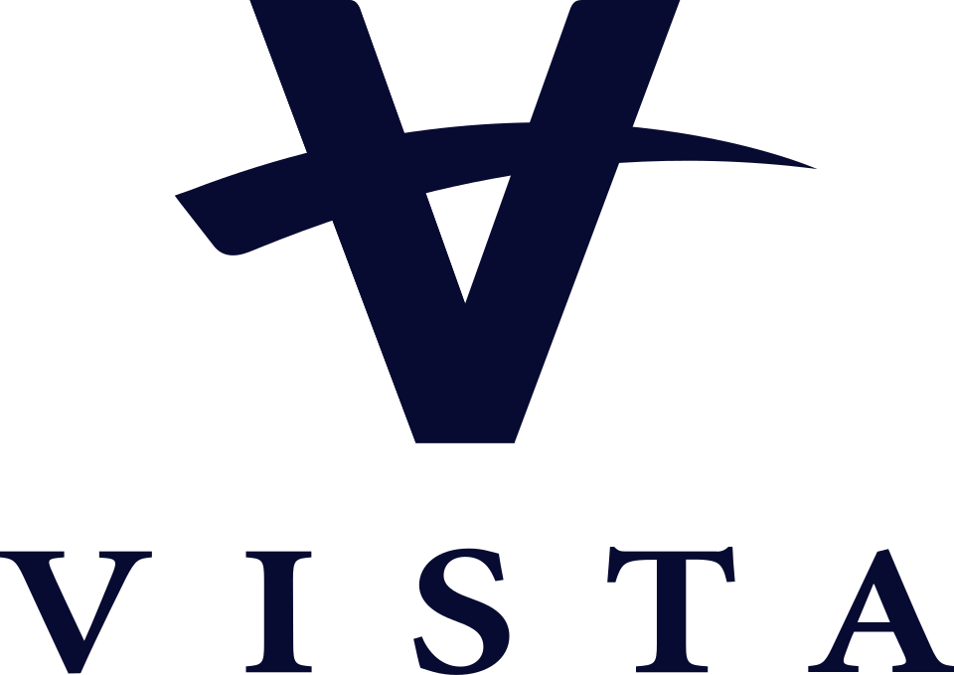
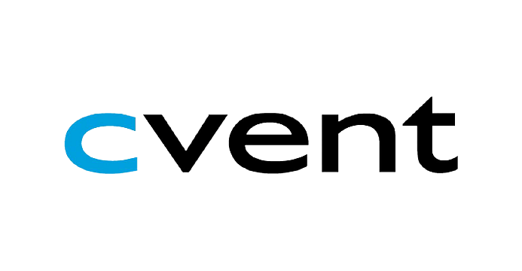
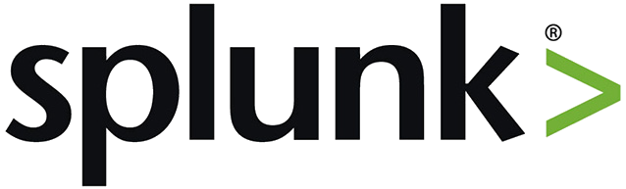
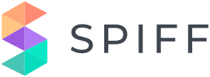




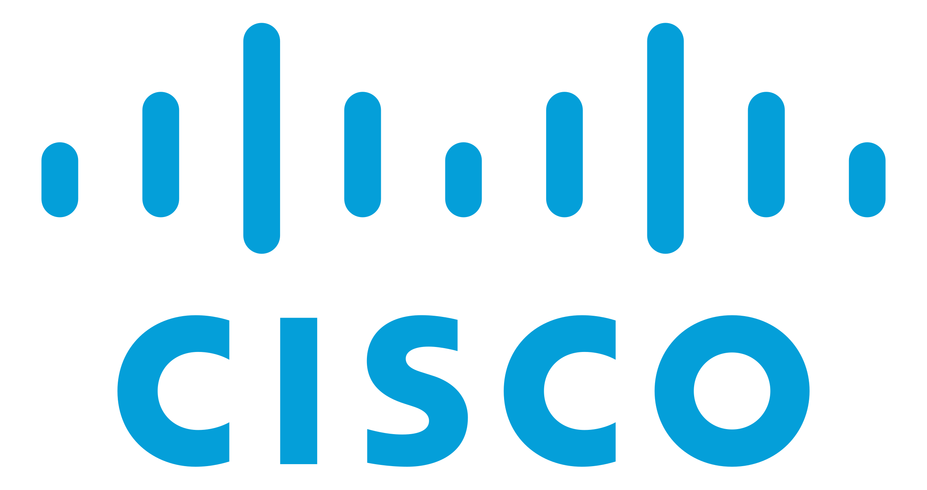


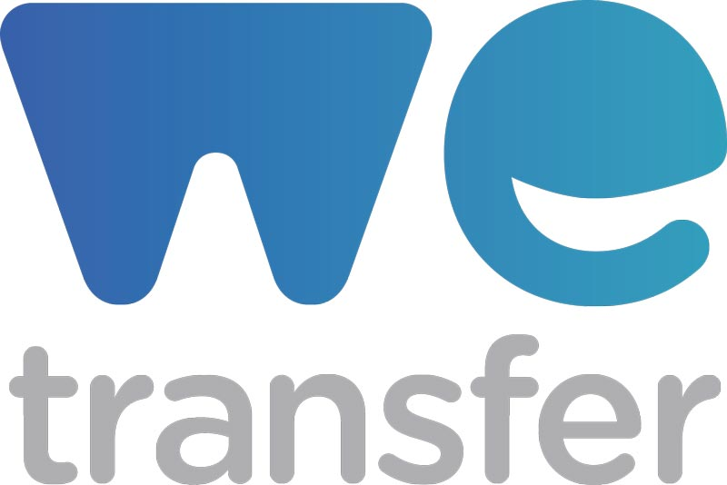

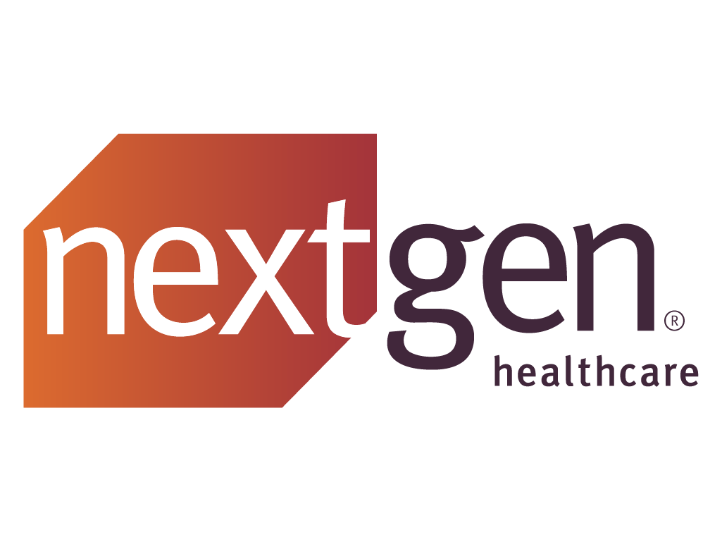

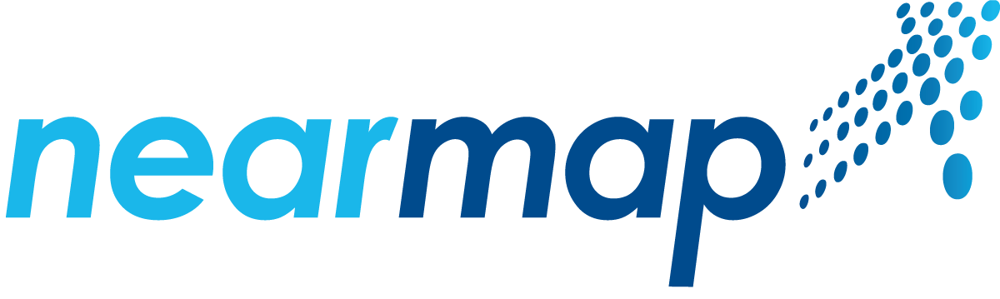
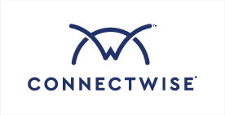

Select Software and Technology Transactions
Acumatica
Olo
Darktrace
Nexthink
Energy Exemplar
Avalara
Acquired by
Acquired by
Acquired by
Acquired by
Acquired by
Acquired by
2025
2025
2024
2024
2023
2022
Cvent
Splunk
Spiff
Revelstoke
Coupa Software
Bottomline Technologies
Acquired by
Acquired by
Acquired by
Acquired by
Acquired by
Acquired by
2025
2024
2024
2023
2022
2022
WeTransfer
Everbridge
NextGen Healthcare
Magnet Forensics
Nearmap
ConnectWise
Acquired by
Acquired by
Acquired by
Acquired by
Acquired by
Acquired by
2024
2024
2023
2023
2022
2019
* Includes transactions completed by current employees while at previous firms.
3

Slide 4

What Our Clients are Saying
“DiceBot Capital brought genuine sector depth to our process. They knew every relevant buyer and helped us navigate a complex deal with competing offers. The outcome exceeded our expectations on price and fit.”
Jordan Mills
NorthStar Cyber – CEO
“We interviewed five banks. DiceBot was the only team that had operated in our exact vertical and could speak credibly to enterprise security buyers. That expertise was decisive in closing the right deal at the right valuation.”
ALEX CROSS
Vectara Security – Founder and CEO
4

Slide 5
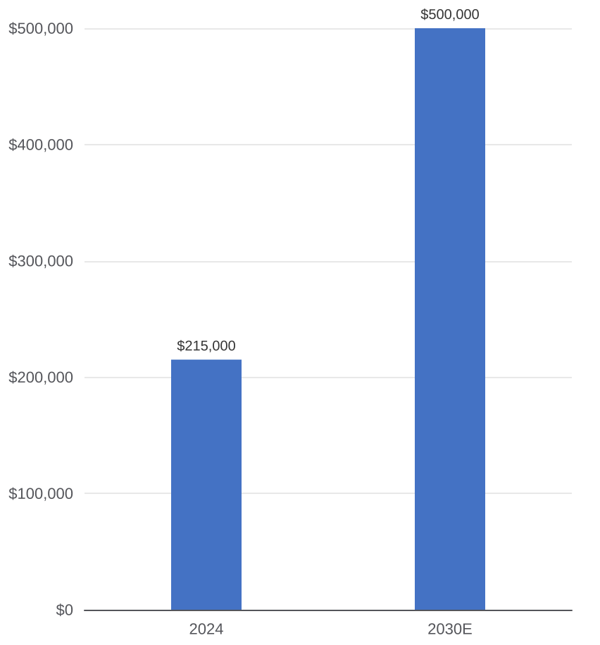
Cybersecurity Market Update
Driven by the rise of AI-powered threats, regulatory mandates, and the failure of legacy perimeter defenses, the global cybersecurity market is entering a structural expansion phase with durable, non-discretionary demand
Global Cybersecurity Market
Select Market Trends
AI-Powered Attacks Raise the Stakes for Defenders
Generative AI is dramatically lowering the cost of spear-phishing, malware development, and adversarial reconnaissance. Defenders face faster, more convincing attacks with the same headcount, driving demand for AI-native detection and response platforms
Identity Has Become the New Perimeter
With 80%+ of breaches involving stolen credentials (Verizon DBIR), enterprises are prioritizing identity security, privileged access management, and zero trust architecture — a structural shift away from network-centric defenses
Regulatory Mandates Creating Non-Discretionary Demand
SEC cybersecurity disclosure rules, NIS2 in Europe, and DORA for financial services are forcing boards to treat cyber risk as a governance issue — creating mandatory, recurring budget resistant to economic cycles
Cloud & OT Expansion Widening the Attack Surface
Multi-cloud adoption and the proliferation of connected OT/ICS devices are creating vast new attack surfaces with limited native security controls, driving category formation in CNAPP, SSPM, and industrial cybersecurity
5

Slide 6
02.
INDUSTRY OVERVIEW
6

Slide 7
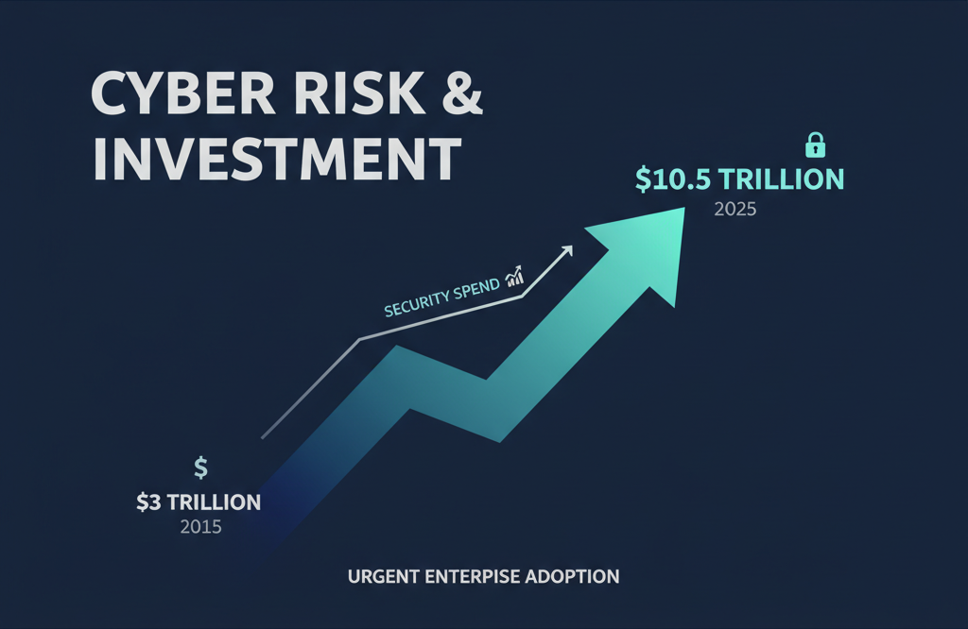
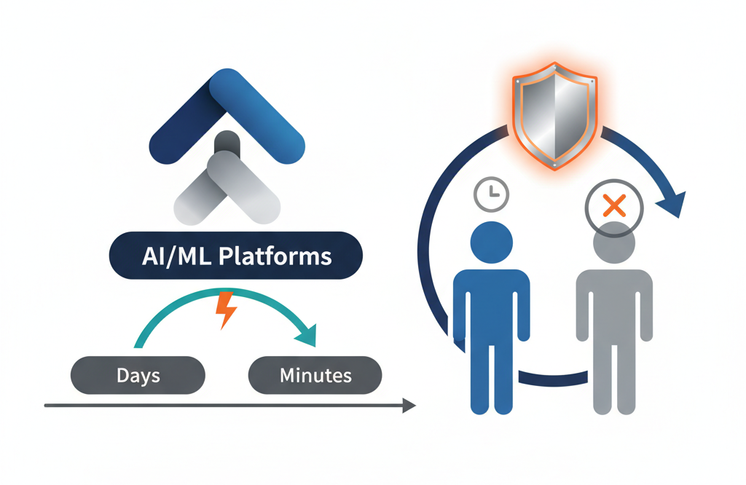
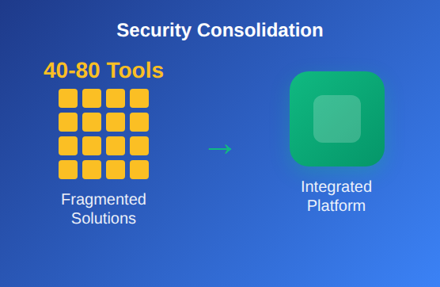
Cybersecurity Industry Key Trends
Accelerating threat complexity, AI-driven innovation, and large-scale platform consolidation are reshaping the cybersecurity market — creating compelling opportunities for investors across the value chain.
Rising Threat Landscape & Regulatory Pressure
AI & Automation Reshaping the Security Stack
Consolidation, M&A, and Platform Convergence
Global cybercrime costs projected to reach $10.5T annually by 2025, up from $3T in 2015, driving urgent enterprise security investment. Regulatory mandates — SEC disclosure rules, NIS2, DORA — force boards to treat cyber risk as financial issue, not just IT. Average breach cost: $4.88M globally (IBM), $9M+ for critical infrastructure. As ransomware, supply chain attacks, nation-state threats proliferate, spend on detection/response platforms accelerates.
AI transforms attack surface and defense — adversaries use generative AI for hyper-personalized phishing, deepfakes, and automated exploits at scale. Security vendors embed AI/ML across threat detection, alert triage, and autonomous response — compressing MTTD and MTTR from days to minutes. SOCs adopt AI-driven platforms to address analyst burnout and global shortage of ~3.5M unfilled cybersecurity roles. Emerging categories — AI-SPM, non-human identity governance, and agentic AI security — represent high-growth opportunities.
Enterprises with 40–80 security tools consolidate toward integrated platforms — benefiting vendors with unified endpoint, cloud, identity, and network coverage. Cybersecurity M&A hit record levels in 2022–2024, with Thoma Bravo, Insight Partners, and Francisco Partners deploying billions. Cloud-native security (CNAPP, SASE, SSE) replaces legacy appliances, compressing cycles and accelerating switching. PE-backed platforms outpace organic growth: buyers acquire best-of-breed solutions and integrate them into scalable platforms commanding premium multiples.
Sources: IBM Cost of a Data Breach Report 2024, ISC² Cybersecurity Workforce Study 2024, Cybersecurity Ventures, Gartner
7

Slide 8
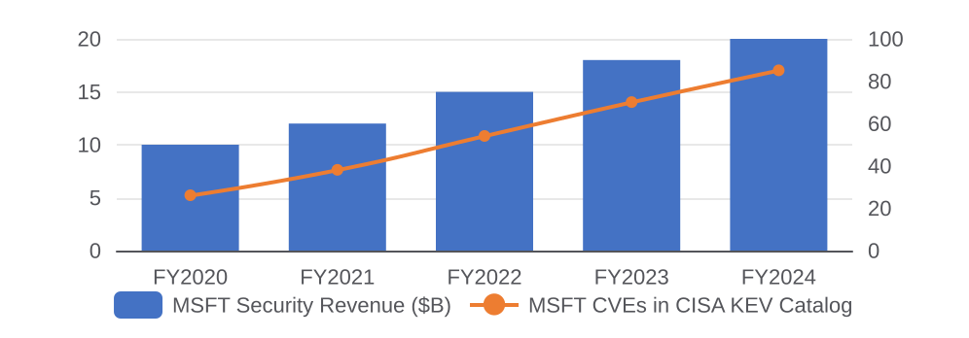
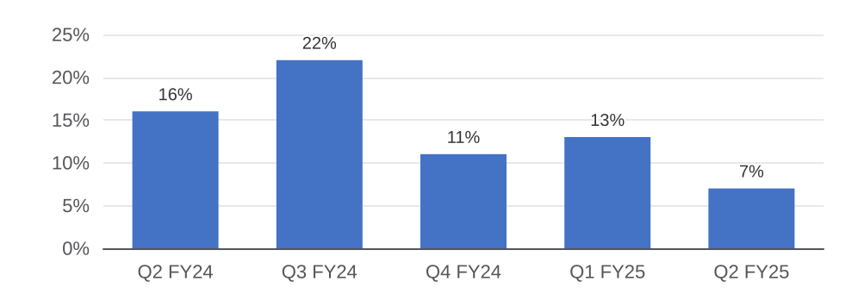
CONTRARIAN VIEW
Consolidation Is Concentrating Risk
The consensus trade — buy platform consolidators — builds systemic fragility. The world's largest security vendor is its most-exploited software stack. Next cycle's winners are best-of-breed specialists making independent security the rational choice.
MSFT Revenue vs. Known Exploited CVEs
The Consolidation Paradox
CrowdStrike Jul '24: 8.5M Windows crashed, $5.4B losses
Kernel access + monoculture = systemic blast radius
PANW platformization: billings growth fell 22%→7%
Trading security efficacy for procurement ease = risk
The Microsoft Liability
CSRB: Microsoft security 'inadequate'; Storm-0558 preventable
Midnight Blizzard breached exec email via legacy tenant
Microsoft leads cybersecurity revenue ($20B+) AND vulnerabilities
E5 pricing drives growth — Secure Future was admission
PANW Billings Collapse After Platformization
Where the Opportunity Sits
Best-of-breed specialists: identity (CyberArk), email AI (Abnormal), cloud posture (Wiz), OT/ICS (Claroty)
Open standards vendors (OCSF, STIX/TAXII) integrate vs replace SIEM/SOAR
Platforms with measurable efficacy vs Microsoft
Regulatory moats (FedRAMP, CMMC, NIS2) create demand
Sources: CSRB Report Apr 2024, Microsoft Security Blog Jan 2024, Parametrix Jul 2024, Palo Alto Networks FY2025 Q2 Earnings, CISA KEV Catalog, Gartner 2024
8

Slide 9
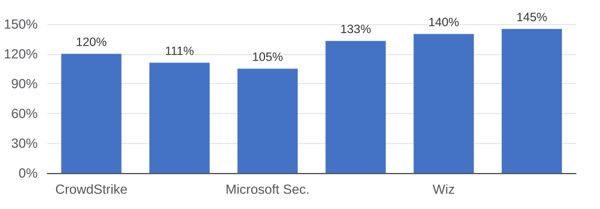
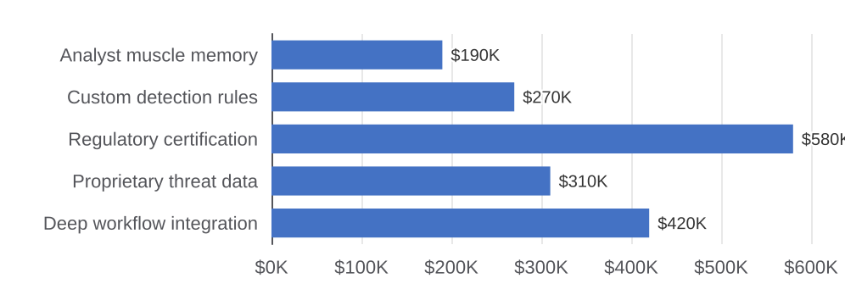
CONTRARIAN VIEW
Best-of-Breed: Platform Vendors Can't Buy
Platform vendors win on procurement. Specialists win on outcomes. In cybersecurity, outcomes are the only metric that survives a board-level breach post-mortem — and specialists structurally outperform on every dimension that predicts durable enterprise value.
NRR: Specialists vs. Platform Vendors
Why NRR Diverges
Specialists build data moats generalists can't replicate
Platform vendors expand via discounted modules — NRR inflates then compresses
CyberArk's 133% NRR: identity sprawl creates new credentials to manage
Microsoft's ~105% Sec. NRR anchored to M365 seats, not outcomes
Underappreciated Regulatory Moat
FedRAMP High takes 12-18mo, $2-5M — creates displacement barriers
CMMC L2/3 & NIS2 mandate specific controls, creating captive demand
SEC 2023 rules force CISOs to document tool efficacy
Kiteworks' FedRAMP auth generated 35%+ new ARR in FY24
Why Switching Costs Compound Over Time
The Investable Framework
Own chokepoints: identity (CyberArk), email (Abnormal), cloud (Wiz), OT (Claroty)
Interoperability as moat: OCSF/STIX vendors become infrastructure
Avoid middle: mid-tier faces MSFT bundles above, AI below
AI widens gaps between specialists with data vs generalists
Sources: CrowdStrike FY2025 Earnings, Wiz S-1 Draft Reporting, Abnormal Security 2024 Customer Data, CyberArk Annual Report 2024, Gartner Magic Quadrant, CISA Zero Trust Maturity Model
9

Slide 10
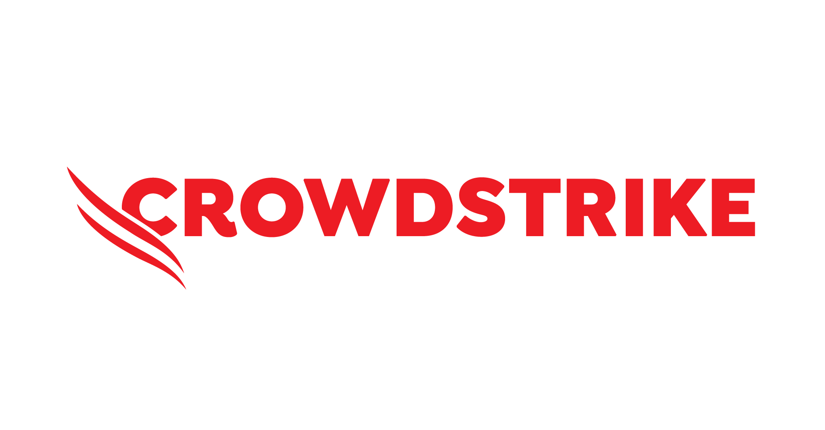
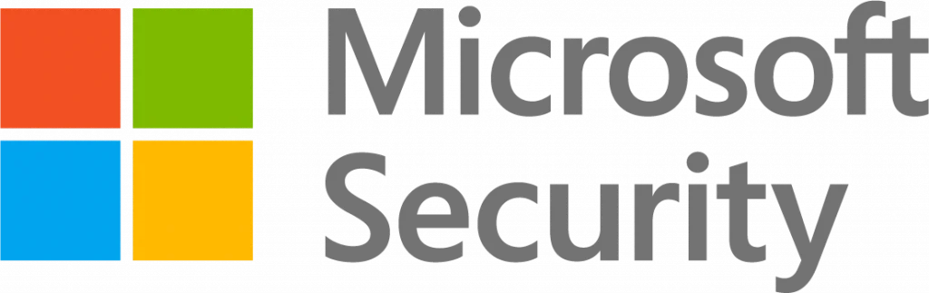



COMPETITIVE ANALYSIS
Cybersecurity Competitive Landscape
Category
EDR / XDR
Defender XDR
Falcon EDR
Cortex XDR
FortiEDR
— None
Singularity XDR
— N/A
Identity / PAM
Entra ID + Gov
Falcon ID + PAM
⚠ CIEM only
⚠ FortiAuth+PAM
— None
ITDR only
PAM + Identity
Cloud / CNAPP
Defender for Cloud
Falcon Cloud Sec
Prisma Cloud
FortiCNAPP
⚠ Posture only
Singularity Cloud
⚠ CIEM only
Network / SASE
⚠ Azure FW only
— None
NGFW + Prisma SASE
FortiGate + SASE
ZIA+ZPA+SD-WAN
— None
—
Email Security
Defender/O365
— None
— None
FortiMail
⚠ DLP inline
— None
—
SecOps / SIEM
Sentinel + Copilot
NG-SIEM + SOAR
XSIAM + XSOAR
FortiSIEM+SOAR
— None
⚠ AI-SIEM beta
—
Data / DLP
Purview DLP
⚠ Data Protect
Prisma+Cortex DLP
FortiDLP
ZIA DLP + DSPM
⚠ Cloud only
—
OT / IoT
Defender for IoT
⚠ IoT Discover
Industrial OT+IoT
OT Portfolio
⚠ ZPA OT access
— None
—
Vuln Mgmt
Defender VM+EASM
Spotlight+Exposure
Cortex Xpanse
⚠ FortiRecon
⚠ Exposure Mgmt
Singularity VM
—
Sec Awareness
⚠ Attack Sim only
—
—
SAT+FortiPhish
—
—
—
Full offering
⚠ Partial
— No product
Sources: Vendor websites Feb 2026, Gartner MQ 2024-2025. ⚠ = partial. — = no product.
10

Slide 11
Public Company Profile
Zscaler — Company Profile (1/3)
Company Overview
Management Team
Zscaler (NASDAQ: ZS) is the leader in cloud-native zero trust security, founded in 2007 by Jay Chaudhry in San Jose, CA. The platform replaces legacy network security — VPN, firewalls, proxies — with a zero trust architecture that connects users and workloads directly to applications. Zscaler serves ~8,800 customers including 40% of the Fortune 500, with 7,923 employees and $2.67B in FY2025 revenue (+23% YoY).
Jay Chaudhry
CEO, Chairman & Founder — serial entrepreneur; founded AirDefense, CipherTrust, Securit Inc.
Kevin Rubin
CFO — joined 2019; previously CFO at Hortonworks and SVP Finance at Nutanix
Adam Geller
CPO — leads product strategy for the Zero Trust Exchange platform
Products & Services
Mike Rich
CRO & President, Global Sales — drives global revenue and go-to-market
ZIA (Internet Access) — secure internet & SaaS; replaces proxies and cloud firewalls
ZPA (Private Access) — zero trust app access; replaces VPN with identity-based connectivity
ZDX (Digital Experience) — end-to-end visibility into user and app performance
Data Protection — cloud DLP, CASB, DSPM, endpoint DLP; unified data security
AI Security — AI asset mgmt, AI access security, AI guardrails for enterprise AI
Zero Trust Firewall & Branch — SD-WAN, IoT/OT segmentation, zero trust branch
Dhawal Sharma
EVP, AI Security & Strategic Initiatives — leads AI security product line
Board of Directors
Jay Chaudhry
CEO, Chairman & Founder — executive board member
Charles Giancarlo
CEO, Pure Storage — independent director
Karen Blasing
Independent Director — ex-CFO Guidewire, NetSuite
David Schneider
General Partner, Coatue Management
Scott Darling
President, Dell Technologies Capital
Eileen Naughton
Independent Director — ex-VP People Ops, Google
Source: Zscaler IR, SEC filings. Market data as of Feb 24, 2026.
11

Slide 12
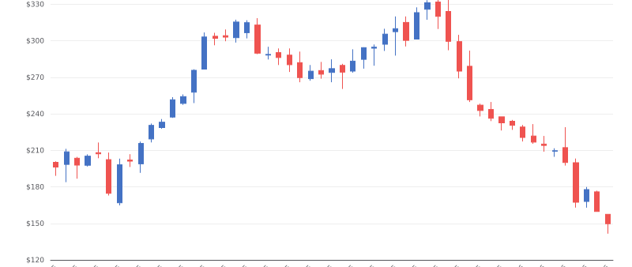
Public Company Profile
Zscaler — Company Profile (2/3)
Valuation & Capital Structure
Income Statement Summary ($M / $B)
Market Cap | $23.9B
Total Debt | $1.83B
Cash & Investments | $3.32B
Enterprise Value | $22.4B
 | FY2024A | FY2025A | FY2026E | FY2027E
Revenue | $2.17B | $2.67B | $3.29B | $3.94B
Gross Profit | $1.69B | $2.05B | $2.55B | $3.06B
Gross Margin | 77.9% | 76.9% | 77.5% | 77.5%
EBITDA | $65M | $112M | $914M | $1.09B
EBITDA Margin | 3.0% | 4.2% | 27.7% | 27.7%
Net Income | ($58M) | ($42M) | $611M | $690M
Net Margin | -2.7% | -1.6% | 18.6% | 17.5%
EPS (Diluted) | ($0.39) | ($0.27) | $3.81 | $4.47
Metric | LTM | NTM
EV / Revenue | 7.9x | 6.8x
EV / EBITDA | NM | 24.5x
P / E | NM | 39.3x
Shareholder Overview
ZS (NASDAQ) — 52-Week Stock Performance
Shareholder | Shares | Ownership
Jay Chaudhry (CEO) | 19.5M | 12.2%
Vanguard Group | 13.2M | 8.3%
BlackRock | 12.8M | 8.0%
Total Institutional | ~115M | ~72%
Total Retail | ~44M | ~28%
Total | 159.5M | 100%
Source: Zscaler IR, StockAnalysis.com. FY ends July 31. Market data as of Feb 24, 2026.
12

Slide 13



Public Company Profile
Zscaler — Company Profile (3/3)
Strategic Focus
Competitive Positioning
AI Platform
Expand AI Security suite: AI asset mgmt, AI access security, AI guardrails, agentic AI defense
Palo Alto Networks
Broadest security platform; Zscaler wins on pure-play cloud-native zero trust architecture
Platform Consol.
Z-Flex commercial model drives larger platform deals; displace point products and legacy vendors
Netskope
Strong SSE competitor; Zscaler leads on scale (150+ PoPs), customer base, and integrations
Federal / Gov't
U.S. federal expansion via FedRAMP; Peraton partnership for mission-critical environments
Cloudflare
Aggressive SASE entrant; faster RPO growth; Zscaler leads on enterprise feature depth
Zero Trust SASE
Unified SASE combining SSE + SD-WAN; Gartner Magic Quadrant Leader for SSE (2025)
Fortinet
Hardware-based SD-WAN/SASE; Zscaler wins on cloud-native scale and zero trust architecture
Data Security
DSPM, unified SaaS security, Microsoft Copilot data protection — growing data security TAM
Microsoft Entra
Bundled with Azure; Zscaler wins on internet access depth and ThreatLabz intelligence
M&A / Innovation
SquareX acquisition (Feb 2026): extends zero trust browser security for AI era
Source: Zscaler IR, CNBC, GlobeNewswire, Gartner. Market data as of Feb 24, 2026.
13

Slide 14
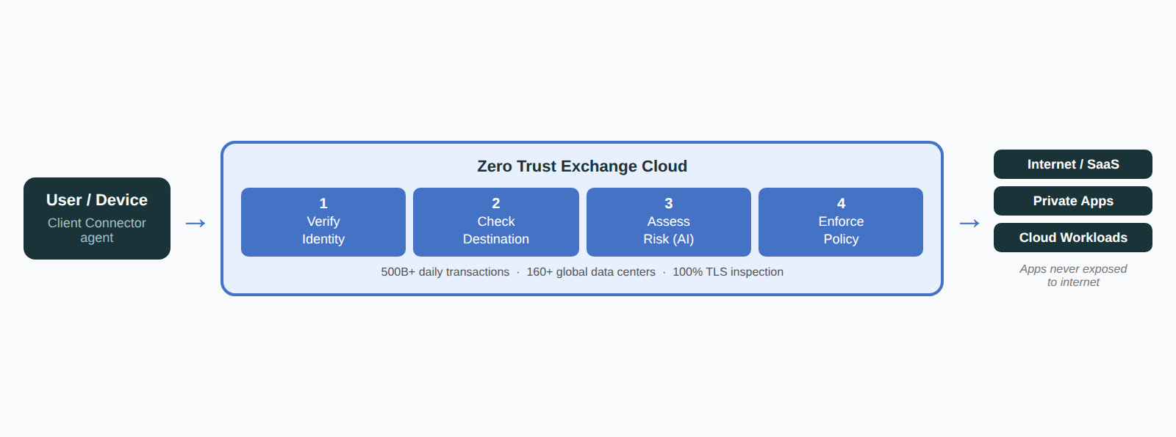
Public Company Profile
Zscaler — Zero Trust Exchange Platform
How It Works — Zero Trust Exchange
Core Product Families
ZIA (Internet Access) — cloud-native SWG; full TLS inspection, URL filtering, DLP, CASB, sandbox; replaces proxies and firewalls
ZPA (Private Access) — world's most deployed ZTNA; brokers direct user-to-app connections without VPN or network access
ZDX (Digital Experience) — end-to-end performance monitoring from device to app; AI root cause; 52% reduction in MTTR
Data Security — unified DLP across web, email, SaaS, cloud, and endpoints; CASB, DSPM, AI-powered data classification
AI Security — governs enterprise AI use (ChatGPT, Copilot, agents); inspects prompts, prevents data leakage into public models
Security Operations — Risk360 cyber risk quantification, deception technology, vulnerability mgmt, MDR via Red Canary
Zero Trust vs. Legacy Architecture
Legacy VPN
Public IPs exposed — firewalls and VPN gateways visible and scannable on the internet
Customer Proof Points
Siemens AG
70% reduction in management costs; ZIA deployed to 320K users across 192 countries
Legacy VPN
Broad network access once inside — compromised user can move laterally to any system
State of Oklahoma
Private app access 6x faster within 2 days of ZPA deployment replacing legacy VPN for 30K+ users
Zero Trust
Apps invisible to internet — no public IPs, zero attack surface for external scanners
Molson Coors
Incident resolution time cut from ~8 hours to ~15 minutes using ZDX digital experience monitoring
Zero Trust
User-to-app only — no network access granted; lateral movement structurally impossible
Careem
~55% cost reduction replacing legacy firewalls and VPNs; 62% improvement in MTTR as workforce doubled
Source: Zscaler product documentation, IR presentations, customer case studies.
14

Slide 15
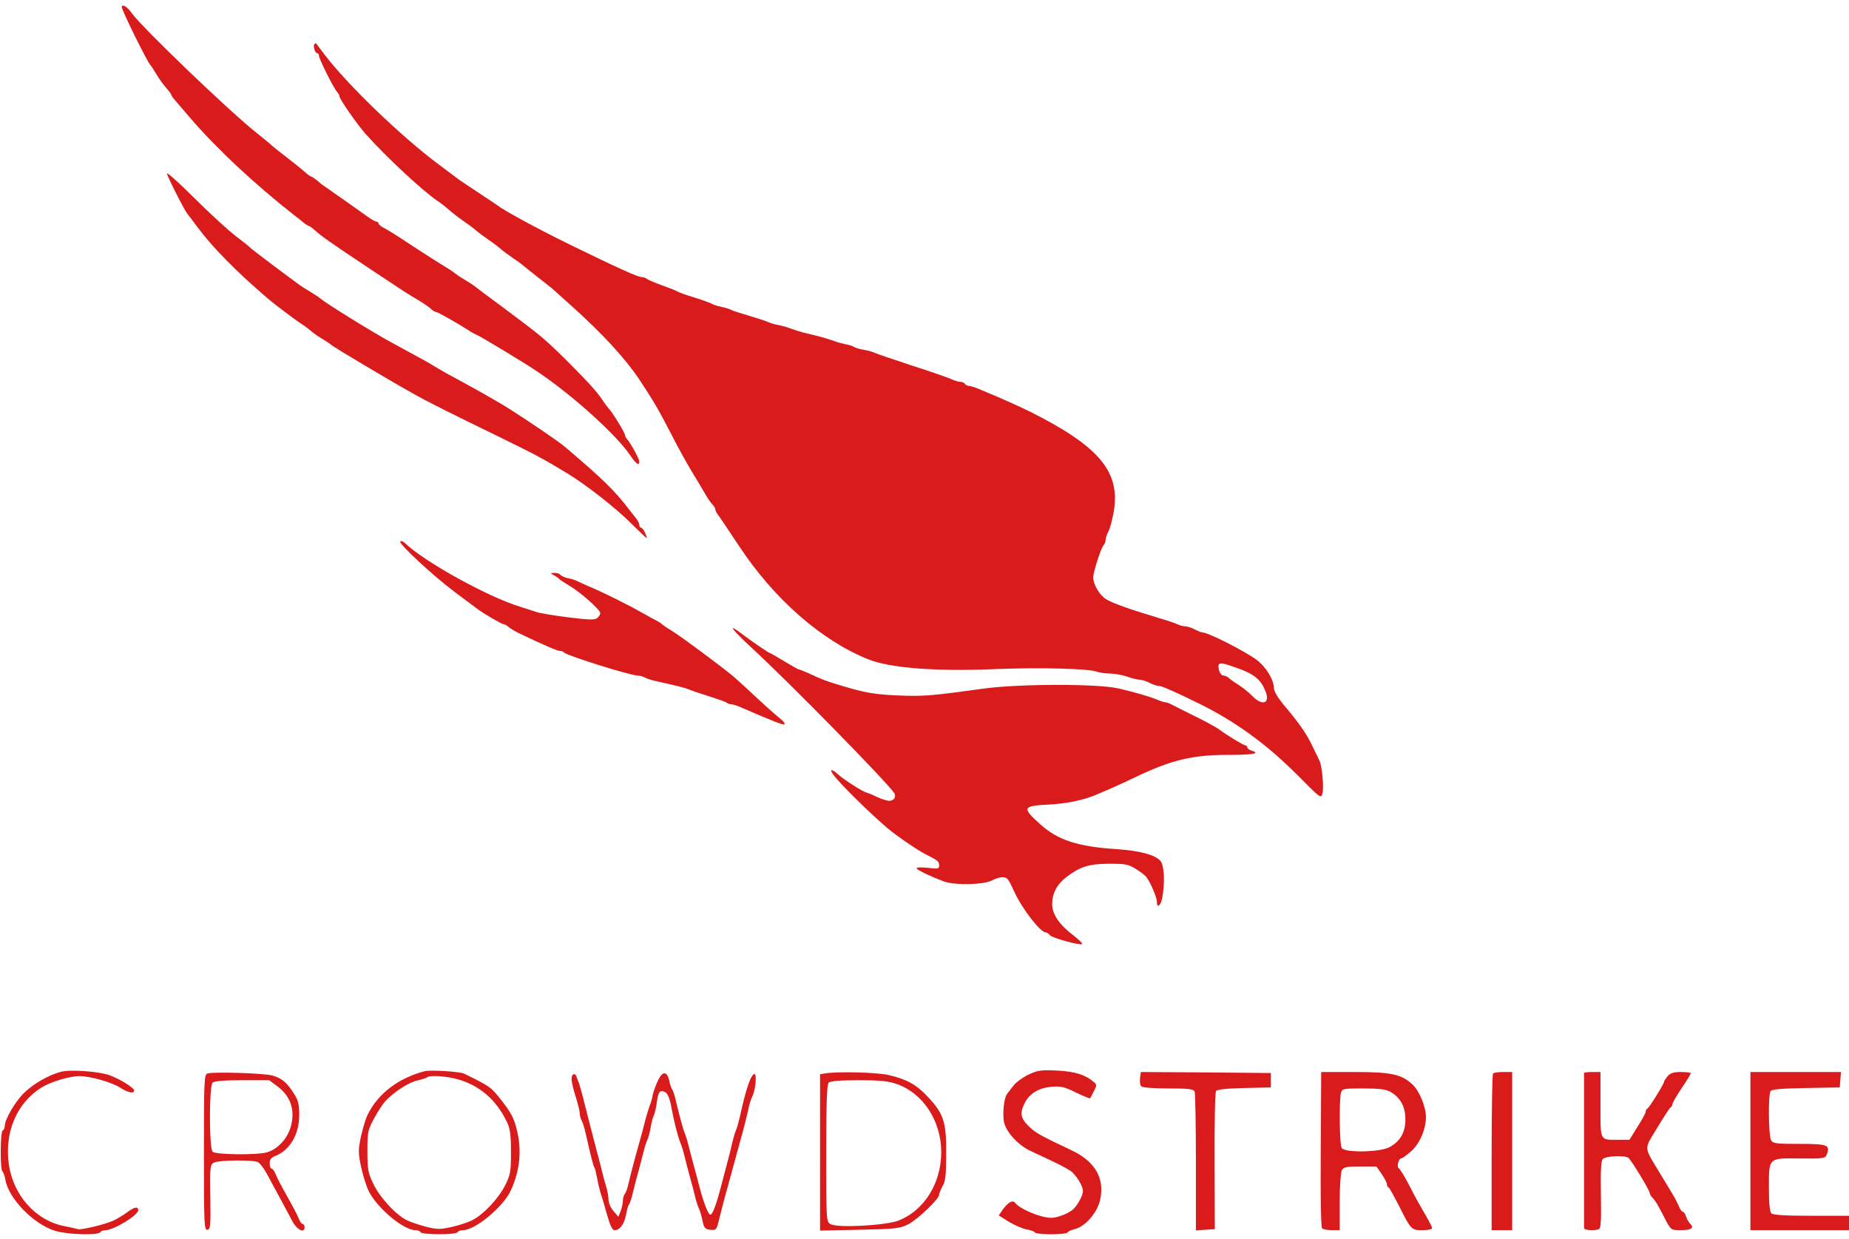
Public Company Profile
CrowdStrike — Company Profile (1/4)
Company Overview
Management Team
CrowdStrike (NASDAQ: CRWD) is the global leader in AI-native cybersecurity, founded in 2011 by George Kurtz. The Falcon platform protects endpoints, cloud workloads, identity, and data through a single lightweight agent. CrowdStrike serves 29,000+ customers including 65% of the Fortune 100, with $3.95B in FY2025 revenue (+29% YoY). The company pioneered "single agent, single platform" — replacing legacy AV with unified AI-driven protection.
George Kurtz
CEO & Co-Founder — former McAfee CTO; led co. from founding through IPO and $88B market cap
Burt Podbere
CFO — joined 2013; ex-VP Finance CrowdStrike; leads financial strategy & investor relations
Shawn Henry
President, CrowdStrike Services & CSO — ex-FBI Executive Assistant Director; leads threat intel
Products & Services
Daniel Bernard
Chief Business Officer — oversees global sales, channels, and go-to-market strategy
Falcon Prevent — next-gen AV; AI/ML-based malware prevention replacing legacy antivirus
Falcon Insight XDR — endpoint detection & response with cross-domain threat correlation
Falcon Cloud Security — CNAPP; CSPM, CIEM, CWPP for multi-cloud workload protection
Falcon Identity Protection — AD and Entra ID threat detection; stops identity-based attacks
Falcon Intelligence — threat intelligence; adversary tracking and IOC enrichment
Falcon Complete MDR — managed detection & response; 24/7 SOC-as-a-service
Charlotte AI — generative AI security analyst; NL threat hunting, case summaries
Elia Zaitsev
CTO — leads platform engineering and AI/ML research; joined from founding team
Board of Directors
George Kurtz
CEO, President & Co-Founder — executive board member
Gerhard Watzinger
Lead Independent Director — ex-CEO Teligent; chairs compensation committee
Denis O'Leary
Independent Director — ex-JPMorgan Chase EVP; chairs audit committee
Laura Schumacher
Independent Director — ex-AbbVie Vice Chair; governance committee
Roxanne Austin
Independent Director — ex-CEO DIRECTV; audit and nominating committees
Source: CrowdStrike IR, SEC filings, proxy statement. Market data as of Feb 24, 2026.
15

Slide 16
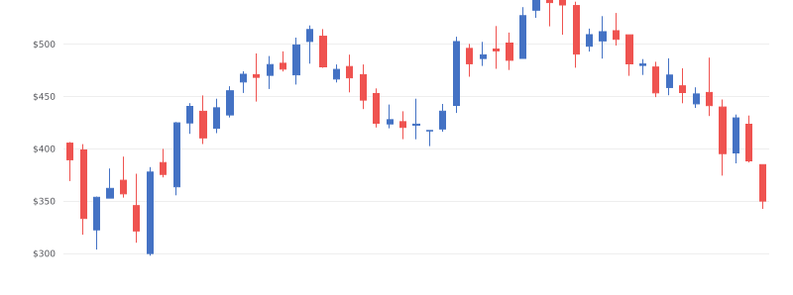
Public Company Profile
CrowdStrike — Company Profile (2/4)
Valuation & Capital Structure
Income Statement Summary ($M / $B)
Market Cap | $88.3B
Total Debt | $0.82B
Cash & Investments | $4.80B
Enterprise Value | $84.3B
 | FY2024A | FY2025A | FY2026E | FY2027E
Revenue | $3.06B | $3.95B | $4.80B | $5.86B
Gross Profit | $2.30B | $2.96B | $3.67B | $4.52B
Gross Margin | 75.3% | 74.9% | 76.5% | 77.2%
EBITDA | $294M | $295M | — | —
EBITDA Margin | 9.6% | 7.5% | — | —
Net Income | $89M | ($19M) | $924M | $1.27B
Net Margin | 2.9% | -0.5% | 19.2% | 21.7%
EPS (Diluted) | $0.37 | ($0.08) | $3.71 | $4.81
Metric | LTM | NTM
EV / Revenue | 21.3x | 17.5x
EV / EBITDA | NM | NM
P / E | NM | 94.4x
Shareholder Overview
Shareholder | Shares | Ownership
George Kurtz (CEO) | 15.2M | 6.0%
Vanguard Group | 22.1M | 8.8%
BlackRock | 18.4M | 7.3%
Total Institutional | ~222M | ~88%
Total Retail | ~30M | ~12%
Total | 252.1M | 100%
CRWD (NASDAQ) — 52-Week Stock Performance
Source: CrowdStrike IR, FMP. FY ends Jan 31. Estimates per analyst consensus. Market data as of Feb 24, 2026.
16

Slide 17



Public Company Profile
CrowdStrike — Company Profile (3/4)
Strategic Focus
Competitive Positioning
Platform Consolidation
Expand from endpoint into cloud, identity, and data — increasing modules per customer (avg 8+ now); $100B+ TAM
Microsoft Defender
Bundled with M365; CrowdStrike wins on detection efficacy, cross-platform support, and threat intelligence depth
Charlotte AI
Generative AI layer across Falcon — NL threat hunting, automated triage, case summaries; reduces analyst workload 40%+
SentinelOne
Closest pure-play EDR rival; CrowdStrike leads on ARR scale ($4.2B vs ~$800M), module breadth, and MDR services
Falcon Flex
Consumption-based licensing lets customers deploy any module — accelerates platform expansion and reduces churn risk
Palo Alto Networks
Broader platform including network; CrowdStrike leads on endpoint and AI-native architecture; competing on CNAPP
Federal / Gov't
FedRAMP High authorized; IL5 certification; significant DOGE/federal IT modernization opportunity
Elastic Security
Open-source SIEM competitor; CrowdStrike leads on managed detection, threat intel, and single-agent deployment
International Expansion
EMEA and APAC growing 30%+ YoY; investing in regional DCs and channel partners to reduce US revenue concentration
Trellix (McAfee/FireEye)
Legacy AV incumbent; CrowdStrike systematically displacing at enterprise with faster detection and lower TCO
Cloud & CNAPP
Falcon Cloud Security fastest-growing module; competing for CNAPP consolidation against Wiz, Palo Alto PRISMA
Source: CrowdStrike IR, press releases, Gartner, IDC. Market data as of Feb 24, 2026.
17

Slide 18
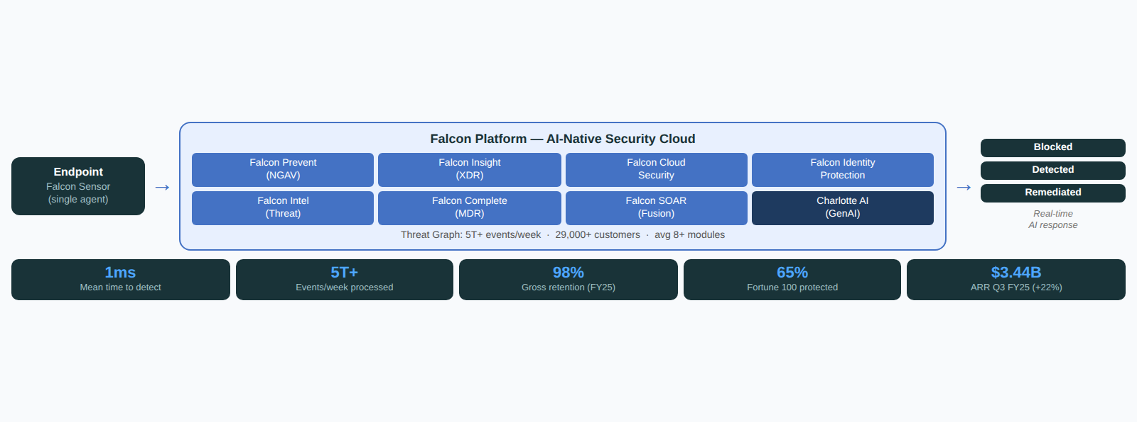
Public Company Profile
CrowdStrike — Falcon Platform Deep-Dive (4/4)
How the Falcon Platform Works
Core Product Modules
Falcon Prevent (NGAV) — AI/ML malware prevention; replaces legacy AV with no signature updates required
Falcon Insight XDR — EDR + cross-domain detection; unified visibility across endpoint, cloud, identity, and network
Falcon Cloud Security — CNAPP (CSPM + CIEM + CWPP); agentless and agent-based multi-cloud protection
Falcon Identity Protection — real-time AD/Entra ID monitoring; stops credential theft and lateral movement
Falcon Intelligence — adversary intelligence; 200+ tracked nation-state and eCrime groups; IOC enrichment
Falcon Complete MDR — fully managed 24/7 SOC; CrowdStrike analysts hunt, contain, and remediate on your behalf
Falcon Fusion SOAR — no-code workflow automation; integrates with 300+ third-party tools
Single Agent, Unlimited Modules
One Sensor
Lightweight Falcon sensor (~30MB) deployed once — activates any module cloud-side with no re-install or reboot
Customer Proof Points
Goldman Sachs
Replaced legacy AV across 40,000+ endpoints; threat detection time reduced from hours to seconds
Threat Graph
Proprietary graph database correlates 5T+ events/week across all customers — network effect improves detection for everyone
Hyatt Hotels
Consolidated 5 security tools into Falcon platform; 60% reduction in security operations overhead
AI / ML Engine
Behavioral AI detects unknown threats in real time; trained on decade of adversary data from Falcon Intelligence
KPMG
Deployed Falcon Complete MDR globally; zero breach incidents in 3 years post-deployment
Charlotte AI
GenAI analyst layer — NL threat hunting, guided investigations, automated case summaries; 40%+ analyst time saved
AWS
Falcon Cloud Security protects AWS workloads natively; joint go-to-market via AWS Marketplace
Source: CrowdStrike IR, product documentation, customer case studies.
18

Slide 19
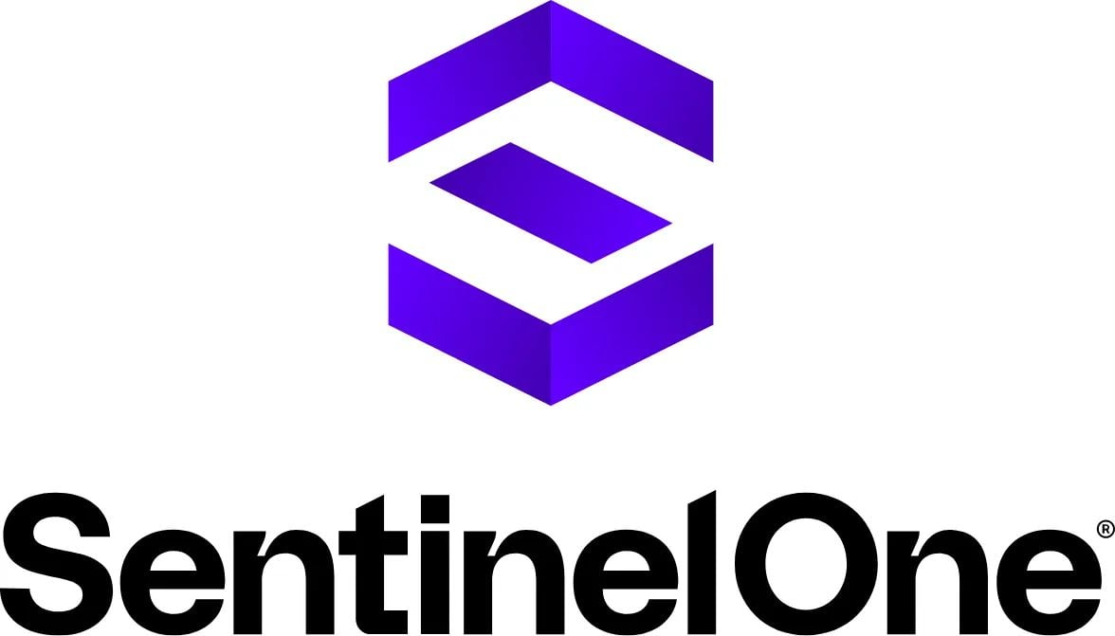
Public Company Profile
SentinelOne — Company Profile (1/4)
Company Overview
Management Team
SentinelOne (NYSE: S) is an AI-native cybersecurity platform founded in 2013 by Tomer Weingarten. The Singularity platform delivers autonomous endpoint, cloud, and identity protection powered by AI that detects and responds to threats at machine speed. SentinelOne serves 14,000+ customers including 350+ Global 2000 companies, with ~3,000 employees and $821M FY2025 revenue (+32% YoY).
Tomer Weingarten
CEO & Co-Founder — serial entrepreneur; ex-Serianu, Carmel Ventures; leads vision
David Bernhardt
CFO — joined 2020; ex-CFO Ping Identity, ex-VP Finance McAfee; oversees financial ops
Ric Smith
Chief Product & Technology Officer — leads Singularity platform engineering & AI research
Products & Services
Ken Marks
CRO — leads global sales & go-to-market; ex-CRO at Zscaler & Symantec
Singularity Endpoint — autonomous EPP+EDR; AI-powered prevention, detection, response, and remediation on a single agent
Singularity Cloud — CNAPP; agentless cloud workload protection, CSPM, CIEM, and container/K8s security
Singularity Identity — Active Directory and Entra ID protection; decoy-based deception and credential threat detection
Singularity Data Lake — unified AI-powered data ingestion, search, and correlation across all security telemetry
Purple AI — generative AI security analyst; NL threat hunting, automated investigations, guided remediation
Singularity RemoteOps — remote script execution and forensic collection for incident response at scale
Managed Detection & Response (MDR) — Vigilance MDR and Vigilance MDR Pro with SentinelOne analysts
Nicholas Warner
President, Security — oversees SOC, threat intelligence, and Vigilance MDR services globally
Board of Directors
Tomer Weingarten
CEO & Co-Founder — executive board member
Art Gilliland
Independent Director — ex-CEO Symantec Enterprise; chairs audit committee
Teddy Troutman
Independent Director — Partner, Tiger Global Management; investment committee
Charlene T. Begley
Independent Director — ex-SVP GE; chairs compensation committee
Mark Anderson
Independent Director — ex-President Palo Alto Networks; strategic advisory
Source: SentinelOne IR, SEC filings, proxy statement. Market data as of Feb 24, 2026.
19

Slide 20
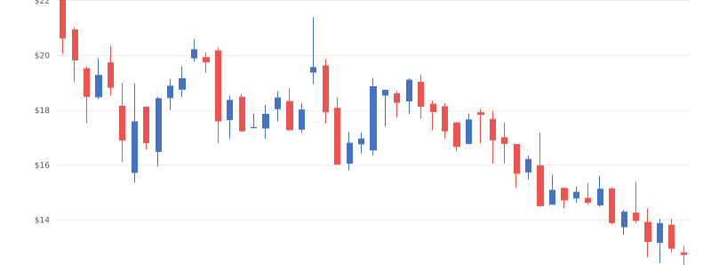
Public Company Profile
SentinelOne — Company Profile (2/4)
Valuation & Capital Structure
Income Statement Summary ($M / $B)
Market Cap | $4.25B
Total Debt | $0.01B
Cash & Investments | $0.65B
Enterprise Value | $3.61B
 | FY2024A | FY2025A | FY2026E | FY2027E
Revenue | $621M | $821M | $1.00B | $1.20B
Gross Profit | $443M | $610M | $765M | $925M
Gross Margin | 71.3% | 74.3% | 76.5% | 77.1%
EBITDA | ($293M) | ($239M) | — | —
EBITDA Margin | -47.2% | -29.1% | — | —
Net Income | ($339M) | ($288M) | $66M | $101M
Net Margin | -54.6% | -35.1% | 6.6% | 8.4%
EPS (Diluted) | ($1.15) | ($0.92) | $0.19 | $0.30
Metric | LTM | NTM
EV / Revenue | 4.4x | 3.6x
EV / EBITDA | NM | NM
P / E | NM | NM
Shareholder Overview
Shareholder | Shares | Ownership
Tomer Weingarten (CEO) | 14.8M | 4.4%
Tiger Global Mgmt | 28.2M | 8.5%
Vanguard Group | 22.6M | 6.8%
Total Institutional | ~271M | ~81%
Total Retail | ~62M | ~19%
Total | 333.3M | 100%
S (NYSE) — 52-Week Stock Performance
Source: SentinelOne IR, FMP. FY ends Jan 31. Estimates per analyst consensus. Market data as of Feb 24, 2026.
20

Slide 21

Public Company Profile
SentinelOne — Company Profile (3/4)
Strategic Focus
Competitive Positioning
Purple AI
Generative AI security analyst embedded across Singularity — NL threat hunting, guided triage, and automated remediation; fastest-growing module
CrowdStrike
Largest pure-play EDR rival; SentinelOne differentiates on autonomous AI response, lower TCO, and no per-module pricing
Data Lake Expansion
Singularity Data Lake positioned as SIEM replacement — ingest any telemetry, AI-powered correlation; targeting $8B SIEM market
Microsoft Defender
Bundled with M365; SentinelOne wins on cross-platform depth, Linux/cloud coverage, and non-Microsoft ecosystem accounts
Cloud Security
CNAPP fastest-growing segment; agentless + agent coverage across AWS, Azure, GCP; competing directly with Wiz and Palo Alto PRISMA
Palo Alto Networks
Broader platform; SentinelOne competes on endpoint and CNAPP with simpler agent deployment and superior Linux/container coverage
Platform Consolidation
Expand from EPP/EDR into identity, cloud, and data — increasing ARR per customer; NRR >115% target
Trellix (McAfee/FireEye)
Legacy incumbent; SentinelOne systematically displacing on endpoint with autonomous response and lower operational overhead
Profitability Path
Non-GAAP operating margin improving YoY; targeting FCF breakeven by FY2026E; S&M efficiency improving as mid-market motion matures
Cybereason
Smaller XDR rival; SentinelOne leads on platform breadth, cloud native architecture, and partner ecosystem scale
Channel & MSSP
60%+ of new ARR through channel partners; MSSP/MDR model scaling; Lenovo OEM partnership expanding endpoint reach globally
Source: SentinelOne IR, press releases, Gartner, IDC. Market data as of Feb 24, 2026.
21

Slide 22
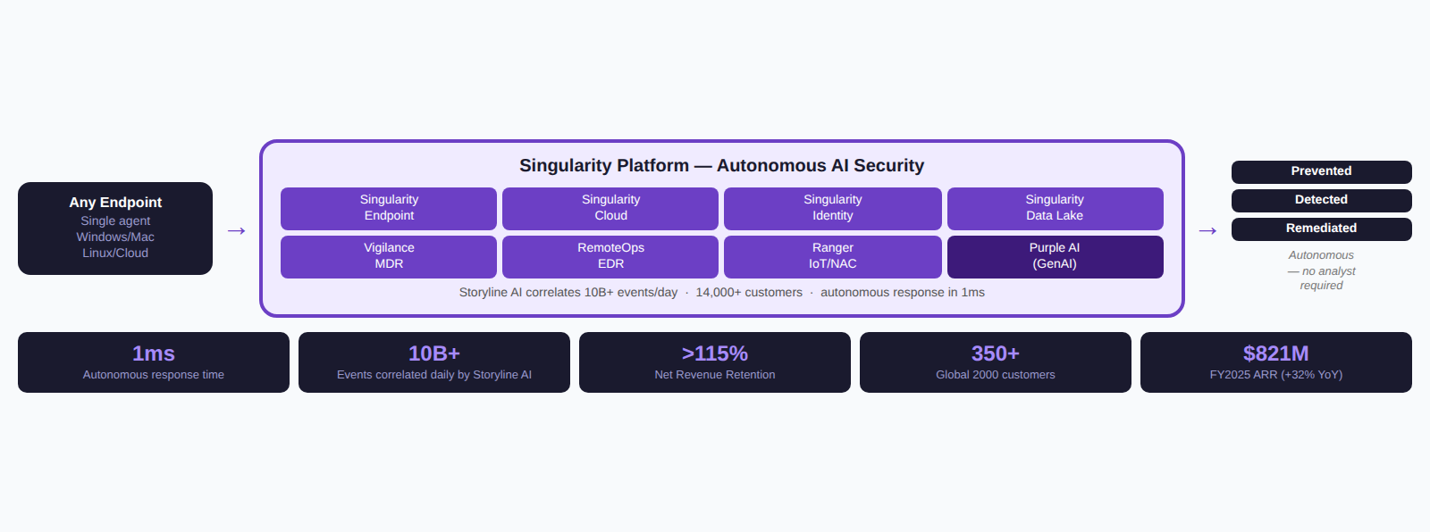
Public Company Profile
SentinelOne — Singularity Deep-Dive (4/4)
How the Singularity Platform Works
Core Platform Modules
Singularity Endpoint — autonomous EPP+EDR+XDR; AI prevention and 1-click rollback on Windows, Mac, Linux, and VDI
Singularity Cloud — agentless CNAPP; CSPM, CIEM, CWPP, and container security across AWS, Azure, GCP
Singularity Identity — AD and Entra ID threat detection; deception-based honeypots stop credential-based lateral movement
Singularity Data Lake — AI-native SIEM alternative; ingest, correlate, and query petabyte-scale security data
Purple AI — GenAI analyst layer; NL queries, automated investigations, alert summaries, and guided remediation steps
Vigilance MDR — 24/7 managed detection & response; SentinelOne analysts triage, investigate, and contain on your behalf
Ranger — passive network discovery and IoT/NAC visibility with no additional agents or infrastructure
The Autonomous Security Difference
Storyline AI
Patented context engine automatically correlates all events into attack stories — no analyst needed to connect the dots
Customer Proof Points
Autodesk
Replaced legacy AV across 14K endpoints; cut threat detection from days to seconds
1-Click Remediation
AI rolls back all malicious changes system-wide with a single click — including registry, files, and processes
Pandora
Consolidated 4 security tools into Singularity; 80% reduction in alert triage time using Purple AI
Purple AI
Natural language threat hunting and investigation — analysts ask questions in plain English; AI generates queries and summaries
Norwegian Air
Deployed Singularity Endpoint across 10,000+ devices globally; zero breach incidents post-deployment
True Multi-Tenant
Single codebase serves SMB through Fortune 10; no separate SKUs or code branches for enterprise vs. commercial
Hitachi
Singularity Cloud protecting 50,000+ cloud workloads across hybrid infrastructure; CSPM compliance automated
Source: SentinelOne product documentation, IR presentations, customer case studies.
22

Slide 23
COMPETITIVE DYNAMICS
Platform Wars: 3 Cybersecurity Trends
Three deals and one catastrophic failure have fundamentally redrawn the competitive map — creating both winners and structural gaps that specialist vendors are uniquely positioned to fill
Google / Mandiant / Wiz
Palo Alto Networks Platformization
CrowdStrike Outage (Jul 2024)
$5.4B + $32B = Google Cloud Security
25+ acquisitions, $25B+ deployed
8.5M machines, $5.4B insured loss
Mandiant (2022, $5.4B): threat intel + IR
Wiz (2025, $32B): CNAPP leader, 45% F100
Google now has end-to-end cloud security
Gap: No EDR/identity/email vs MSFT/CRWD
Free bundles to displace point solutions
Billings growth slowed 22% to 7% on discounts
Prisma/Cortex: broad but shallow coverage
Gap: Customers choose simplicity over efficacy
Kernel update caused global BSOD in critical sectors
8.5M failures exposed monoculture risk
CSRB cited poor testing/QA processes
Enterprises evaluating secondary EDR options
Strategic Position by Vendor
Vendor | Strategic Bet | Strength | Gap / Vulnerability
Microsoft | E5 bundle dominance | Ubiquity, Entra identity, Defender suite | Known leader; CSRB reputational damage
CrowdStrike | AI-native EDR platform | Falcon efficacy, threat intel, Charlotte AI | Outage trust deficit; kernel risk
Palo Alto Ntwks | Platformization via M&A | Network + cloud breadth, Cortex XSIAM | Margin pressure; shallow vs. specialists
Google / Chronicle | Cloud-native + Wiz CNAPP | Wiz posture, Mandiant IR, GCP integration | No endpoint; limited identity play
SentinelOne | AI-driven autonomous response | Purple AI, hyperscale data ingest | Subscale vs. CRWD; limited non-EDR
Cisco | Network-anchored XDR | Hypershield, network telemetry depth | Cloud-native credibility gap
Source: Company filings, CSRB reports, press releases
23

Slide 24
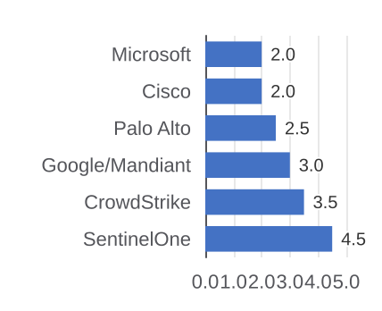
AI LANDSCAPE
Vendor AI: What's Shipping vs. What's Marketed
Every major vendor claims 'AI-native' — the operational reality is far more uneven, and the gaps define where specialists capture durable share
Vendor | AI Product (GA Year) | What It Actually Does | Competitive Reality
Microsoft | Security Copilot (2024) | Incident summaries, KQL generation, alert explanation across Defender + Sentinel | Widest M365 distribution; limited autonomous action; quality tied to data
CrowdStrike | Charlotte AI (2023) | NL threat hunting, case summaries, analyst Q&A on Falcon telemetry | 25T+ weekly events; no autonomous remediation yet; best-in-class threat context
Palo Alto Ntwks | Copilot XSIAM (2023) | SOC automation, alert triage, playbook generation in Cortex XSIAM | Compelling in XSIAM; limited to PANW data; platformization limits openness
SentinelOne | Purple AI (2023) | Autonomous threat hunting, one-click remediation, cross-platform NL queries | Only GA vendor with autonomous remediation; strongest open-data (Singularity DL)
Google / Mandiant | Threat Intel + SecLM (2024) | AI threat reports, malware reverse engineering (MAGIKA), Gemini-in-Security | Mandiant IR + Gemini LLM differentiated; still unifying product post-Wiz
AI Autonomy by Vendor
Key Differentiators
Only SentinelOne ships autonomous remediation GA
Open data lakes vs. closed ecosystems define extensibility
Microsoft wins on reach; CrowdStrike on depth; specialists on action
Cisco: Hypershield is novel but AI layer remains early-stage
Source: Company announcements and product documentation, 2023-2025
24

Slide 25
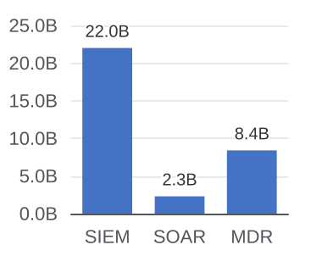
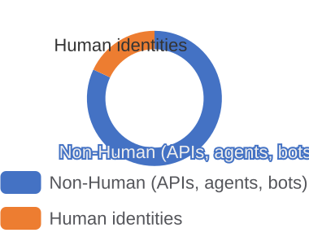
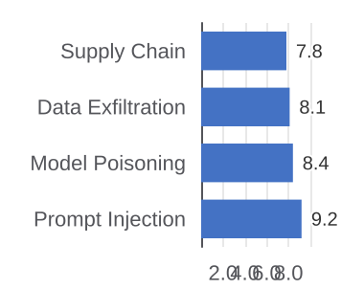
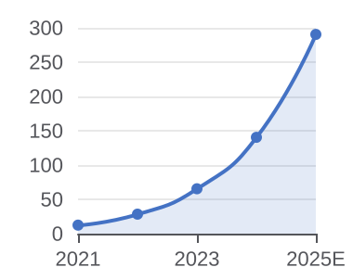
AI LANDSCAPE
4 AI Blue Oceans Incumbents Can't Capture
Platform vendors bolt AI onto products. Four structural gaps exist where AI-native specialists build defensible, durable positions
Autonomous SOC
Non-Human Identity
AI Attack Surface
AI Threat Intel
$24B TAM (SIEM + SOAR + MDR)
45:1 — AI agents vs. human IDs
No LLM attack class tools exist
100x scale vs. human analyst teams
Incumbents sell AI as analyst assistant, not replacement
Dropzone AI, Torq, Intezer: Tier-1 triage with zero humans
Platforms can't cannibalize own SIEM/SOAR revenue streams
Logical acqui-hire for any of the 6 major platform vendors
AI agents and API keys outnumber humans 45:1 in enterprises
CyberArk and Okta built for human IAM — no NHI governance
Astrix, Entro, Clutch: purpose-built for machine credentials
Adjacent to $20B+ PAM/IAM market — no incumbent owner
LLM prompt injection, model poisoning unaddressed today
Enterprises with AI copilots lack DLP for model interactions
HiddenLayer, Protect AI, CalypsoAI: purpose-built AI/ML
OWASP LLM Top 10 formalizing taxonomy — regulation imminent
Mandiant/Recorded Future need large teams; AI scales 100x
Attribution, campaign correlation, IOC gen are automatable
Flare, Flashpoint, Cyberint: LLMs for OSINT and dark web
CISA/NSA sharing mandates create compliance demand floor
Source: Gartner, OWASP, IDC, CISA/NSA advisories, and company disclosures, 2024-2025
25

Slide 26
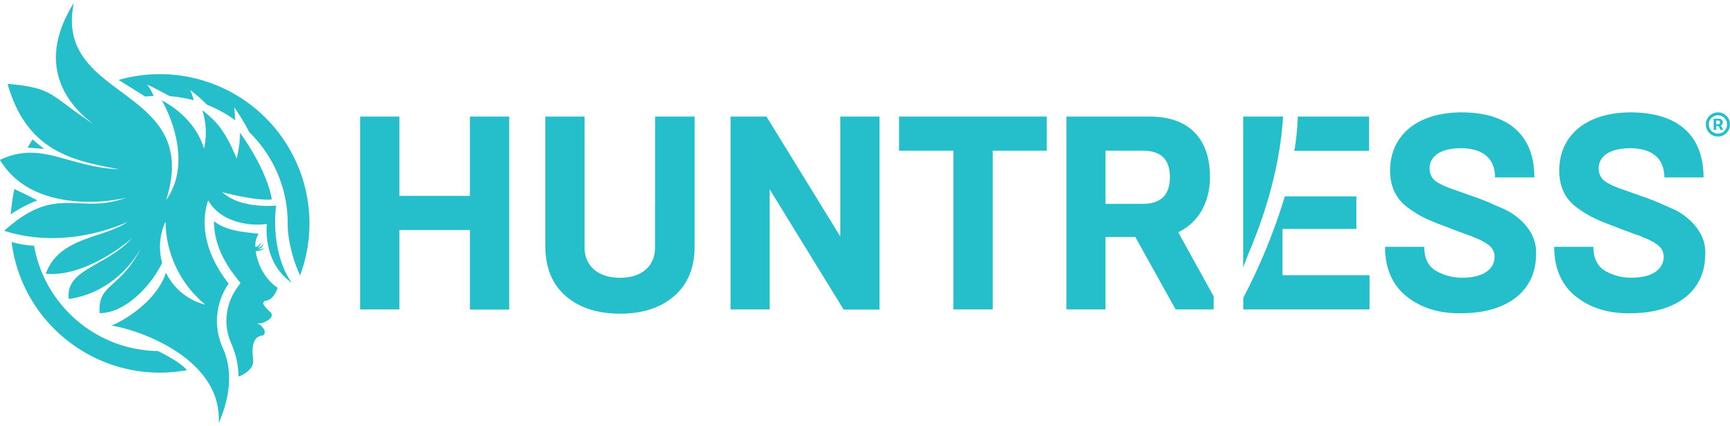
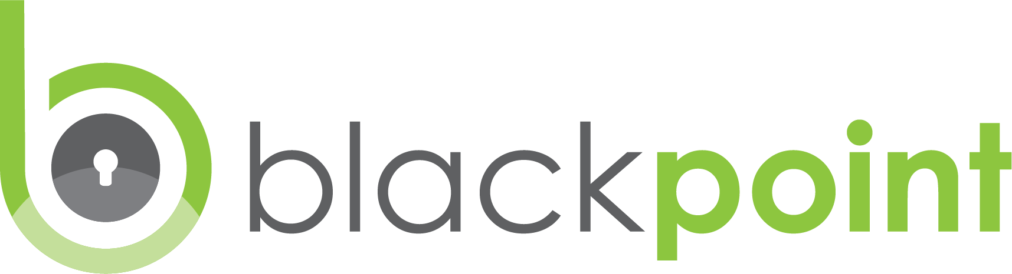
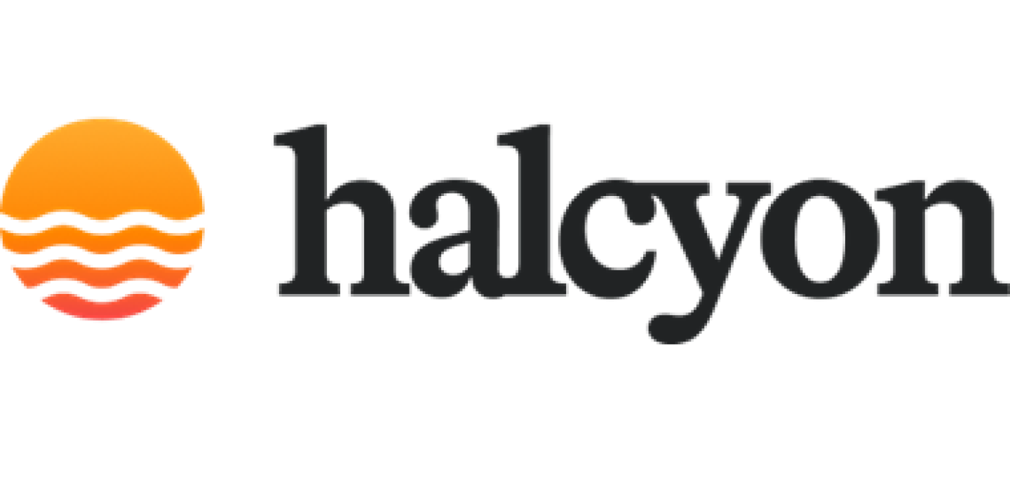

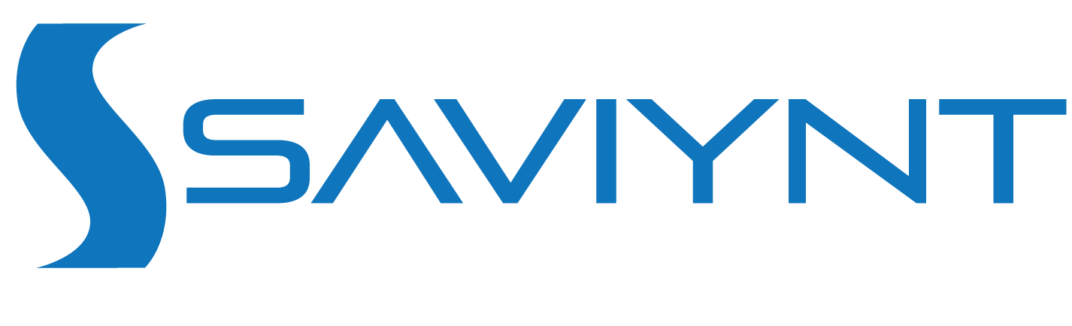


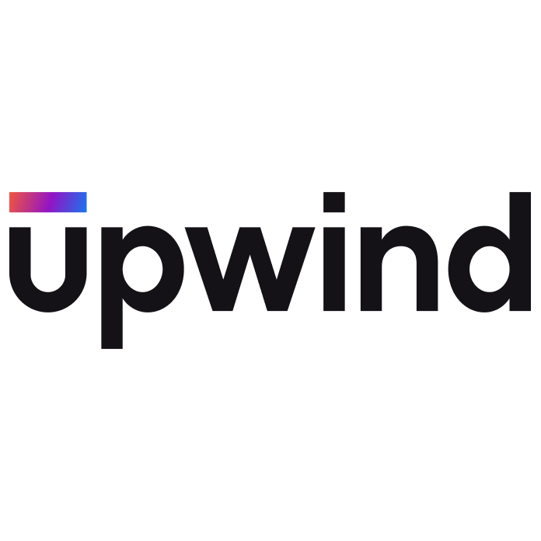



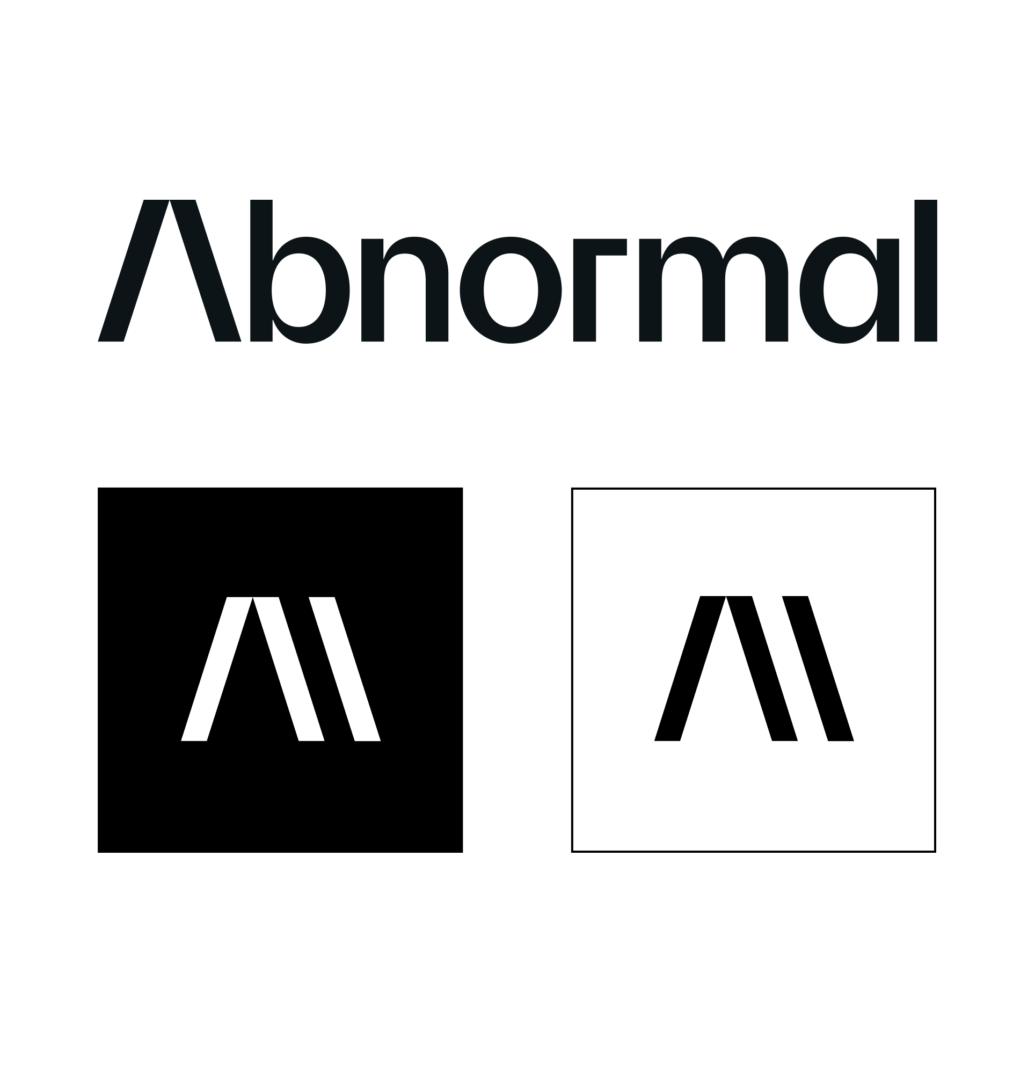

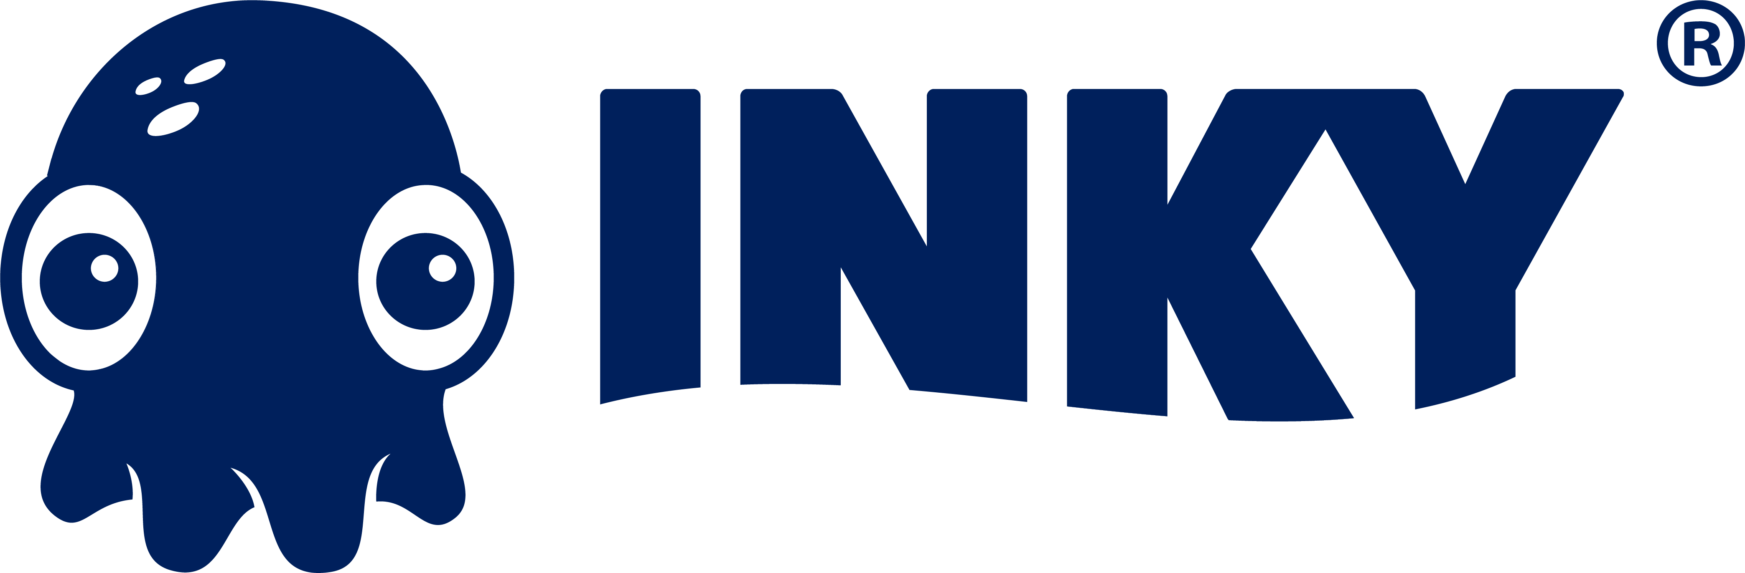
MARKET LANDSCAPE
Cybersecurity Startup Landscape
EDR / XDR
$210M raised
$300M raised
$190M raised
Series C, $150M, Apr 2024
Series C, $190M, Aug 2023
Series B, $100M, Sep 2024
Managed EDR/MDR for SMBs and MSPs; founded by ex-NSA operators; Deloitte Fast 500.
AI-powered MDR with 24/7 SOC services delivered through MSP channel; Vista-backed.
Anti-ransomware platform combining EDR with automated resilience and recovery.
Identity & PAM
$230M raised
$320M raised
$33M raised
Series D, $110M, 2023
Series C, $205M, 2023
Series A, $25M, Feb 2026
Identity threat protection using recaptured criminal underground data to prevent ATO.
Cloud-native IGA and PAM platform managing 100M+ identities for enterprise customers.
Agentless just-in-time PAM across cloud, on-prem, and SaaS; IVP and Index-backed.
Cloud / CNAPP
$1.9B raised
$430M raised
$620M raised
Series E, $1B, May 2024
Series B, $250M, Jan 2026
Series D, $150M, Oct 2022
Agentless CNAPP covering CSPM, CIEM, and CWPP; $500M+ ARR; rejected $23B Google offer.
Runtime-native CNAPP for real-time cloud and AI workload security; $1.5B valuation.
Agentless CNAPP using SideScanning for full cloud estate visibility; $100M+ ARR.
Network / SASE
$1B+ raised
$1.47B raised
$155M raised
Series G, $359M, Jun 2025
Series H, $401M, 2023
Series D, $75M, 2023
Converged SASE platform integrating SD-WAN, SSE, and XDR; 3,500+ customers; $4.8B val.
Cloud-native SSE/SASE with inline DLP, CASB, and ZTNA; ~$200M ARR range.
Multi-vector cyber platform for mid-market combining network, email, and endpoint.
Email Security
$546M raised
$60M raised
$40M raised
Series D, $250M, Jun 2024
Series B, $60M, Jun 2024
Series B, ~$20M
AI-native behavioral email security; 3,000+ customers including 25% of Fortune 500.
Open-architecture email security letting teams write and deploy custom detection rules.
AI email security using computer vision and NLP for real-time phishing detection.
Sources: Crunchbase, PitchBook, company press releases, SecurityWeek, TechCrunch. Funding figures reflect total disclosed capital as of Feb 2026. Private companies only.
26

Slide 27





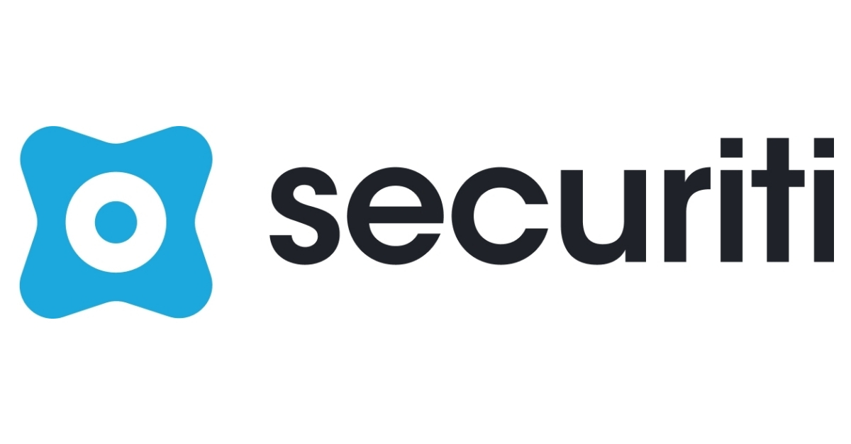









MARKET LANDSCAPE
Cybersecurity Startup Landscape Overview
SecOps / SIEM / SOAR
$185M raised
$110M raised
$142M raised
Series B, $120M, Feb 2026
Series B, $70M, 2023
Series C, $70M, 2024
AI-native SecOps platform running threat detection in-place across cloud and data lakes.
ACQUIRED
N-able (NYSE: NABL) · Oct 2023
No-code AI security automation platform for hyperautomating SOC incident response.
SIEM, vulnerability management, and MDR platform focused on mid-market enterprises.
Data Security / DSPM
$1B+ raised
$405M raised
$220M raised
Strat. Round, $400M, Jan 2026
Series E, $70M, 2023
Series C, $75M, 2022
AI-native DSPM and DLP across cloud, SaaS, and on-prem; $6B valuation; Frank Slootman-backed.
Data intelligence platform automating discovery, classification, and privacy compliance.
Unified data controls combining security, privacy, governance, and compliance automation.
OT / IoT Security
$900M raised
$440M raised
$250M raised
Series F, $150M, Jan 2026
Series D, $200M, 2022
Series E, $100M, 2022
Cyber-physical systems security covering OT, IoT, and IIoT; ~$3B valuation; IPO eyed 2027.
OT/ICS detection, threat intel, and IR; $100M+ ARR; leading ICS threat research publisher.
OT and IoT security with real-time visibility for critical infrastructure; 8,000+ deployments.
Vulnerability Mgmt
$53M raised
$45M raised
$115M raised
Series A, $42M, Feb 2026
Series B, $25M, Feb 2026
Series C, $75M, 2023
Agentic AI automating vuln investigation, prioritization, and remediation end-to-end; Bain-backed.
Vulnerability intelligence tracking CVE exploitation lifecycle and weaponized payloads.
Internet intelligence and ASM platform continuously mapping global internet exposure.
Security Awareness
$60M raised
$40M raised
$35M raised
Growth equity, 2022
Series B, $40M, 2023
Series B, ~$28M, 2022
Short-form animated security awareness training with episodic phishing simulations; PSG-backed.
Adaptive spear-phishing simulation using gamification to drive measurable behavior change.
Behavioral science-based platform measuring and reducing human cyber risk; Oxford Capital-backed.
Sources: Crunchbase, PitchBook, company press releases, SecurityWeek, TechCrunch. Funding figures reflect total disclosed capital as of Feb 2026. ACQUIRED badge denotes completed M&A exit.
27

Slide 28

Private Company Profile
Adlumin — Company Profile (1/2)
Company Overview
Leadership
Adlumin was founded in 2016 by Robert Johnston, former Marine intelligence officer and NSA contractor. The company built a cloud-native XDR/MDR platform for mid-market and regulated industries lacking enterprise security. The platform combines SIEM, SOAR, UEBA, and MDR with compliance reporting. Adlumin served 700+ customers and ~400 MSSP partners before N-able acquired it in Aug 2024 for ~$266M.
Robert Johnston
Founder & CEO — former USMC intel officer & NSA contractor; led FBI cyber advisory post-DNC breach; built Adlumin 0 to $266M exit
Kevin O'Brien
Chief Revenue Officer — previously VP Sales at Optiv and IBM Security; scaled Adlumin's MSSP channel to 400+ partners
Sherri Davidoff
Chief Strategy Officer — cybersecurity author and forensic investigator; heads threat intelligence and compliance strategy
Products & Services
XDR Platform — unified telemetry ingestion, AI-powered detection, and automated response across endpoints, network, cloud, and identity
MDR Service — 24/7 managed detection and response; Adlumin SOC analysts triage, investigate, and contain on customer behalf
ITDR (Identity Threat Detection & Response) — detects credential-based attacks, lateral movement, and Active Directory abuse
SIEM — cloud-native log management and correlation; pre-built compliance reports for FFIEC, HIPAA, CMMC, PCI-DSS, and SOC 2
SOAR — automated playbook execution for alert triage, threat containment, and incident response workflows
UEBA — user and entity behavior analytics; baseline deviation detection for insider threats and compromised accounts
Darknet Exposure Monitoring — continuous scanning of dark web for credential leaks tied to customer domains
Total Ransomware Defense — add-on combining honeypots, deception technology, and automated isolation to stop ransomware spread
Funding & Investors
Series B (2023)
$45M led by Ten Eleven Ventures — brought total funding to ~$70M; used to expand MDR team and MSSP partner program
Series A (2021)
$25M led by Ten Eleven Ventures with participation from Osage Venture Partners; accelerated product development
Acquisition (2024)
N-able (NYSE: NABL) acquired Adlumin for ~$266M in August 2024; integrated as N-able Adlumin Security Operations within the N-able Ecoverse platform
Key Investors
Ten Eleven Ventures (lead), Osage Venture Partners, SYN Ventures — all cybersecurity-specialist funds
Source: Adlumin IR, N-able press releases, SEC filings, Crunchbase. Acquired by N-able August 2024 for ~$266M.
28

Slide 29

Private Company Profile
Adlumin — Company Profile (2/2)
Strategic Focus
Competitive Positioning
Mid-Market MDR
Purpose-built for organizations with 250–5,000 employees that need enterprise SOC capabilities without enterprise headcount or budget
Huntress
SMB-focused MDR; Adlumin differentiates on deeper compliance reporting and larger mid-market enterprise coverage
Compliance-First
Pre-built reports for FFIEC, HIPAA, CMMC, PCI-DSS, GLBA, and SOC 2 — a major wedge into regulated financial services and healthcare buyers
Arctic Wolf
Broader MDR player; Adlumin wins on MSSP white-label flexibility and built-in regulatory compliance automation
MSSP Channel
400+ MSSP partners resell and co-deliver Adlumin MDR; white-label capability lets partners offer branded SOC services
Secureworks
Legacy enterprise MDR; Adlumin competes with simpler onboarding, lower price point, and native MSSP channel model
Customer Proof Points
N-able Integration
Post-acquisition, Adlumin is cross-sold to N-able's 25,000+ MSP customer base globally — dramatically expanding addressable reach
Community Bank
Mid-Atlantic community bank replaced legacy SIEM with Adlumin; achieved FFIEC exam-ready compliance reporting in 60 days
AI Detection
Machine learning models trained on regulated-industry threat patterns; UEBA detects insider threats and account compromise with low false-positive rates
Healthcare System
Regional health system deployed Adlumin MDR across 3,000 endpoints; stopped active ransomware campaign within 12 minutes of detection
Deception Tech
Honeypots and decoy credentials deployed automatically across customer networks; high-fidelity ransomware and lateral movement detection
Federal Contractor
DoD contractor used Adlumin SIEM to achieve CMMC Level 2 certification; compliance audit completed in 30% less time vs. prior vendor
Source: Adlumin product documentation, N-able IR, press releases, G2 reviews, customer case studies.
29

Slide 30
Private Company Profile
Coro — Company Profile (1/2)
Company Overview
Leadership
Coro (founded 2014, Tel Aviv) delivers all-in-one cybersecurity for mid-market (100–2,500 employees) and MSPs. Platform consolidates endpoint, email, network, cloud & data protection in single agent/console with minimal IT overhead. $255M+ funding (Series D: $100M, Oct 2023), 4,000+ customers across 10,000+ MSP environments. CEO Joe Sykora joined 2024 for global scale via channel-first strategy.
Joe Sykora
CEO — joined 2024; 20+ yrs global channel sales; scaled $1B+ revenues in cybersecurity & IT
Guy Moskowitz
Co-Founder & President — 20+ yrs at Amdocs, Ness, Mitrelli, IXI Mobile; leads biz dev
Dror Liwer
Co-Founder — former IDF CIO; 25+ yrs tech/security; leads product vision & tech
Products & Services
Eyal Hen
CFO — Jan 2026; leads finance for ANZ & global expansion; ex-CFO at high-growth SaaS
Endpoint Protection — AI-powered EPP+EDR; log all endpoint activity, detect anomalies, and automate remediation across Windows, Mac, and Linux
Email Protection — scan inbound/outbound email for phishing, malware, and BEC; automated quarantine and remediation reducing manual triage
Network Protection — Zero Trust Network Access (ZTNA), VPN replacement, and military-grade encryption for distributed workforces
Cloud App Security — protect Microsoft 365, Google Workspace, Salesforce, Slack, and Box; detect account takeover and data exfiltration
Data Protection — prevent data leaks, unauthorized sharing, and policy violations across endpoints and cloud apps with DLP controls
Security Awareness Training — phishing simulations and micro-learning modules; track user risk scores and automate remediation workflows
Managed Services — Coro SOC overlay for MSPs needing co-managed MDR without building in-house analyst capacity
Funding & Investors
Series D (Oct 2023)
$100M led by Energy Impact Partners and One Peak Partners; used to accelerate MSP channel, EMEA expansion, and product R&D
Series C (2022)
$75M led by Energy Impact Partners; brought total to ~$155M; expanded US go-to-market and MSP partner program
Total Raised
$255M+ across Seed through Series D; investors include Energy Impact Partners, One Peak Partners, and JVP (Jerusalem Venture Partners)
Source: Coro IR, press releases, Crunchbase, G2 reviews. Funding data as of Feb 2026.
30

Slide 31


Private Company Profile
Coro — Company Profile (2/2)
Strategic Focus
Competitive Positioning
SMB/Mid-Market
Targets 100–2,500 seat organizations priced out of enterprise platforms; single-agent, single-console replaces 5–7 point tools at a fraction of cost
Guardz
MSP-focused SMB security; Coro differentiates on platform depth (ZTNA, DLP, SAT) and larger mid-market customer coverage
Channel-Only GTM
100% channel: MSPs, resellers, distributors, TSDs — Coro Compass partner program provides margin-rich recurring revenue model for partners
Huntress
EDR+MDR focused; Coro offers broader platform (email, network, cloud) at similar price for MSPs wanting single-vendor ease
AI Automation
AI engine auto-remediates 95%+ of threats without human intervention — eliminates 2AM alert calls and false positive fatigue for lean IT teams
Webroot / OpenText
Legacy SMB AV/endpoint; Coro wins on modern AI architecture, broader module set, and native MSP multi-tenant management
Customer Proof Points
EMEA Expansion
Appointed VP/GM EMEA (Nov 2025) and CFO ANZ (Jan 2026); aggressively expanding into UK, Australia, and continental Europe via channel
Law Firm (250 seats)
Replaced 6 point-product tools with Coro; IT team reduced security management time by 70%; achieved SOC 2 Type II with built-in compliance mapping
Platform v3.7
Dec 2025 release: redesigned Actionboard with AI-powered insights, improved MSP multi-tenant visibility, and expanded automation playbooks
Manufacturing Co.
Mid-size manufacturer deployed Coro across 800 endpoints and 5 cloud apps; blocked business email compromise attempt saving $320K
Compliance Suite
Built-in compliance survey and mapping tool; helps SMBs understand regulatory impact and demonstrate adherence to HIPAA, GDPR, SOC 2, and PCI-DSS
School District
K-12 district with 1,200 devices deployed Coro with 1 IT admin; zero ransomware incidents in 18 months post-deployment; CIPA-compliant
Source: Coro product documentation, press releases, G2 reviews, customer case studies. Feb 2026.
31

Slide 32


STARTUP PROFILES
Torq — Company Profile (1/2)
Company Overview
Fundraising
Torq was founded in 2020 in Denver, CO by Ofer Smadari, Leonid Belkind, and Eldad Livni. The platform automates security operations workflows across cloud and hybrid environments. Torq reached unicorn status in January 2026 at a $1.2B valuation following its $140M Series D led by Merlin Ventures.
Date
Round
Lead Investor(s)
Amount
2021
Series A
Insight, GGV Capital
$50M
Jan 2024
Series B+
Notable, Insight
$42M
Sep 2024
Series C
Insight, Notable
$70M
Products & Services
Jan 2026
Series D
Merlin, Insight
$140M
Torq Hyperautomation™
Management Team
No-code/low-code SOC workflow automation; 600+ integrations with SIEM, EDR, cloud, and identity tools
Ofer Smadari
CEO & Co-Founder — ex-Check Point
Leonid Belkind
CTO & Co-Founder — ex-Check Point, Tufin
Torq HyperSOC™
Eldad Livni
CINO & Co-Founder — ex-CyberArk
AI-native SOC with multi-agent system; Socrates AI Analyst closes 90% of Tier-1 tickets autonomously
Josh Morris
CRO — ex-Splunk SVP Sales (2024)
AI Agents & Case Mgmt
Don Jeter
CMO — ex-Pax8
Collaborative multi-agent framework for end-to-end threat investigation, triage, and remediation
Yaron Bartov
Chief Financial Officer
Sources: torq.io, Reuters, Bloomberg, Forbes, CRN. $332M total raised; Series D closed Jan 2026 at $1.2B valuation.
32

Slide 33


STARTUP PROFILES
Torq — Company Profile (2/2)
Recent Announcements
Strategic Focus
Jan 2026
$140M Series D at $1.2B valuation; Merlin Ventures led
Auton. SOC
Own the auton. SOC category; HyperSOC replaces SOAR
Feb 2026
Hired John White (ex-Virgin Atlantic CISO) for AI GTM
Federal
Expand U.S. federal via Carahsoft distribution
Apr 2025
Acquired Revrod; added multi-agent RAG to HyperSOC-2o
AMP Alliance
Ecosystem: Wiz, Zscaler, Google, Armis partners
Apr 2025
Won RSAC 2025 Best Emerging Technology award
EMEA
EMEA HQ 2025; Infinigate as European channel
Jan 2025
300% revenue & 200% employee growth in 2024; EMEA HQ open
Competitive Positioning
Board Members
Palo Alto XSOAR
Legacy SOAR: rule-based & high maintenance. Torq: AI-native architecture
Ofer Smadari
CEO & Co-Founder, Torq
Splunk SOAR
Playbook-centric; Torq leads on AI autonomy and 300% faster execution
Dan Cahana
Partner, Notable Capital — lead Series B/C investor
Tines
No-code automation; Torq differentiates on multi-agent AI at Fortune 500 scale
Thomas Krane
Managing Director, Insight Partners
Aner Izraeli
CISO, Torq — board observer
Swimlane
Targets OT/Gov; Torq leads on commercial enterprise and AI SOC
Sources: torq.io/news, Forbes, CRN, SecurityWeek, SC Media, Reuters. As of Feb 2026.
33

Slide 34




STARTUP PROFILES
Censys — Company Profile (1/2)
Company Overview
Fundraising
Censys was founded in 2017 in Ann Arbor, MI by Zakir Durumeric, ZMap inventor. The platform provides internet intelligence for attack surface management and threat hunting. Censys raised $115M total, including $75M Series C in 2023 led by GV and Decibel. Serves 50,000+ organizations including U.S. federal agencies.
Date
Round
Lead Investor(s)
Amount
2017
Seed
GV (Google Ventures)
$5M
2019
Series A
GV, Decibel, Intel
$15.5M
2021
Series B
GV, Decibel, Sequoia
$35M
Products & Services
2023
Series C
GV, Decibel, Ten El.
$75M
Censys Search
Management Team
Internet-wide search engine for hosts, certificates, and services; 350K+ community users
Zakir Durumeric
CEO & Founder — Stanford prof., ZMap inventor
Attack Surface Mgmt
Sarah Ashburn
CRO — ex-Attivo Networks SVP Sales
Continuous external exposure discovery, cloud asset context, and risk prioritization
Anil Gupta
CTO — ex-VMware, Sumo Logic
ICS/OT Intelligence
Jilbert Washten
CFO — ex-Attivo Networks, 1Kosmos
26 protocols, 68 vendors, HMI fingerprinting for critical infrastructure defense (Oct 2025)
Jasmine Burns
CPO — ex-Duo Security
Sources: censys.com, leadership page, PitchBook, GV portfolio. $115M total raised; Series C closed 2023.
34

Slide 35



STARTUP PROFILES
Censys — Company Profile (2/2)
Recent Announcements
Strategic Focus
Oct 2025
ICS/OT intelligence: 26 protocols, 68 vendors, HMI data
Gov't / CISA
Critical infra & federal via EPA, CISA partnerships
2025
Censys Platform: unified ASM, threat hunting, and Search
CensAI
AI-assisted hunting and exposure prioritization
2025
CensAI™ AI assistant reached general availability
ASM Platform
Platform play alongside Wiz, CrowdStrike, Tenable
2025
Named top new integration in Wiz Integration Network
International
APAC & Europe go-to-market now active with U.S.
2024
Expanded to Nordics, France, Australia, Singapore, Japan
Competitive Positioning
Board Members
Shodan
Original internet scanner; Censys leads on scan freshness and enterprise support
Zakir Durumeric
CEO & Founder — board member
Tenable ASM
Traditional vuln mgmt player; Censys wins on internet-scale external ASM
Karim Faris
General Partner, GV (Google Ventures)
Dug Song
Founder, Duo Security (sold to Cisco $2.35B)
Cortex Xpanse
Palo Alto's ASM module; Censys wins on data quality and research credibility
Jon Sakoda
Founder & Managing Partner, Decibel
Microsoft EASM
Bundled with Azure; Censys wins on depth, multi-cloud, and government trust
Andrew Boyd
Former Director, CIA Cyber Intelligence
Sources: censys.com, press releases, GV portfolio, leadership page. As of Feb 2026.
35

Slide 36


























Select Active Cybersecurity Investors
Investor
Cybersecurity
Investments
Select Cybersecurity Investment Targets & Descriptions
50+
Cloud security platform detecting risks across cloud environments.
Agentless device visibility and security for enterprise OT/IoT assets.
AI-powered threat intelligence platform for enterprise security teams.
Jan-20
Jan-20
Mar-19
40+
Email security and human-centric cybersecurity platform for enterprises.
Identity security platform managing workforce access and entitlements.
AI-driven autonomous cyber defense detecting and responding to threats.
Aug-21
Apr-22
Apr-24
25+
Data and web security solutions protecting enterprise users and data.
Unified threat management and firewall security for SMBs and enterprises.
Privileged identity and secure access management security solutions.
Jan-21
Jun-16
Sep-18
12+
Managed detection and response service for mid-market enterprises.
Security ratings platform measuring cyber risk of organizations globally.
OT/IoT cybersecurity platform securing operational technology environments.
Dec-17
Sep-18
Mar-22
10+
Identity, access management, fraud detection, and cybersecurity risk platform.
Extended detection and response (XDR) enterprise cybersecurity platform.
Cloud-native security service edge platform protecting cloud data.
Feb-20
Mar-21
Jan-22
10+
Cloud-first email security and network protection for SMBs and enterprises.
Intelligent identity verification and access management for enterprises.
AI-powered threat intelligence platform (co-investor alongside Insight).
Apr-22
Jun-22
Mar-19
8+
Network device visibility and control cybersecurity platform.
Consumer-focused digital protection and antivirus software platform.
Data intelligence and privacy management platform for enterprise security.
Aug-20
Mar-22
Feb-21
8+
AI-driven endpoint detection and response and XDR platform.
Cyber protection combining backup, anti-malware, and endpoint management.
Developer-first security platform for finding and fixing code vulnerabilities.
Jun-21
Nov-21
Jan-21
8+
Intelligent identity platform for enterprise access management.
Security awareness training and simulated phishing platform for enterprises.
Apple device management and security platform for enterprise IT teams.
Nov-19
Oct-21
Feb-20
5+
Consumer and SMB antivirus and cybersecurity software platform.
Firmware-embedded endpoint resilience and zero-trust security platform.
Cloud-native security platform for container and Kubernetes environments.
Jun-16
Aug-22
Mar-23
36

Slide 37
































Select Active Cyber Strategic Acquirers
Acquirer
Acquisitions
Select Cybersecurity Acquisitions & Descriptions
35+
Leading SIEM/observability platform acquired for $28B to anchor Cisco's security analytics strategy
eBPF-based cloud networking and security; powers Cisco's Hypershield kernel enforcement
AI-native email security platform; NLU-based BEC and phishing prevention
Mar-24
Dec-23
Jun-23
20+
Enterprise browser security startup; secures unmanaged and BYOD endpoints at the browser layer
Cloud data security posture management (DSPM); protects data across multi-cloud environments
SOAR platform foundational to Cortex XSOAR; now core to PANW's SecOps automation portfolio
Dec-23
Oct-23
Mar-19
15+
Application security posture management (ASPM); runtime visibility into cloud application risk
External attack surface management; continuous discovery of exposed internet-facing assets
Identity threat detection; zero trust conditional access enforcement now in Falcon Identity
Sep-23
Aug-22
Sep-20
25+
Nation-state threat intelligence and influence operation detection for MSTIC
Cloud infrastructure entitlement management (CIEM); now Microsoft Entra Permissions Management
External threat intelligence and digital footprint mapping; powers Microsoft Defender Threat Intel
Jun-22
Jul-21
Jul-21
15+
Cloud security posture management leader; $32B acquisition to anchor Google Cloud security platform
Elite threat intelligence and incident response firm; acquired for $5.4B
SOAR platform; integrated into Google Chronicle as the automation layer
Mar-25
Sep-22
Jan-22
10+
Endpoint detection and response platform; acquired via VMware purchase for $61B
Enterprise security division (DLP, endpoint, email); acquired from Broadcom's Symantec purchase
AI-powered cyber risk quantification and CAASM platform for enterprise attack surface management
Nov-19
Nov-19
Apr-23
8+
Cloud-native application protection platform (CNAPP); integrates into Singularity Cloud
Identity security and active directory threat detection; now Singularity Identity
High-speed log management and analytics; powers Singularity Data Lake ingestion engine
Mar-24
Mar-22
Feb-21
12+
AI-driven cloud security platform; CNAPP leader acquired to strengthen FortiCNAPP offering
SaaS-native data loss prevention platform for modern cloud and hybrid environments
Unified SASE architecture combining SD-WAN and cloud security into a single-vendor platform
Aug-24
Apr-24
Jan-24
6+
Identity security posture management (ISPM); continuous identity risk scoring across cloud environments
Developer-first identity platform; acquired for $6.5B to address CIAM market
No-code workflow automation for identity lifecycle management and provisioning
Sep-23
May-21
Mar-19
8+
Security data fabric and risk quantification; powers Zscaler Risk360 platform
SaaS security posture management; continuous governance of third-party SaaS app integrations
Active defense and deception technology; integrates into Zscaler's zero trust platform
Jan-24
Apr-23
Mar-21
37

Slide 38




Insight Partners: Cybersecurity Profile
Founded in 1995, Insight Partners has deployed $5B+ across 90+ cybersecurity companies, making it one of the most active software-focused investors in the sector globally.
$90B+
875+
55+
Select Active Cybersecurity Holdings
AUM
Portfolio Companies
IPOs
Cloud security platform; agentless CSPM
Reached $350M ARR by May 2024
Targeting $1B ARR by 2025
Declined Google's $23B offer
Pursuing IPO
Peak valuation $32B
Insight led Series B ($130M, Mar 2021)
AI email security for BEC, phishing
Protects ~20% Fortune 500; 800+ employees
Valued $5B+ (Jun 2024, Greylock)
Insight led $210M Series C at $4B
Stephen Ward (MD) leads relationship
$5B+
90+
96
Mar-21
May-22
Deployed in Cyber
Cyber Investments
Companies Tracked
AI-powered EDR/XDR platform
NYSE IPO (Jun 2021): $1.2B at $10B valuation
Major cybersecurity IPO
Competes w/ CrowdStrike
Insight was pre-IPO investor
Agentless security for IoT, OT, ICS devices
Protects managed/unmanaged enterprise devices
Insight co-led $300M Series C at $3.4B valuation
Customers: global healthcare, manufacturing, energy
Select Exits & Outcomes
Company
Event
Value
Pre-IPO
Sep-21
Recorded Future
Acq. by Mastercard (2025)
$2.65B
KnowBe4
Acq. by Vista Equity (2022)
$4.6B
Private Content Network for secure email/file sharing
FedRAMP-authorized; 3,650+ enterprise/gov clients
100M+ users; profitable 2 years
Insight led $456M round (Aug 2024)
Valued at $1B+; data privacy tailwinds
Hybrid AD security & identity protection
ITDR for on-prem and cloud environments
Insight led Series B ($40M, Mar 2020); $3M ARR
Reached $100M ARR Jan 2025 — 33x growth
Protects from ransomware & identity attacks
SentinelOne
IPO – NYSE (2021)
$10B
Tenable
IPO – NASDAQ (2018)
$4.0B
Aug-24
Mar-20
CyberArk
IPO – NASDAQ (2014)
Public
38

