Slide 1
The Biotech Barbell
A Contrarian Framework for the Next Wave of Biopharma Value Creation — February 2026
1

Slide 2
Agenda
01.
State of Play: Biotech's Qualified Recovery
02.
The Barbell Thesis: Why the Middle Will Be Left Behind
03.
Force #1: The $300B Patent Cliff Imperative
04.
Force #2: GLP-1 Wars & the Incretin Revolution
05.
Force #3: China's Rise as an Innovation Superpower
06.
Force #4: FDA Turbulence and Regulatory Recalibration
07.
Where Capital Is Actually Flowing: Platform vs. Asset Companies
08.
The M&A Landscape: Buyers, Targets & Deal Dynamics
09.
Themes Worth Watching: Beyond GLP-1
10.
Investment Implications & Actionable Takeaways
2

Slide 3
01.
STATE OF PLAY
3

Slide 4
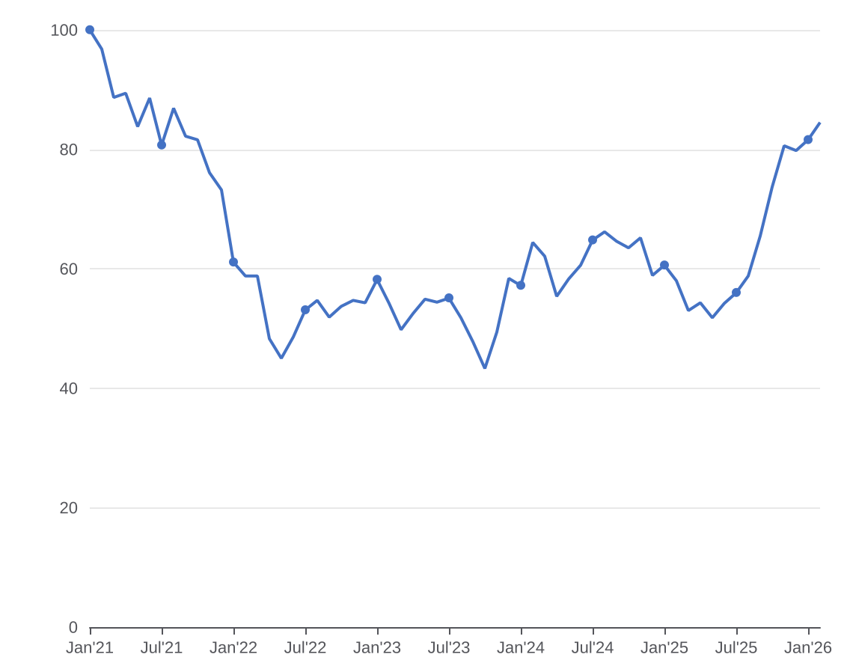
STATE OF PLAY
Biotech 2026: Recovery Real, Not Broad
Sector Snapshot
XBI (Biotech Index) Recovery — Multi-Year Context
$36B+
$300B
Late-2025 M&A Deal Value
Patent Cliff (2025–2030)
Signals renewed confidence
Forces Big Pharma to buy
$30B+
~70%
GLP-1 Alliances in 2024
Biotech Index Off 2021 Peak
Single category dominance
But recovery underway
Key Narrative
Green shoots are real but recovery is narrow — platforms and validated mechanisms win
Big Pharma holds $500B+ acquisition firepower; the patent cliff makes M&A existential
IPO window cautiously reopening after near-total closure in 2022–23
Venture capital bifurcating sharply: AI-enabled platforms win; preclinical single-assets lose
XBI remains ~30% below its 2021 peak — sentiment improving but reset is not fully reversed
Source: Financial Modeling Prep; XBI monthly close prices Jan 2021 – Feb 2026. Indexed: Jan 2021 = 100.
4

Slide 5
STATE OF PLAY
The Market Recovery Is Bifurcated
Winners: Where Capital Is Flowing
Losers: Where Capital Is Scarce
Platform biotech with broad applicability (mRNA, ADC, cell therapy platforms)
Validated mechanisms with Phase 2+ human proof-of-concept data
Obesity/metabolic — GLP-1, GIP, amylin, and combination approaches
Oncology with differentiated mechanism or biomarker selectivity
China-originated IP in bispecifics, ADCs, and GLP-1 analogs finding Western buyers
Single-asset biotechs without clear acquirer rationale or line-of-sight to Phase 3
CNS programs that lack compelling biomarkers or patient selection strategy
Companies reliant on 2021-era valuation frameworks to raise follow-on rounds
Mid-cap biotechs with one approved product but no pipeline — one-hit wonders
Broad-indication oncology programs without genomic or biomarker hook
Winner Signals
Loser Signals
3.2x
$30B+
~60%
14mo
Avg. M&A Premium (platform)
GLP-1 Alliance Value (2024)
Single-asset IPOs (2024)
Mid-cap biotech avg. cash runway
vs. 0.7x for single-asset Ph1
One category, one year
Trading below issue price
Down from 24mo in 2021
40+
58%
31%
2.1x
ADC Deals Signed (2023–25)
Platform Biotech Valuation Premium
VC follow-on rate (pre-Ph2)
Mushy middle down-rounds (2024)
Fastest-growing modality
Over asset-centric peers
Lowest since 2015
Rise vs. prior year
Source: Evaluate Pharma, J.P. Morgan Healthcare Conference 2026 observations
5

Slide 6
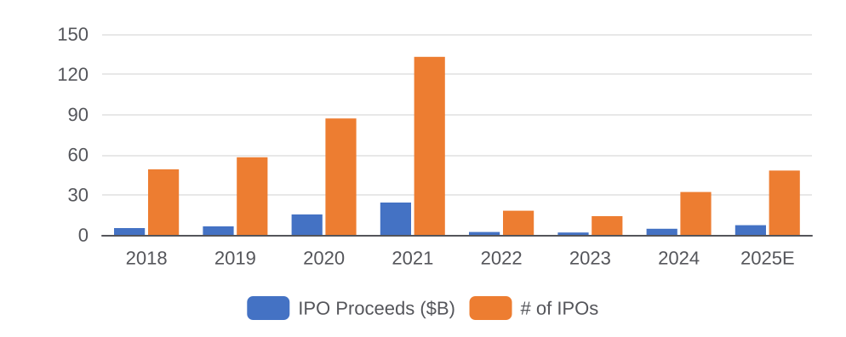
STATE OF PLAY
The Financing Reset: Capital Is Unequal
Biotech IPO Volume & Proceeds 2018–2025 ($B)
Who Gets Funded in 2025
Company Type | Avg. Series A | Avg. Series B
AI platform biotech | $80M+ | $200M+
ADC / payload platform | $65M | $150M
GLP-1 / metabolic | $55M | $130M
Single-asset oncology Ph2 | $35M | $80M
Single-asset preclinical | $18M | Rare/down
CNS (no biomarker) | $15M | Rare
Follow-On & Crossover Financing Dynamics
What This Means for the Market
Metric | 2021 Peak | 2022 | 2023 | 2024 | Trend
Biotech IPOs (#) | 133 | 18 | 14 | 32 | ↑ cautious reopen
Avg. IPO raise ($M) | $312 | $198 | $156 | $228 | ↑ selectivity up
Crossover rounds (#) | 210 | 62 | 44 | 78 | ↑ gating signal
Down-rounds (% of all) | 8% | 34% | 41% | 29% | ↓ still elevated
Median cash runway (mo.) | 28 | 20 | 16 | 14 | ↓ still squeezed
The IPO window has reopened, but only for a narrow band of companies — platform stories and clinical-stage assets with de-risked data
Crossover rounds are the new gating mechanism: no crossover = no IPO; crossover investors are picking winners 12-18 months early
Down-round frequency at 29% in 2024 is nearly 4x the 2021 level — a large cohort of 2020-21 vintage companies is being written down or wound up
Cash runway compression is forcing forced M&A and licensing on acquirer terms — the best time to be a buyer in 15 years
Source: BioPharma Catalyst, Evaluate Pharma, SVB Healthcare Financing Report 2025, FactSet.
6

Slide 7
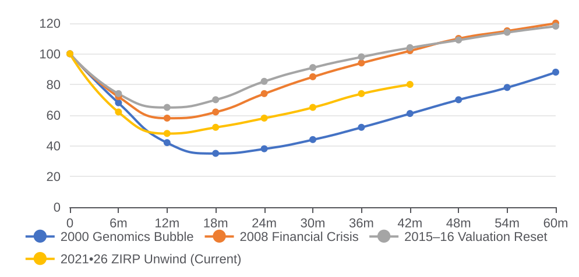
STATE OF PLAY
Where Are We in the Cycle: Comps
Biotech Bear-Recovery Cycles: Peak-Indexed
What Each Recovery Had in Common
A Defining Catalyst
Every durable recovery had a new scientific paradigm: genomics, biologics, immuno-oncology. Today: GLP-1 + AI
M&A as the Ignition
Big Pharma M&A accelerated each prior recovery by recycling capital into the ecosystem and validating valuations
Survivors Were Narrow
In every cycle, <20% of companies that crashed fully recovered. The rest were acquired, merged, or wound down
Timing Is Hard
The 2016 reset looked like prolonged malaise until PD-1 data broke; the 2021 reset may resolve the same way
Our Read on the Current Cycle
Cycle Comparison: Key Statistics
At month 42 of the current cycle, we're tracking closest to the 2015–16 reset — not the catastrophic 2000 bubble
The defining catalysts are already in place: GLP-1 is the immuno-oncology of this decade; AI drug discovery is the genomics bet
Unlike prior cycles, M&A has front-loaded the recovery for a narrow set of winners — the rest may wait significantly longer
Contrarian view: the median biotech is not recovering — only the top quartile is. Investors pricing in a broad recovery are wrong
Cycle | Peak-to-Trough | Trough | Recovery to Peak | Catalyst
2000 Bubble | -78% | 2002 | 6–7 yrs | Genomics/personalized medicine
2008 Crisis | -52% | 2009 | 3–4 yrs | Biologics era; biosimilar law
2015–16 Reset | -55% | 2016 | 2–3 yrs | Immuno-oncology wave (PD-1)
2021–26 (Now) | -70% | 2022 | 3–5 yrs? | GLP-1 + AI + patent cliff M&A
Source: FactSet, BioCentury, Evaluate Pharma. XBI indexed to 100 at each cycle peak.
7

Slide 8
02.
THE BARBELL THESIS
8

Slide 9
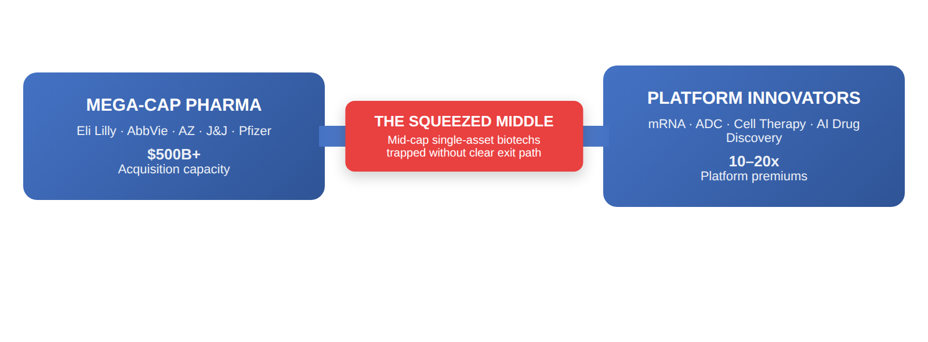
THE BARBELL THESIS
The Barbell: Extremes Win, Middle Loses
Left Bell: Mega-Cap Acquirers
Right Bell: Innovative Platforms
Eli Lilly, AbbVie, J&J, AZ, Pfizer: $500B+ firepower
Patent cliff = urgency to pay 50–100% premiums
Prefer Phase 2/3 with clear indication synergies
mRNA, ADC, cell therapy platforms attract premiums
AI drug discovery: Recursion, Relay, Insilico
China innovators: bispecifics, ADCs, GLP-1 analogs
The Barbell Dynamic: Conceptual Framework
Source: EY Firepower Report 2026; FactSet; Evaluate Pharma
9

Slide 10
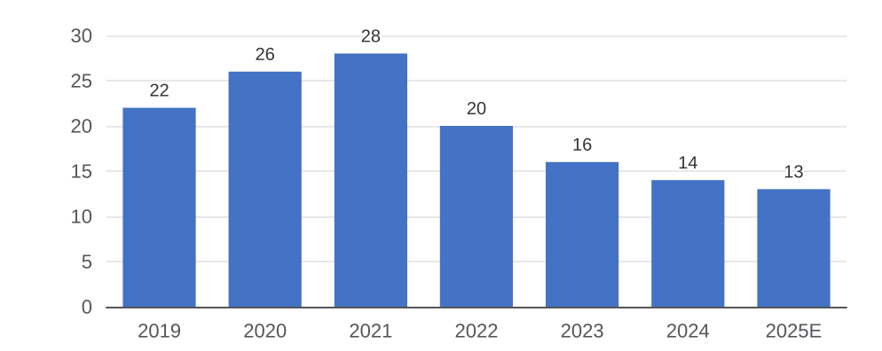
THE BARBELL THESIS
Why the Middle Gets Squeezed
The Cost of Capital Trap
Structural Forces Converging on the Middle
Post-2022 rate environment raised biotech WACC to 12–15% — Phase 2 NPVs collapse
Mid-caps must dilute heavily to raise cash; each round resets valuation anchor lower
Public market comps no longer support 2021 multiples; down-rounds normalized
The Acquirer Threshold Problem
The Death Valley Dynamics
Big Pharma M&A desks screen for $5B+ peak sales potential — most mid-caps can't clear the bar
Single-asset Phase 2 companies lack the risk distribution that makes a large deal pencil out
Preferred targets: de-risked Phase 3 or approved assets with clean IP and global rights
VC pulls back from preclinical: Series A average now requires Phase 1 data
Crossover funds demand near-term catalyst visibility before participating in IPOs
IRA drug pricing reform hits single-product mid-caps hardest — peak sales assumptions cut 20–35%
Result: companies in the middle face a capital desert with no clear path to exit or independence
Source: SVB Leerink, Evaluate Pharma, FactSet 2025
10

Slide 11
THE BARBELL THESIS
The Barbell in Practice: Named Companies
Left Bell: Mega-Cap Acquirers
Company | Firepower ($B) | Key Target Modalities | Recent Move
Eli Lilly | $70B+ | GLP-1, obesity, immunology | Morphic ($3.2B), Versanis
AbbVie | $60B+ | Immunology, oncology, neuroscience | ImmunoGen ($10.1B), Cerevel ($8.7B)
AstraZeneca | $50B+ | Oncology, ADCs, rare disease | Fusion Pharma, Gracell Bio
Johnson & Johnson | $55B+ | Oncology, immunology, MedTech | Ambrx ($2B), NM26 bispecific
Pfizer | $50B+ | Oncology, RSV, mRNA pipeline | Seagen ($43B), Arena Pharma
Right Bell: Platform Innovators
Company | Platform | Why It Wins
Moderna | mRNA | Platform breadth beyond COVID; oncology pipeline
Daiichi Sankyo | ADC | Best-in-class linker tech; AZ partnership validates
Recursion | AI drug discovery | Platform economics; Roche/Bayer partnerships
BioNTech | mRNA / oncology | Individualized neoantigen cancer vaccines Ph3
Source: Public filings, FactSet, Evaluate Pharma 2025. For illustrative purposes.
11

Slide 12
03.
THE $300B PATENT CLIFF
12

Slide 13
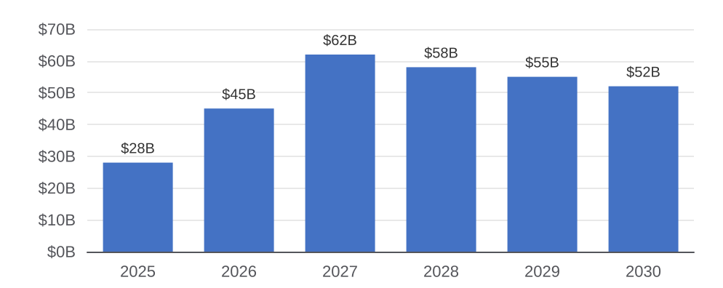
THE $300B PATENT CLIFF
The $300B Patent Cliff Imperative
Revenue at Risk by Year
Strategic Response Archetypes
Transformational M&A
Pfizer/Seagen ($43B), AbbVie/Cerevel ($8.7B)
Acquire blockbuster potential at scale
Bolt-On Acquisition
Phase 2/3 assets in core therapeutic area
Lower risk, faster pipeline integration
Lifecycle Extension
AbbVie's Skyrizi/Rinvoq post-Humira
New formulations, indications, combos
China Licensing
Fast, cheaper pipeline access
BMS, Pfizer, AZ all in market for deals
Key Drugs Losing Exclusivity (2025–2028)
My View: Urgency = Premium Pricing
Drug | Company | Indication | Peak Sales
Keytruda | Merck | Oncology (PD-1) | $25B+
Humira (post-LoE) | AbbVie | Immunology | $14B
Eliquis | BMS/Pfizer | Anticoagulant | $12B
Stelara | J&J | Immunology | $11B
Enbrel | Pfizer/Amgen | Immunology | $7B
Merck alone faces $25B+ Keytruda expiry by 2028 — willingness to pay 80%+ premium
AbbVie's Humira transition is the blueprint: Skyrizi/Rinvoq replace $14B
Companies that missed 2023 dip face even steeper acquisition competition
Source: Evaluate Pharma Portfolio Tactics Report, Oct 2025; Evaluate 2026 Preview
13

Slide 14
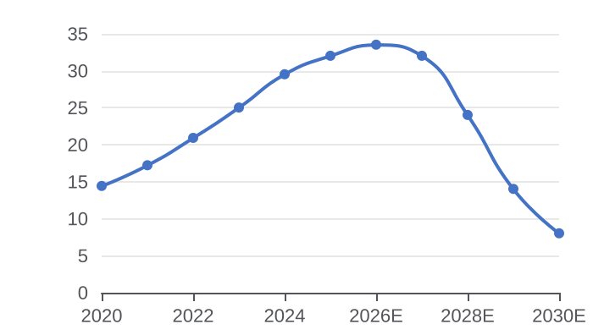
THE $300B PATENT CLIFF
Merck & Co.: Racing the Keytruda Clock
Company Snapshot
Keytruda Revenue Trajectory & Cliff
M&A Firepower
~$260B
$63.6B
$13B
$35B
Market Cap
2024 Revenue
As of Jan 2026
+7% YoY
$29.5B
2028
Cash & Equivalents
Estimated Debt Capacity
Keytruda Revenue
Patent Expiry
End of Q3 2024
At current leverage
46% of total sales
US exclusivity cliff
The Core Problem
Pipeline: What Can Fill the Gap?
Recent Deals
Keytruda is the world’s best-selling drug — and Merck’s single largest dependency
US patent expires 2028; biosimilar entry could erode 60–80% of revenue within 3 years
No single pipeline asset comes close to replacing $29B in annual revenue
Merck must acquire or partner its way out — urgency creates premium willingness
Asset | Indication | Stage | Peak Sales Est.
MK-1084 | Oncology combo | Phase 2 | ~$3-5B
Clesrovimab | Infant RSV | Filed | ~$1-2B
Sotatercept | PAH | Approved | ~$3B
MK-7684A | NSCLC | Phase 3 | ~$4-6B
Efineptazone | CNS/Alzheimer | Phase 2 | Speculative
Prometheus Bio ($10.8B) — autoimmune, TL1A
Acceleron ($11.5B) — sotatercept, PAH
Harpoon Therapeutics ($680M) — T-cell engager
Eyebiotech — retinal disease, early bolt-on
Source: Merck 10-K 2024, Evaluate Pharma, FactSet. Market data as of Jan 2026.
14

Slide 15
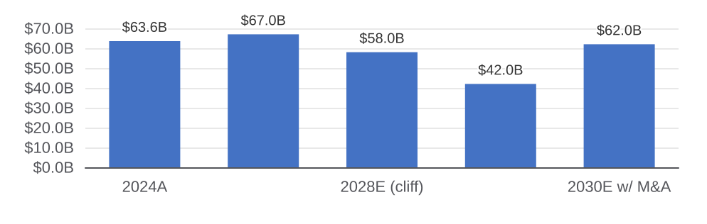
THE $300B PATENT CLIFF
Merck: M&A Strategy & Target Framework
The Revenue Gap Merck Must Fill ($B)
Illustrative Acquisition Candidates
Company | Rationale | Mkt Cap
Seagen (done) | ADC platform; acquired $43B | Acquired
Incyte | JAK/oncology; Jakafi LOE | ~$14B
Protagonist Tx | Rusfertide, hematology | ~$3B
Karuna (BMS) | CNS; diversification | Acquired
Argenx | FcRn platform; immunology | ~$28B
What Merck Must Acquire to Stay Whole
Our View
Criteria | Why It Matters for Merck
$5B+ peak sales potential | Only assets this size offset Keytruda erosion
Oncology or immunology fit | Leverages commercial infra and KOL relationships
Phase 2/3 or approved | 2028 cliff: 3-4yr window; early-stage too slow
Clean global rights | Merck competes globally; ex-US rights critical
No direct Keytruda overlap | Avoid over-concentration in PD-1 pathway
Merck is the most acute case of patent cliff urgency in pharma — no company has more riding on a single asset
The pipeline partially offsets the gap but cannot close it alone; at least one $10–20B deal is likely by 2026
Willingness to pay 70–90% premiums is rational given the alternative: permanent revenue step-down
Ideal targets: late-stage oncology or immunology with global rights and $5B+ commercial potential
Source: Evaluate Pharma, SVB Leerink, company filings. Views are analytical, not recommendations.
15

Slide 16
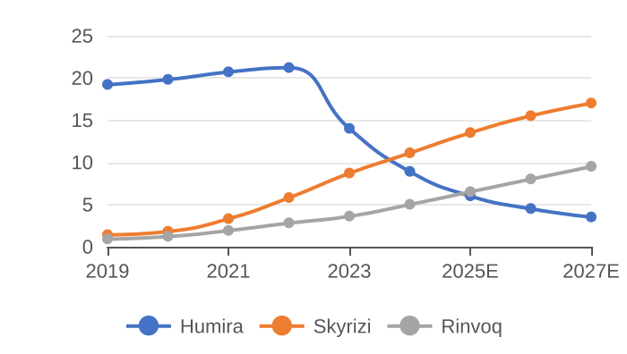
THE $300B PATENT CLIFF
AbbVie: The Patent Cliff Playbook
Company Snapshot
Humira Decline vs. Successor Ramp
AbbVie Firepower
~$320B
$56.3B
$12B
$18B+
Market Cap
2024 Revenue
As of Jan 2026
+3% YoY post-Humira
$21.2B
$18B+
Cash & Equivalents
Free Cash Flow (2024)
Humira Peak (2022)
Skyrizi + Rinvoq
End of Q3 2024
Funds future M&A
Since biosimilar entry
2024 combined revenue
Why AbbVie Is the Blueprint
The Transition Mechanics
Recent Acquisitions
Humira biosimilar entry in 2023 was the most-anticipated patent cliff in pharma history
AbbVie spent 2018–2022 quietly building Skyrizi (risankizumab) and Rinvoq (upadacitinib) into blockbusters
Result: revenue barely dipped; Skyrizi/Rinvoq now growing faster than Humira ever did
The market underestimated execution quality — AbbVie stock hit all-time highs post-cliff
Phase | Years | What AbbVie Did
Anticipation | 2016-2019 | Pharmacyclics acq; seeded IL-23
Build | 2019-2022 | Skyrizi/Rinvoq: 8+ approvals each
Transition | 2023 | Absorbed $7B drop; partial offset
Recovery | 2024-now | Skyrizi to beat Humira peak 2027
ImmunoGen ($10.1B) — ELAHERE ADC, ovarian cancer
Cerevel ($8.7B) — CNS; emraclidine schizophrenia
Landos Biopharma — GI inflammation
Syndesi Therapeutics — CNS synaptic modulation
Source: AbbVie 10-K 2024, Evaluate Pharma, FactSet. Market data as of Jan 2026.
16

Slide 17
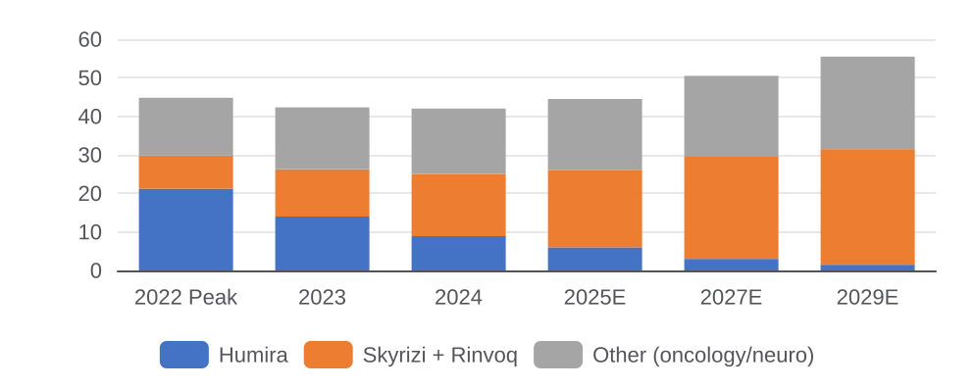
THE $300B PATENT CLIFF
AbbVie: Next Chapter & Market Lessons
AbbVie Revenue Bridge: Humira to Next Cycle ($B)
Lessons for the Sector
Start Early
AbbVie began successor development 7+ years before Humira LoE
Most companies wait too long
Bet on Mechanism, Not Brand
Skyrizi (IL-23) and Rinvoq (JAK1) are mechanistically superior to Humira in some indications
M&A as Acceleration
Pharmacyclics ($21B) wasn’t a replacement — it was diversification that bought time
Execution Is Alpha
Market chronically underestimates how good large pharma commercial teams are at product launches
What AbbVie Must Do Next
Our View
Challenge | Status | Implication
Skyrizi/Rinvoq LOE (2030s) | ~10 years runway | Seed next cycle via early M&A
Cerevel CNS execution | Emraclidine Phase 3 | Schizophrenia $8B+; binary risk
ImmunoGen ADC integration | ELAHERE growing | Platform vs. one-product TBD
Neuroscience buildout | Post-Allergan: Botox | Migraine/psych = diversification
China generic exposure | Adalimumab biosimilars | Mostly priced in
AbbVie proves patent cliffs are survivable with right lead time and pipeline discipline
Market still prices most pharma cliffs as terminal; AbbVie shows that's wrong
Key risk: Cerevel's emraclidine Phase 3 failure would reset CNS thesis and remove diversification
AbbVie template: expect Merck, BMS, Pfizer to follow same playbook with 2-4 year lags
Source: AbbVie investor day 2024, Evaluate Pharma, SVB Leerink. Views are analytical.
17

Slide 18
04.
GLP-1 WARS
18

Slide 19
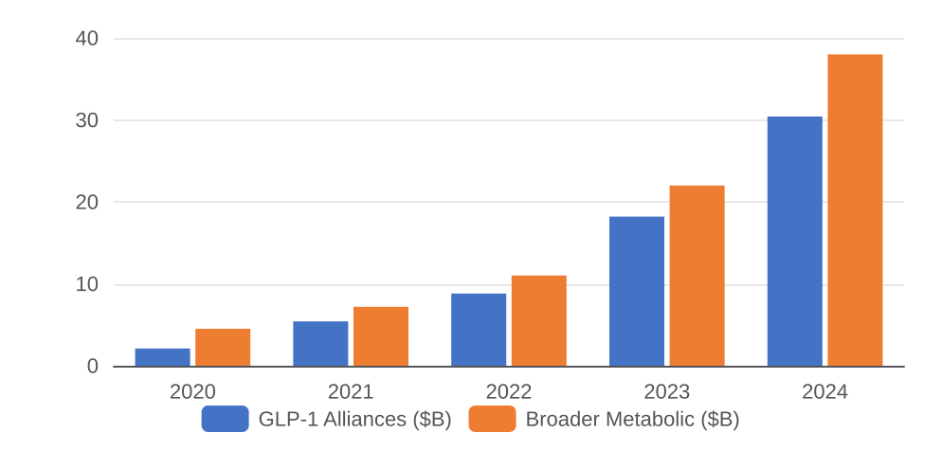
GLP-1 WARS
GLP-1 Is Reshaping the Entire Drug Market
The Numbers Tell the Story
GLP-1 Market Leaders vs. Challengers
$75.5B
$30B+
Company | Asset | Stage | Differentiation
Eli Lilly | Tirzepatide | Approved | GLP-1/GIP; SURPASS data
Novo Nordisk | Semaglutide | Approved | SELECT CV; first-mover
Novo Nordisk | CagriSema | Phase 3 | GLP-1+amylin combo
AstraZeneca | AZD5004 | Phase 2 | Oral mol. GLP-1
Pfizer | Danuglipron | Phase 2 | Once-daily oral GLP-1
Lilly's Projected '26 Rx Sales
GLP-1 Alliances in 2024
Pharma's first-ever milestone
Single-year record
500+
>40%
GLP-1 Programs in Pipeline
China's Pipeline Share
Global, all stages
GLP-1 programs globally
GLP-1 Entering a Combination Era
GLP-1 vs. Broader Metabolic Pipeline Deal Value
The next frontier isn't better GLP-1s — it's GLP-1 + muscle preservation (myostatin inhibitors, ACVR2B)
Amylin analogs (Cagrilintide) are the real sleeper — preserve muscle while losing fat
NASH/MASH is GLP-1's next battleground after obesity; $35B+ opportunity by 2030
Oral GLP-1 formulation will disrupt injectable market — Pfizer, Lilly, BioHaven racing
Investors overvaluing pure GLP-1 plays; combo-mechanism companies are underappreciated
Source: Evaluate Pharma GLP-1 Dealmaking Report Nov 2025; Evaluate 2026 Preview; Company filings
19

Slide 20
GLP-1 WARS
The GLP-1 Wars: Competitive Battlemap
Full Competitive Landscape by Mechanism
Why Lilly Is Pulling Away
Company | Asset | Mechanism | Stage | Key Edge
Eli Lilly | Tirzepatide | GLP-1/GIP | Appr. | Best-in-class
Eli Lilly | Retatrutide | GLP-1/GIP/Gcg | Ph3 | Triple; 24% loss
Novo Nordisk | Semaglutide | GLP-1 | Appr. | SELECT CV
Novo Nordisk | CagriSema | GLP-1+amylin | Ph3 | Muscle-preserving
AstraZeneca | AZD5004 | GLP-1 (oral) | Ph2 | Oral QD
Pfizer | Danuglipron | GLP-1 (oral) | Ph2 | Oral QD dosing
Amgen | MariTide | GLP-1/GIP antag | Ph3 | Monthly dosing
Structure Tx | GSBR-1290 | GLP-1/GIP bspec | Ph2 | Long-act bispfc
Boehringer | Survodutide | GLP-1/Gcg | Ph3 | NASH focus
Roche/Carmot | CT-388 | GLP-1/GIP | Ph2 | Acq $2.7B; depth
Tirzepatide's dual mechanism: ~20% weight loss vs. ~15% for semaglutide
Retatrutide Phase 3: ~24% weight loss — new ceiling
Manufacturing scale-up outpaced Novo; supply constraints ease by 2025
Cardio outcomes data due 2026 — final gap vs. Novo's SELECT advantage
Novo's Defensive Moat
SELECT CV outcomes trial (2023) - only completed MACE data for GLP-1s
Payer coverage cemented by outcomes evidence
CagriSema targets muscle-preservation gap vs pure GLP-1s
Oral semaglutide gaining traction; pipeline positions Novo for next wave
Total GLP-1 Market 2030E
$130B+
10+
GLP-1 Market 2030E
# of Approved GLP-1s by 2028
Up from $34B in 2024
Obesity + cardiometabolic
Source: Evaluate Pharma, GlobalData, company filings, ClinicalTrials.gov Jan 2026.
20

Slide 21
GLP-1 WARS
Next-Gen GLP-1: Beyond Semaglutide
GLP-1 Generation Map
Investment Angles: Who Benefits Beyond Lilly & Novo
Generation | Mechanism | Best-in-Class | Weight Loss
Gen 1 | GLP-1 mono | Semaglutide | ~15%
Gen 2 | GLP-1 / GIP | Tirzepatide | ~20%
Gen 3 | GLP-1/GIP/Gcg | Retatrutide | ~24%
Gen 3+ | GLP-1 + amylin | CagriSema | ~25%*
Gen 4 | GLP-1 + muscle | Various | TBD
Oral | Small-mol GLP-1 | Danuglipron | ~10%
Company | GLP-1 Angle | Our Take
Viking Therapeutics | VK2735 oral+inject | Best pure-play challenger
Structure Tx | GSBR-1290 oral | Chinese-origin oral GLP-1
Altimmune | Pemvidutide | GLP-1/Gcg; NASH+obesity
Carmot (Roche) | CT-388/CT-868 | Roche platform; acq. valid.
Zealand Pharma | Petrelintide | Pure amylin; Novo partner
Inventiva | Lanifibranor | NASH adjacent PPAR agonist
Adjacent Opportunities GLP-1 Unlocks
Our Contrarian View on GLP-1
NASH/MASH: GLP-1 + FXR agonist combinations; Madrigal (Rezdiffra) leads but GLP-1s threatening
Heart failure: FLOW trial showed semaglutide reduces HF hospitalization — new indication filing
Sleep apnea: Lilly/Novo both filing; ~20M undiagnosed US patients, no drug therapy exists
Addiction/CNS: GLP-1 receptors in reward circuits; Novo exploring alcohol/opioid use disorder
CKD: FLOW renal outcomes trial could unlock nephrology market worth $15B+
Consensus is too focused on the Lilly/Novo duopoly — the real alpha is in the next-gen mechanism companies and oral challengers
Oral GLP-1 will be the single largest catalyst for market expansion: 500M+ addressable patients globally who won't self-inject
GLP-1 for CNS and addiction is the most underappreciated adjacency — 3-5 year horizon but massive if it works
Muscle preservation (GLP-1 + myostatin/amylin) is the key differentiator in the next generation; pure GLP-1 plays commoditize
Source: Evaluate Pharma, NEJM clinical data, SVB Leerink GLP-1 deep-dive 2025.
21

Slide 22
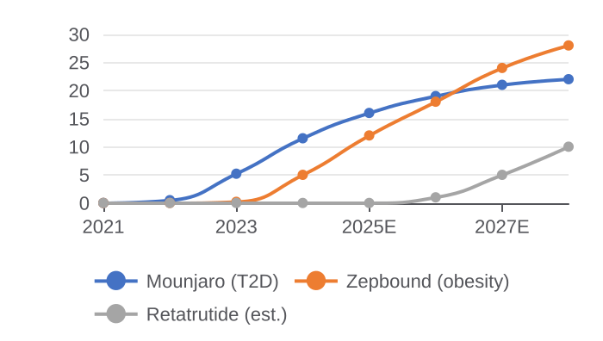
GLP-1 WARS
Eli Lilly: The GLP-1 Juggernaut
Company Snapshot
Incretin Revenue Ramp ($B)
Financial Strength
~$750B
$45.0B
$12B
$9B
Market Cap
2024 Revenue
Largest pharma globally
+32% YoY
$11.5B
$5.0B
2024 Free Cash Flow
R&D Spend (2024)
Mounjaro Revenue
Zepbound Revenue
Rapidly expanding
20% of revenue
Type 2 diabetes
Obesity; approved Nov 2023
The Lilly Thesis
Lilly Pipeline Beyond GLP-1
Key Risks
Tirzepatide (GLP-1/GIP) best-in-class weight loss drug — 20%+ body weight reduction
Retatrutide Phase 3 showed 24% weight loss — no competitor close
Lilly closed manufacturing gap vs. Novo; supply no longer constraint
Pipeline diversification: oncology (Jaypirca), immunology, Alzheimer's (donanemab)
Revenue trajectory toward $75B+ in 2026 — unprecedented for pharma
Asset | Indication | Stage | Peak Sales Est.
Donanemab | Alzheimer's | Approved | ~$5-7B
Retatrutide | Obesity | Phase 3 | ~$15B+
Lebrikizumab | Atopic derm. | Approved | ~$3B
Jaypirca | B-cell malign. | Approved | ~$2B
Orforglipron | Obesity (oral) | Phase 3 | ~$5B+
IRA price negotiation: Mounjaro eligible 2026
Valuation pricing near-perfection: >30x 2025E EPS
Novo + Amgen competitive response in 2025-26
Retatrutide Ph3 failure would reset obesity thesis
Source: Lilly 10-K 2024, Evaluate Pharma, FactSet. Market data as of Jan 2026.
22

Slide 23
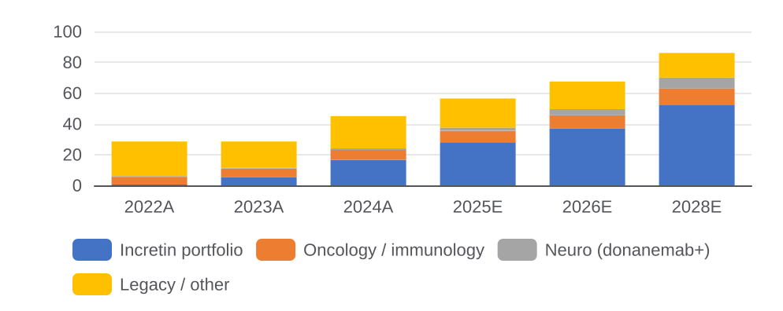
GLP-1 WARS
Eli Lilly: Strategic Outlook & View
Lilly Revenue Composition 2024 vs. 2028E ($B)
Lilly vs. Novo: Head-to-Head
Dimension | Lilly | Novo
Weight loss | ~20% (tirz) | ~15% (sema)
CV outcomes | Pending 2026 | SELECT done
Oral option | Orforglipron | Rybelsus/Amyc.
Valuation | ~30x EPS | ~25x EPS
Next-gen | Retatrutide | CagriSema
Strategic Priorities: What Lilly Does Next
Our View
Priority | Action | Timeline | Implication
Oral GLP-1 | Orforglipron Ph3 readout | 2025-26 | Unlocks inj-averse pts
Retatrutide Ph3 | Triple agonist obesity data | 2026 | New ceiling; pricing power
IRA mitigation | New formulations, devices | Ongoing | Protect Mounjaro revenue
M&A | Oncology & neuro bolt-ons | 2025-27 | Diversify beyond GLP-1
Manufacturing | $5.5B capex ramp | 2025-26 | Remove supply constraint
Lilly is executing one of the greatest pharmaceutical pivots in history — from mid-tier to largest pharma by market cap in under a decade
The bull case is underappreciated: oral GLP-1 + retatrutide + donanemab together could sustain $100B+ revenue by 2030
Primary risk is valuation, not fundamentals — the stock prices a lot of good news; any trial failure triggers sharp de-rating
Best owned as a core position with size reduced on any significant appreciation from current levels
Source: Lilly investor day 2024, SVB Leerink, Evaluate Pharma. Views are analytical.
23

Slide 24
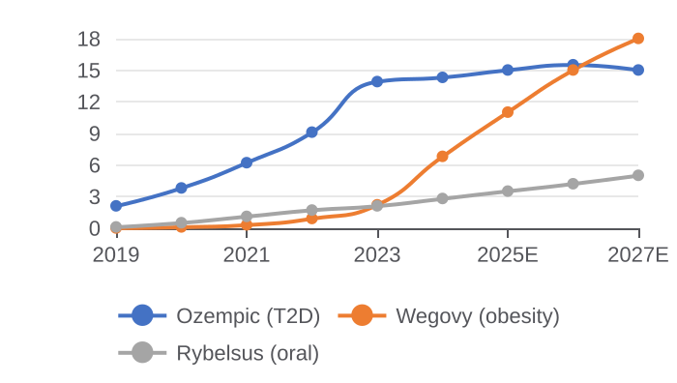
GLP-1 WARS
Novo Nordisk: The GLP-1 Originator
Company Snapshot
Semaglutide Portfolio Revenue ($B)
Financial Strength
~$500B
~$33B
45%+
~$7B
Market Cap
2024 Revenue
Largest European company
+25% YoY
$14.3B
$6.8B
Operating Margin
R&D Spend (2024)
Ozempic Revenue
Wegovy Revenue
Best in class
21% of revenue
T2D & cardiovascular
Obesity; supply-constrained
Why Novo Still Wins
Pipeline Beyond Semaglutide
Key Risks
SELECT CV trial — only MACE data for GLP-1; payer gold standard
First-mover formulary position; embedded in payer rebate structures
CagriSema Phase 3: muscle-preservation advantage over pure GLP-1s
Oral semaglutide expanding; oral pipeline for next-gen wave
Denmark infrastructure: 50%+ global insulin supply — regulatory moat
Asset | Mechanism | Stage | Upside
CagriSema | GLP-1+amylin | Ph3 | ~25%+muscle
Amycretin | GLP-1/amyl or. | Ph2 | First oral combo
IcoSema | Insulin/sema | Ph3 | T2D simplification
NNC0479 | GLP-1/GIP | Ph1 | Vs. Lilly
Sema FLOW | Renal outcomes | Filed | CKD $15B+ mkt
CagriSema Ph3 miss would cede next-gen to Lilly
Wegovy supply: any disruption hits stock hard
IRA: semaglutide negotiation target by 2026
Lilly closing efficacy gap faster than expected
Source: Novo Nordisk Annual Report 2024, Evaluate Pharma, FactSet. Data as of Jan 2026.
24

Slide 25
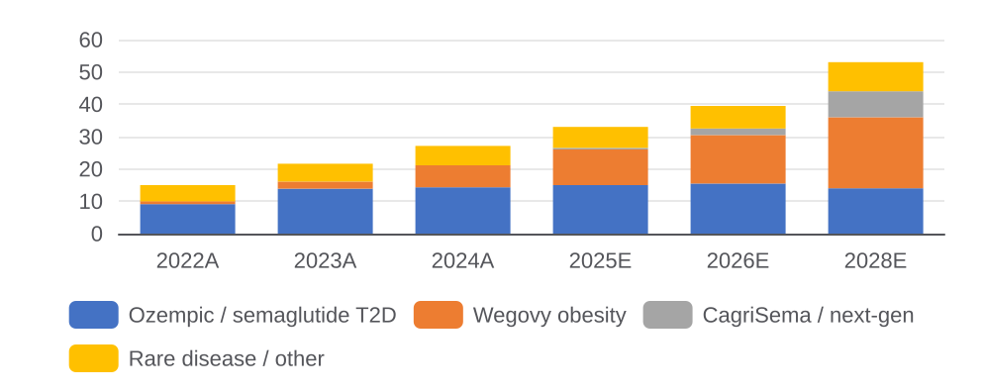
GLP-1 WARS
Novo Nordisk: Beyond Obesity
Novo Revenue Bridge 2024-2028E ($B)
Competitive Positioning vs. Lilly
Factor | Novo Edge | Novo Risk
CV outcomes | SELECT done | Lilly data coming
Oral GLP-1 | Rybelsus appr. | Orforglipron stronger
Payer access | Entrenched | Lilly gaining share
Efficacy | 15% wt loss | Tirz at 20%+
Next-gen | CagriSema | Retatrutide leads
Novo's Expansion Strategy: Beyond GLP-1
Our View
Area | Asset/Move | Status | Why It Matters
Rare disease | Cardior, Forma acq. | Integrated | Hematology diversif.
CNS | GLP-1 CNS trials | Ph2 exploratory | Addiction/Parkinson upside
NASH/MASH | Sema NASH filing | Filed | Vs. Madrigal Rezdiffra
CKD | FLOW renal outcomes | Filed | New large indication
Oral pipeline | Amycretin Ph2 | Phase 2 | First oral GLP-1+amylin
Novo is the more defensive GLP-1 play — SELECT CV outcomes data and payer entrenchment create a durable floor under revenue
CagriSema is the key catalyst: if Phase 3 delivers 25%+ weight loss with muscle preservation, Novo reclaims the efficacy crown
The bear case is not losing to Lilly — it's the IRA and supply disruption compressing both revenue and multiple simultaneously
Best owned as a pair trade with Lilly: lower valuation, more CV/payer protection, slightly lower growth ceiling
Source: Novo Nordisk investor day 2024, Evaluate Pharma, SVB Leerink. Views analytical.
25

Slide 26
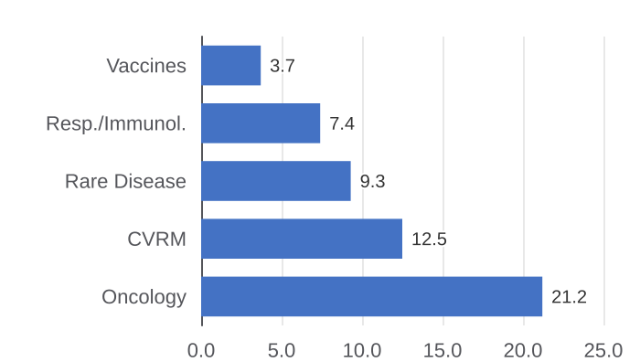
GLP-1 WARS
AstraZeneca: GLP-1 Challenger Strategy
Company Snapshot
AZ Revenue by Franchise 2024 ($B)
Financial Profile
~$250B
$54.1B
$10.0B
~$35B
Market Cap
2024 Revenue
As of Jan 2026
+18% YoY
$21.2B
AZD5004
R&D Investment
M&A Firepower
Oncology Revenue
GLP-1 Program
18% of revenue
Post-Rare Disease build
Largest franchise
Oral; Phase 2
AZ's GLP-1 Thesis
GLP-1 & Metabolic Pipeline
Key Risks
AZ targets oral small-molecule GLP-1s vs IV leaders
AZD5004: once-daily oral with differentiated PK vs Pfizer's danuglipron
MASH/NASH is key GLP-1 opportunity with FXR/PPAR pipeline synergy
Ampio acquisition + Gracell licensing = platform builder strategy
Cardiometabolic + oncology: GLP-1 supports Tagrisso co-prescription
Asset | Mechanism | Stage | Differentiation
AZD5004 | Oral GLP-1 SM | Ph2 | QD tolerable
AZD6234 | GLP-1/GIP oral | Ph1 | Combo oral next-gen
MASH combo | GLP-1+lanif. | Ph2 | Liver disease diff.
AZD9550 | Amylin analog | Pre. | Muscle-preserving
Farxiga | SGLT2 (CKD) | Appr. | CKD outcomes study
AZD5004 Phase 2 data disappointing vs. danuglipron
Tagrisso LOE 2026 — $5.5B revenue at risk
GLP-1 entry is late; scale vs. Lilly/Novo is a real barrier
MASH space getting crowded: Madrigal, Novo, Lilly all competing
Source: AstraZeneca Annual Report 2024, Evaluate Pharma, FactSet. Data as of Jan 2026.
26

Slide 27
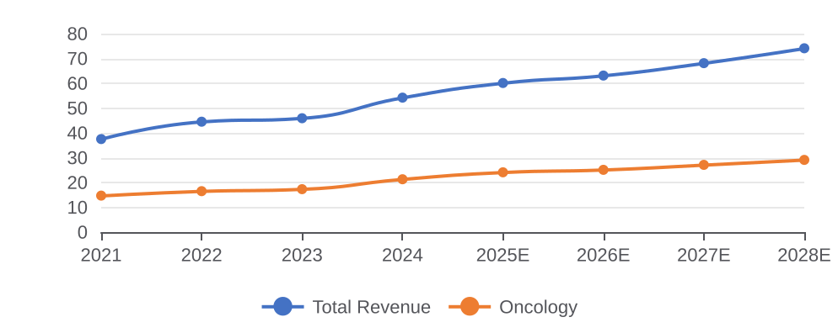
GLP-1 WARS
AstraZeneca: GLP-1 Strategic Outlook
AZ Revenue Trajectory 2022-2028E ($B)
GLP-1 Positioning vs. Leaders
Factor | AZ Position
Entry strategy | Oral SM, not injectable
Target market | GLP-1 naive; inj-averse
Combination | MASH + cardiometa combo
Scale vs. Lilly | Meaningfully smaller
Timeline | 2-3 yrs behind leaders
AZ's Strategic Priorities in GLP-1 Era
Our View
Priority | Rationale | Timeframe
Oral GLP-1 diff. | AZD5004 must show >=10% with tolerability | 2025 Ph2
MASH combo strategy | GLP-1+FXR proven combo; AZ has both | 2026 Ph2/3
Tagrisso lifecycle | 3rd-gen EGFR combos to extend pre-LOE | 2025-2026
ADC expansion | Post-Daiichi; building ADC pipeline | Ongoing
Rare disease defense | Alexion assets sustain margin | Ongoing
AZ angle: oral SM + MASH, not injectable vs. Lilly/Novo
AZD5004 Ph2 mid-2025: clean tolerability = partnership or Ph3
Platform: GLP-1 complements Farxiga CKD and Tagrisso franchise
Watch for GLP-1 acquisition (Zealand? Structure Tx?) to accelerate
Source: AZ investor day 2024, Evaluate Pharma, SVB Leerink. Views are analytical.
27

Slide 28
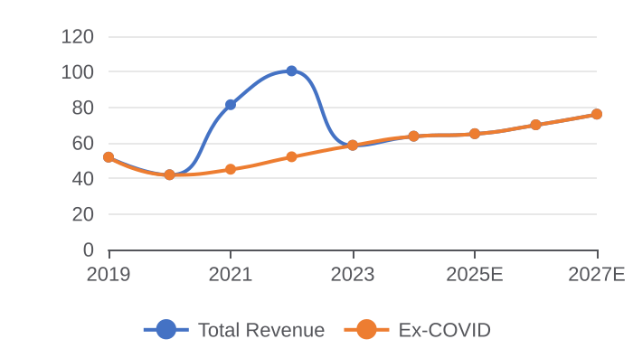
GLP-1 WARS
Pfizer: Oral GLP-1 Bet & COVID Reset
Company Snapshot
Pfizer: COVID to Recovery ($B)
Financial Position
~$145B
$63.6B
~$35B
~$12B
Market Cap
2024 Revenue
Down 60% from 2022 peak
-41% from COVID peak
Ph 2b
$4B+
Net Debt
FCF (2024)
Danuglipron
Cost Cuts
Post-Seagen; elevated
Rebounding post-COVID
Oral GLP-1; QD dosing
Restructuring through 2025
Pfizer's GLP-1 Situation
Non-COVID Pipeline: Key Assets
Key Risks
Danuglipron is once-daily oral GLP-1 targeting injection-averse patients
Earlier BID discontinued due to GI issues; QD is make-or-break program
Success puts Pfizer ahead of AZ in oral GLP-1 — first QD with weight loss
Other reset levers: Seagen ADCs, RSV vaccine Abrysvo, Nurtec migraine
Post-COVID drop brutal: $63B in 2024 vs $100B in 2022 — urgency existential
Asset | Indication | Stage | Peak Sales Est.
Danuglipron | Obesity (oral) | Phase 2b | ~$6-10B
Padcev | Bladder cancer | Approved | ~$4B
Adcetris | Lymphoma | Approved | ~$2.5B
Elranatamab | Myeloma | Approved | ~$2B
Abrysvo | RSV vaccine | Approved | ~$2-3B
Danuglipron QD tolerability data — must be cleaner than BID
Seagen integration: $43B deal must deliver pipeline value
Eliquis LOE 2026: $12B revenue at risk
COVID revenue overhang suppressing multiple re-rating
Source: Pfizer 10-K 2024, Evaluate Pharma, FactSet. Market data as of Jan 2026.
28

Slide 29
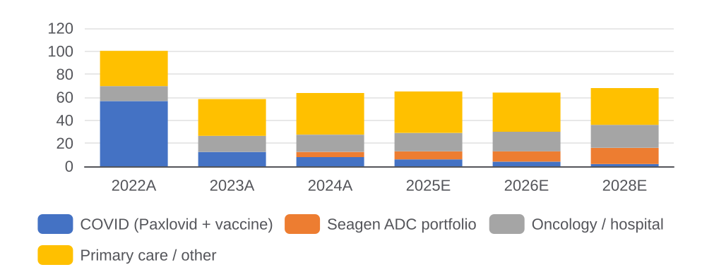
GLP-1 WARS
Pfizer: Can the Giant Rebuild?
Pfizer Revenue Bridge: COVID to New Base ($B)
Danuglipron: What We Need to See
Metric | Bar to Clear
Weight loss | >=10% vs. placebo
GI tolerability | Nausea rate <20%
Dose frequency | Once-daily confirmed
CV safety | No QTc signal
vs. BID | Clearly superior PK
Pfizer's Strategic Reset Plan
Our View
Lever | Action | Status | Revenue Impact
ADC build-out | Seagen integr. + ADCs | Underway | +$5-8B by 2027
Oral GLP-1 | Danuglipron QD Ph2b data | 2025 read | +$6-10B if success
Cost reduction | $4B+ in structural savings | ~Complete | Margin to 35%+
Eliquis LOE | New formulations | Ongoing | Partial offset
M&A | Distressed mid-cap targets | Active | Pipeline refill
Pfizer is the most asymmetric GLP-1 story: the stock prices almost no value for danuglipron — positive Phase 2b data would be a significant catalyst
The post-COVID reset is real but largely complete; the base business at $63B is more durable than the market prices given Seagen ADC momentum
Danuglipron is binary — if QD tolerability is clean, Pfizer is positioned as the first truly accessible oral GLP-1 challenger ahead of orforglipron
Best owned as a value/event-driven position: cheap on pipeline-adjusted basis, with a clear near-term catalyst in mid-2025
Source: Pfizer investor day 2024, SVB Leerink, Evaluate Pharma. Views are analytical.
29

Slide 30
05.
CHINA'S RISE
30

Slide 31
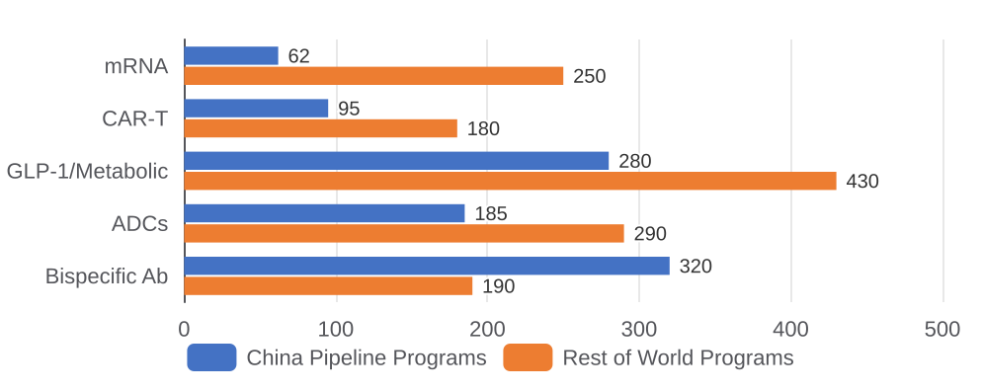
CHINA'S RISE
China: A Genuine Biopharma Superpower
China Innovation Scale
Notable China → West Licensing Deals (2023–2025)
#1
Top 3
Chinese Partner | Western Licensee | Asset | Value
LaNova Medicines | Pfizer | CLDN18.2 ADC | $6.1B
Zymeworks | J&J | HER2 bisp. ADC | $1.7B
Akeso (HK) | Summit Tx | Ivonescimab | $5.0B
Kelun-Biotech | Merck | HER3 ADC | $1.4B
In Bispecific Antibodies Globally
ADC Developer Globally
Pipeline programs
BioNTech, HUTCHMED, Zymeworks
40%+
$15B+
GLP-1 Global Pipeline Share
Outbound Licensing 2023–24
ClinicalTrials data
Western pharma buying
My Contrarian View on China
China Modality Leadership
Most US investors see China through a geopolitical risk lens — they're missing the science
China's ADC programs are at least as good as Western counterparts — often faster and cheaper to develop
The out-licensing wave is accelerating: AZ, Pfizer, BMS all actively sourcing from China
BIOSECURE Act risk is overstated for non-manufacturing partnerships
Best opportunity: licensing deals where clinical risk is largely de-risked by Phase 2 China data
Source: Evaluate Pharma China Strategic Playbook, Jan 2026; ClinicalTrials.gov; Company filings
31

Slide 32
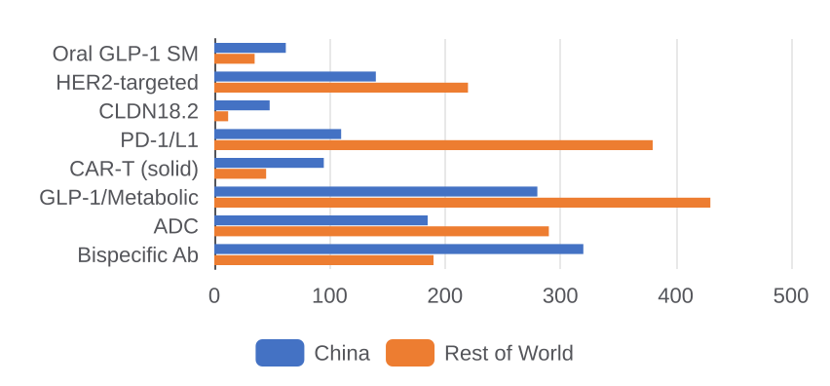
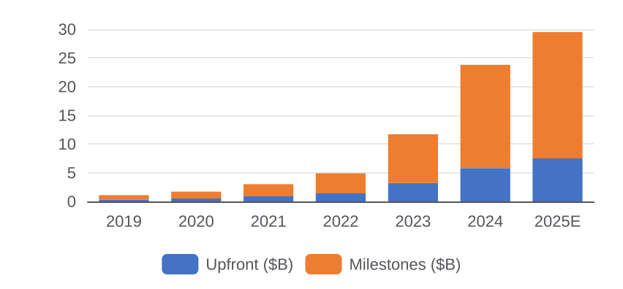
CHINA'S RISE
Where China Is Winning: Innovation Map
China vs. RoW: Pipeline Programs by Modality
China Out-Licensing Deal Flow ($B total)
China's Structural Innovation Advantages
Where China Has Global Leadership
Patient enrollment speed: Chinese Phase 2 trials enroll 3-5x faster than US equivalents — data arrives earlier
Cost of development: Phase 2 oncology trials cost ~40-60% less in China; same FDA-applicable endpoints
NMPA approval as bridge: domestic approval de-risks global licensing — Western pharma buying post-NMPA data
Bispecific engineering depth: China leads in CD3/tumor bispecifics, PD-1/VEGF combos, and CLDN18.2 programs
ADC chemistry: Kelun, RemeGen, and KLUS have pioneered novel linker-payload combinations now in-licensed globally
Area | China Lead | Key Companies | Western Signal
Bispecific Ab | #1 globally | Akeso, Zymeworks | Summit $5B Akeso
PD-1/VEGF combo | Only apprvd | Akeso (AK112) | AZ evaluating
CLDN18.2 ADC | 3 in late | LaNova, KLUS | Pfizer $6.1B
HER3 ADC | Most progs | Kelun, RemeGen | Merck $1.4B
Oral GLP-1 SM | 40%+ pipe | Inventisbio, Sci. | AZ/Pfizer watch
CAR-T (solid) | Most Ph1/2 | Gracell, IASO | AZ $1.2B Gracell
Source: Evaluate Pharma, ClinicalTrials.gov, GlobalData, NMPA filings, Jan 2026.
32

Slide 33
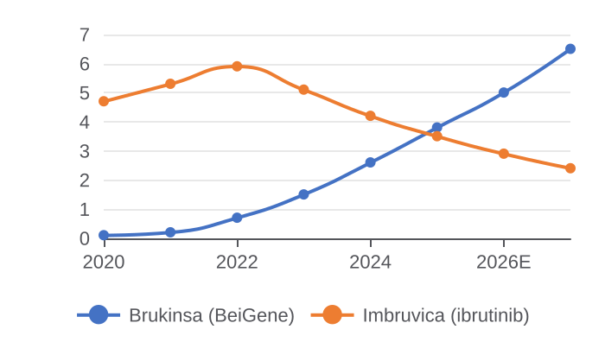
CHINA'S RISE
BeiGene: China's Global Oncology Platform
Company Snapshot
Brukinsa Revenue vs. Ibrutinib ($B)
Financial Profile
~$18B
$3.8B
$4.2B
$1.9B
Market Cap (NASDAQ)
2024 Revenue
Dual-listed HK + US
+26% YoY
$2.6B
50+
Cash Position
R&D Spend (2024)
Brukinsa (BTK)
Pipeline Assets
Well-funded through 2027
50% of revenue
Approved US, EU, CN
Globally active
Why BeiGene Is Different
Key Pipeline Beyond Brukinsa
Our View
Only Chinese biotech with fully commercialized US oncology — Brukinsa taking share from ibrutinib
ALPINE trial showed superiority over ibrutinib in CLL — a best-in-class claim
Global infrastructure: 10,000+ employees, US/EU commercial teams, FDA manufacturing
Tislelizumab (PD-1) partnered with Novartis globally; BeiGene retains China rights
Asset | Target | Stage | Indication
Tislelizumab | PD-1 | Apprvd CN | Multiple cancers
BGB-11417 | BCL2 | Phase 3 | CLL / AML
BGB-16673 | BTK CDAC | Phase 2 | B-cell malign.
Sonrotoclax | BCL2 | Phase 3 | Hematology
BGB-A317 | TIGIT/PD-1 | Phase 2 | Solid tumors
BeiGene proves Chinese biotechs can build global franchises
Brukinsa crossing $5B by 2026 makes it a blockbuster
Risk: geopolitical tension and BIOSECURE Act weigh on multiple
M&A gets commercial oncology platform plus 50+ pipeline assets
Source: BeiGene 20-F 2024, Evaluate Pharma, FactSet. Market data as of Jan 2026.
33

Slide 34
CHINA'S RISE
Akeso & LaNova: Bispecific & ADC Leaders
Akeso Snapshot
Akeso Pipeline
~$8B
$5.0B
2024
Asset | Mechanism | Stage CN | Stage Global | Deal
AK112 (ivonescimab) | PD-1/VEGF bispfc | Approved | Phase 3 | Summit $5B
AK101 | IL-12/23 | Phase 3 | Phase 2 | In-house
AK104 | PD-1/CTLA-4 | Approved | Phase 2 | In-house
AK117 | CD47 mAb | Phase 2 | Phase 1 | In-house
AK129 | IL-2/PD-1 bispfc | Phase 1 | Preclin. | In-house
Market Cap (HK)
AK112 deal (Summit)
US IND filed
HK-listed
PD-1/VEGF bispecific
Ivonescimab Ph3 global
AK112: PD-1/VEGF bispecific — unique dual checkpoint+anti-angio
Phase 3 CN: superior PFS vs. pembrolizumab in NSCLC
Summit licensed ex-CN for $5B; global Ph3 in US/EU/JP
Replication of CN data = $10B+ asset; direct Keytruda threat
LaNova Snapshot
CLDN18.2 Competitive Landscape
Private
$6.1B
Phase 2
Company | Asset | Modality | Stage | Partner
LaNova (CN) | LM-302 | ADC | Phase 2 | Pfizer $6.1B
Zymeworks (CA) | ZW49 | HER2 bispfc ADC | Phase 2 | J&J $1.7B
KLUS Pharma | KL264 | ADC | Phase 1 | Undisclosed
Astellas | Zolbetuximab | mAb | Approved | Commercial
Sotio | SOT102 | ADC | Phase 1 | In-house
Status
Pfizer deal (2024)
Lead asset stage
VC-backed; pre-IPO
CLDN18.2 ADC
CN + US IND filed
LM-302: CLDN18.2 ADC — hottest gastric cancer target
Pfizer paid $6.1B for ex-CN rights to a Ph2 asset
Validates CN ADC chemistry; linker-payload vs. Daiichi
Pre-IPO HK/US listing 2025-26; Pfizer deal = valuation anchor
Source: Akeso HK filings, LaNova press releases, Evaluate Pharma, FactSet Jan 2026.
34

Slide 35
CHINA'S RISE
Zymeworks & Kelun-Biotech: ADC Innovators
Zymeworks Snapshot
Zymeworks ADC Platform & Pipeline
~$1.2B
$1.7B
ZW220
Asset | Target | Modality | Stage | Status
ZW49 | HER2 bispfc | ADC | Phase 2 | J&J $1.7B licensed
ZW220 | HER2 (low) | ADC | Phase 2 | In-house; partnering
ZW171 | CD3/MSLN | Bispfc mAb | Phase 1 | In-house
ZW251 | HER3 | ADC | Preclin. | Azyp platform
Market Cap (NYSE)
J&J deal (2023)
Lead asset
Canada-HK hybrid
HER2 bispecific ADC
Phase 2 HER2+ gastric
Bispecific ADC: two tumor targets for selectivity
ZW49 licensed to J&J $1.7B; validates the class
ZW220 targets HER2-low, ineligible for T-DXd
Azyp platform: modular ADC across tumor antigens
Kelun-Biotech Snapshot
Kelun-Biotech ADC Pipeline
~$3.5B
$1.4B
12+
Asset | Target | Payload | Stage | Partner
SKB264 | Trop-2 | Belotecan | Phase 3 | In-house (global)
A166 | HER3 | DM4 | Phase 2 | Merck $1.4B
KL264 | CLDN18.2 | Camptothecin | Phase 1 | In-house
KL516 | HER2 | Novel | Phase 1 | In-house
KL525 | Trop-2/HER3 | Bispec ADC | Preclin. | Novel platform
Market Cap (HK)
Merck deal (2023)
ADC programs
Subsidiary of Kelun Pharma
HER3-DXd ADC
Broadest CN ADC pipeline
Broadest CN ADC pipeline: 12+ programs, novel
SKB264 (Trop-2): Ph3 vs. Gilead Trodelvy in TNBC
A166 (HER3 ADC) licensed to Merck for $1.4B
Camptothecin payloads: distinct from DXd mechanism
Source: Zymeworks 20-F, Kelun-Biotech HK filing, Merck/J&J press releases, Evaluate Pharma Jan 2026.
35

Slide 36
CHINA'S RISE
HUTCHMED & RemeGen: CN Assets Go Global
HUTCHMED Snapshot
HUTCHMED Global Pipeline
~$3B
3
Approved
Asset | Target | CN Status | Global Status | Partner
Fruquintinib | VEGFR 1/2/3 | Appr. CN | FDA Approved | Takeda (US/EU)
Savolitinib | MET | Appr. CN | Phase 3 | AstraZeneca
Surufatinib | FGFR/VEGFR | Appr. CN | Phase 2 US | In-house
HMPL-306 | IDH1/2 | Phase 2 | Phase 1 US | In-house
Tazemetostat | EZH2 | Phase 2 | Phase 1 | In-house
Market Cap (HK/NASDAQ)
Approved oncology drugs
Fruquintinib (US)
Dual listed
CN approved; 1 US filed
FDA approved Nov 2023
Fruquintinib: first CN small-mol FDA-approved (2023)
Savolitinib (MET) with AstraZeneca for NSCLC globally
Surufatinib CN-approved for NETs; US filing 2025
Proves CN small-mol oncology can clear FDA
RemeGen Snapshot
RemeGen Pipeline & Seagen/Pfizer Partnership
~$2B
RC48
2
Asset | Target | Modality | Stage | Status
RC48 (disitamab v.) | HER2 | ADC | Appr. CN | Pfizer ex-CN rights
RC28 | VEGF/FGF | Bispec Ab | Phase 2 | In-house
RC108 | c-Met | ADC | Phase 2 | In-house
RC118 | CLDN18.2 | ADC | Phase 1 | In-house
RC148 | HER2/HER3 | Bispec ADC | Preclin. | Novel linker
Market Cap (HK)
Lead asset
CN Approvals
HK-listed
HER2 ADC; US filing 2024
RC48 + Teliso-V
RC48: HER2 ADC approved CN; competes with DS-8201
Pfizer partnered RC48 ex-CN via Seagen acquisition
RC28 (VEGF/FGF bispec Ab): next-gen bispecific
One of few CN biotechs in Western pharma portfolio
Source: HUTCHMED Annual Report 2024, RemeGen HK filing, Seagen/Pfizer filings, Evaluate Pharma.
36

Slide 37
06.
FDA TURBULENCE
37

Slide 38
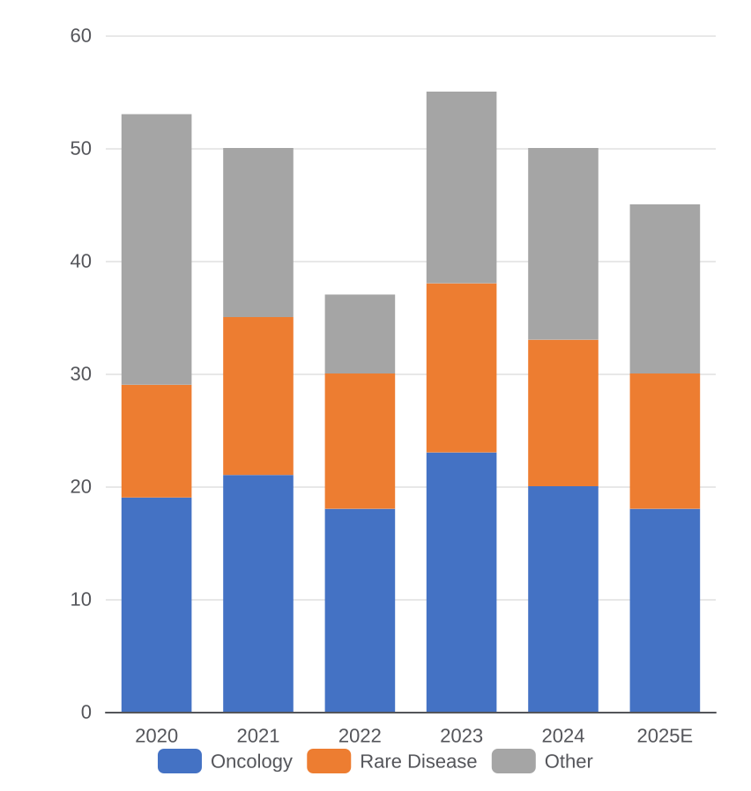
FDA TURBULENCE
FDA Turbulence: Risk and Opportunity
What Is Actually Happening
FDA Approval Trends by Therapeutic Area
Trump administration has installed DOGE-oriented leadership at HHS; FDA leadership in flux
Vaccine advisory committees disrupted; some review panels suspended or restructured
Accelerated Approval Vouchers (AAVs) creating unusual speed opportunities for some programs
Real World Evidence (RWE) guidance being expedited for certain indications
User fees under pressure — PDUFA VII discussions ongoing; could extend timelines
My Read: Not as Bad as Headlines Suggest
FDA career staff are largely intact — institutional knowledge preserved
Oncology and rare disease approvals unlikely to be disrupted meaningfully
AAV pathway could actually accelerate certain rare disease programs
Uncertainty is creating buying opportunities in stocks with near-term PDUFA dates
Offshore manufacturing scrutiny benefits US-based CDMOs — watch Lonza, Catalent acquirer
Source: Evaluate Pharma 2026 Preview; STAT News; Nature Medicine
38

Slide 39
07.
WHERE CAPITAL IS FLOWING
39

Slide 40
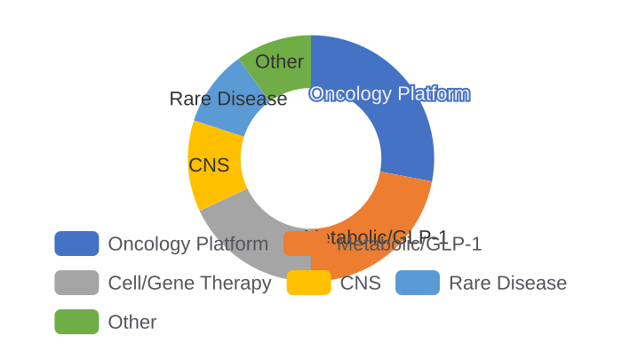
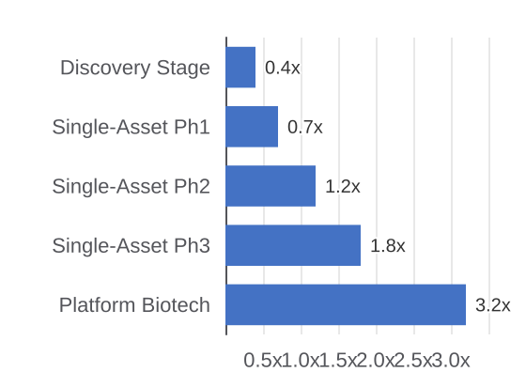
WHERE CAPITAL IS FLOWING
Platform vs. Asset: Capital Bifurcates
VC Funding by Modality
Average Valuation Premium
Top VC Funds (2025)
Fund | Focus | 2025 Deals
ARCH Venture | Platforms | 12
Flagship | Novel bio | 8
Third Rock | Oncology | 9
OrbiMed | Broad | 22
RA Capital | Clinical | 18
Key Themes Attracting Capital in 2025–2026
AI Drug Discovery: Recursion, Exscientia raising at premium — science must still work
Radiopharmaceuticals: Lilly/Aktis and AZ/RayzeBio signal a new arms race in targeted therapy
Oncology: KRAS, PRMT5, CDK4 with biomarker-selected patient populations
Protein Degraders: BMS and Pfizer betting on PROTAC/molecular glues
Source: PitchBook, SVB Securities, FactSet; Data as of Q4 2025
40

Slide 41
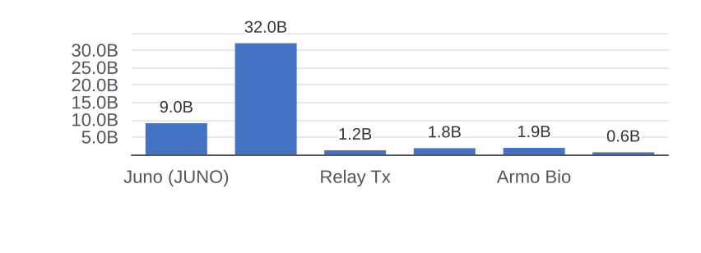
WHERE CAPITAL IS FLOWING
ARCH Venture: Deep Science Platform
Fund Snapshot
Why ARCH Wins: The Deep Science Model
$3B+
~60
Lab-to-company: ARCH spins out science from academic labs
Kadmon, Juno, Alnylam, Relay Tx — all ARCH-founded
Holds through IPO; low-turn, high-conviction style
Key edge: NIH/DoE-adjacent deal flow others can't access
AUM (est.)
Active portfolio cos.
ARCH IX closed 2022
Across all vintages
Selected Exits & Returns (Illustrative $B)
Key Active Holdings (2025)
Company | Modality | Stage | Thesis
Neumora Tx | CNS platform | Phase 2 | Depression/schiz
Dewpoint Tx | Condensate bio | Phase 1 | Undruggable targets
Boundless Bio | ecDNA | Phase 2 | Novel resistance
Rapport Tx | GABA mod. | Phase 2 | CNS selectivity
iTeos Tx | Immuno-oncol. | Phase 2 | TIGIT/A2AR axis
Investment Strategy & LP Positioning
Our View
7–12 yrs
TRL 3–5
US-only
ARCH is the canonical platform-first VC
Alnylam alone = decades of IRR
CNS + condensate bets are contrarian
LP access remains highly competitive
Typical hold
Sweet spot
Geography
Patient capital model
Pre-IND to Phase 1
Boston/SF/Chicago
Source: ARCH Venture Partners, PitchBook, Crunchbase, public filings. Data as of Q4 2025.
41

Slide 42
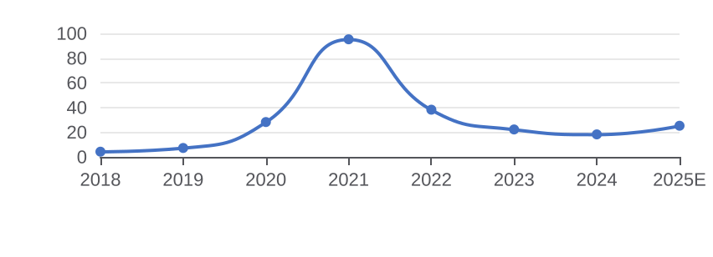
WHERE CAPITAL IS FLOWING
Flagship Pioneering: Company Creator
Fund Snapshot
Why Flagship Is Structurally Different
$4.5B+
100+
Explorations: internal R&D labs generate 200+ ideas/yr
Keeps 30–50% equity; operates as long-term co-founder
Moderna mRNA platform = proof the model scales globally
Three new S-corps in stealth per quarter on average
AUM (est.)
Companies created
Flagship VIII 2023
Since 2000
Flagship Portfolio Value Over Time ($B est.)
Key Active Holdings (2025)
Company | Focus | Stage | Notable
Moderna | mRNA platform | Coml. | COVID + RSV appr.
Larimar Tx | FA (frataxin) | Phase 3 | Rare neuro
Generate Bio | AI protein design | Discov. | ML-native
Quotient Bio | Microfluidics | Phase 1 | Oral biologics
Tessera Tx | Gene writing | Discov. | Beyond CRISPR
Investment Model & LP Profile
Our View
5–8 yrs
$50M/yr
Rare
Key LP
Moderna validates the full thesis
Post-peak; portfolio reset in progress
Generate Bio = most watched asset now
Model is hard to replicate at scale
Concept to IPO
Exploration budget
Co-investors
Novo Holdings
Internal creation timeline
Unfunded R&D arm
Leads solo most rounds
Strategic alignment
Source: Flagship Pioneering, PitchBook, SEC filings, Evaluate Pharma. Data as of Q4 2025.
42

Slide 43
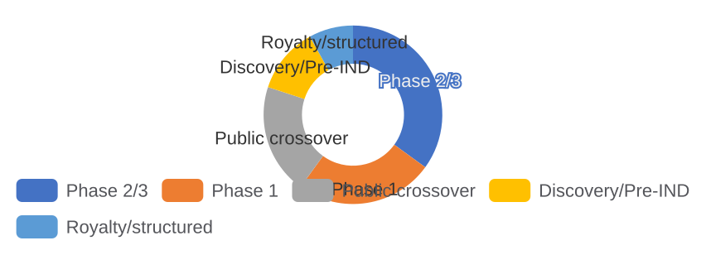
WHERE CAPITAL IS FLOWING
OrbiMed: Largest Dedicated Healthcare VC
Fund Snapshot
Why OrbiMed Spans the Full Stack
$18B+
200+
Only fund with VC, crossover, public, and royalty vehicles
CN presence (OrbiMed Asia) captures China out-licensing deals
Clinical-stage sweet spot: Ph2 data + biomarker story
22 deals in 2025 = highest volume of any dedicated HC fund
AUM
Active investments
VC + public + royalty
Across stages/geographies
2025 Portfolio Mix by Stage (%)
Key Holdings Across Vehicles (2025)
Company | Modality | Stage | Vehicle
Black Diamond Tx | EGFR allosteric | Phase 2 | VC
Protagonist Tx | Peptide mimetics | Phase 3 | Public
Elevation Oncol. | SHP2 inhibitor | Phase 2 | VC
Invacare (royalty) | Medical devices | Revenue | Royalty
Gracell Bio | CAR-T platform | Ph2 (CN) | Asia VC
Cross-Vehicle Strategy & Edge
Our View
$3B
$8B
$2B
$1B+
Broadest platform of any HC-only fund
Asia vehicle = early CN out-license edge
Public book creates crossover arbitrage
Volume player; quality varies by vehicle
VC fund size
Public book
OrbiMed Asia
Royalty vehicle
OrbiMed Private V
Long/short HC equities
CN/APAC VC vehicle
Non-dilutive financing
Source: OrbiMed Advisors, PitchBook, SEC 13F filings, Evaluate Pharma. Data as of Q4 2025.
43

Slide 44
08.
M&A LANDSCAPE
44

Slide 45
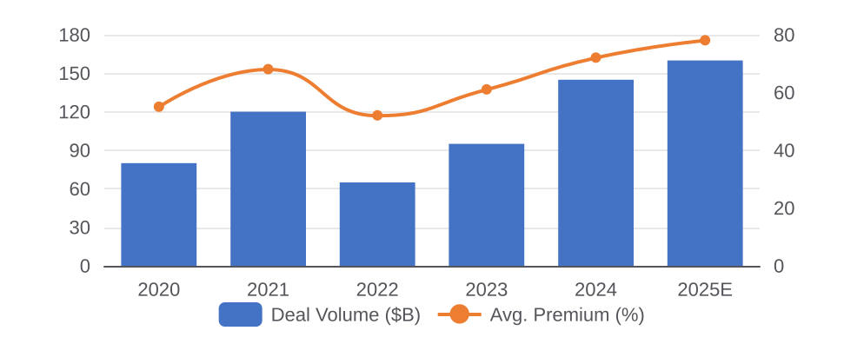
M&A LANDSCAPE
M&A: Buyers, Targets & Mispriced Assets
Select Significant Transactions (2024–2025)
What the Market Is Getting Wrong
Acquirer | Target | Value | Rationale
Pfizer | Seagen | $43B | ADC platform
AbbVie | Cerevel | $8.7B | CNS/emraclidine
AbbVie | ImmunoGen | $10.1B | ADC/ELAHERE
AstraZeneca | Gracell Bio | $1.2B | CAR-T platform
Eli Lilly | Aktis Oncology | $1.4B | Radiopharm
BMS | RayzeBio | $4.1B | Ac-225 therapy
M&A premiums are justified — scarcity of late-stage de-risked assets is real
ADC hype is correct: Pfizer/Seagen commercial execution proves platform thesis
Radiopharmaceuticals: actinium-225 supply is a durable strategic moat
Consensus too bearish on allogeneic CAR-T — contrarian bullish
M&A Volume & Premium Trends
Most Likely Next Wave of Targets
Protagonist Therapeutics: Phase 3 GI programs, IND-approved in multiple anemias
Karuna Therapeutics: acquired — but precedent = neuropsych valuations supportable
Merus N.V.: multi-specific antibody platform, undervalued
Relay Therapeutics: precision oncology, FGFR2 franchise
Instil Bio / Iovance: TIL cell therapy for solid tumors
Source: Evaluate Pharma; FactSet; Company filings; Evaluate 2026 Preview Jan 2026
45

Slide 46
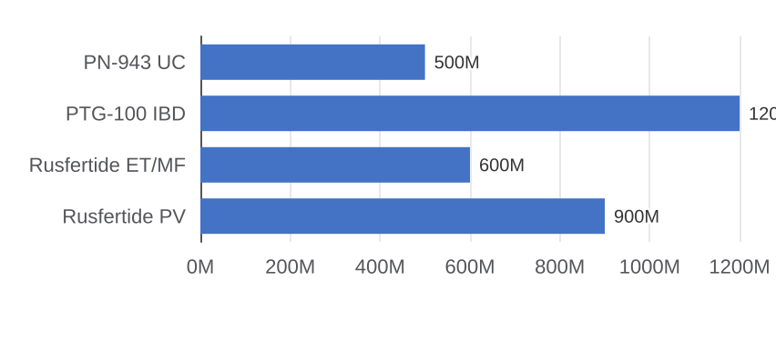
M&A LANDSCAPE
Protagonist Tx: Hepcidin & Oral IL-23
Company Snapshot
Why Protagonist Is a Prime Target
~$2.8B
>2 yrs
H1 2025
Rusfertide: first-in-class hepcidin mimetic, Ph3 PV data H1 2025
Oral IL-23 platform: peptide mimetics dodge biologic IP moats
JNJ already validated category via Tremfya/guselkumab franchise
OrbiMed, Janus among largest holders — activist-friendly cap table
Market Cap
Cash runway
Lead catalyst
NASDAQ: PTGX
$420M cash Q3 2025
Rusfertide Ph3 PV data
Revenue Potential by Asset ($M peak est.)
Comparable M&A Transactions
Acquirer | Target | Value | Modality
JNJ | Aragon Pharma | $1.0B | Peptide
Pfizer | Arena Pharma | $6.7B | Oral GI
AbbVie | Allergan | $63B | Platform
Roche | Inflazome | $0.4B | Oral IL
Sanofi | Kadmon | $1.9B | TGF-beta
M&A Valuation Framework
Our View
$3.8B
40–60%
$3.9–5.0B
JNJ AbbVie
Ph3 readout = binary event in H1 25
Positive data = immediate takeout target
Oral IL-23 alone worth $2B+ to JNJ
Risk: Ph3 miss = significant downside
rNPV (base)
Takeout premium
Implied EV
Best fit buyer
15% cost of capital
vs. 30d VWAP
Plausible range
IL-23 / GI franchise
Source: Protagonist Therapeutics SEC filings, ClinicalTrials.gov, Evaluate Pharma. Jan 2026.
46

Slide 47
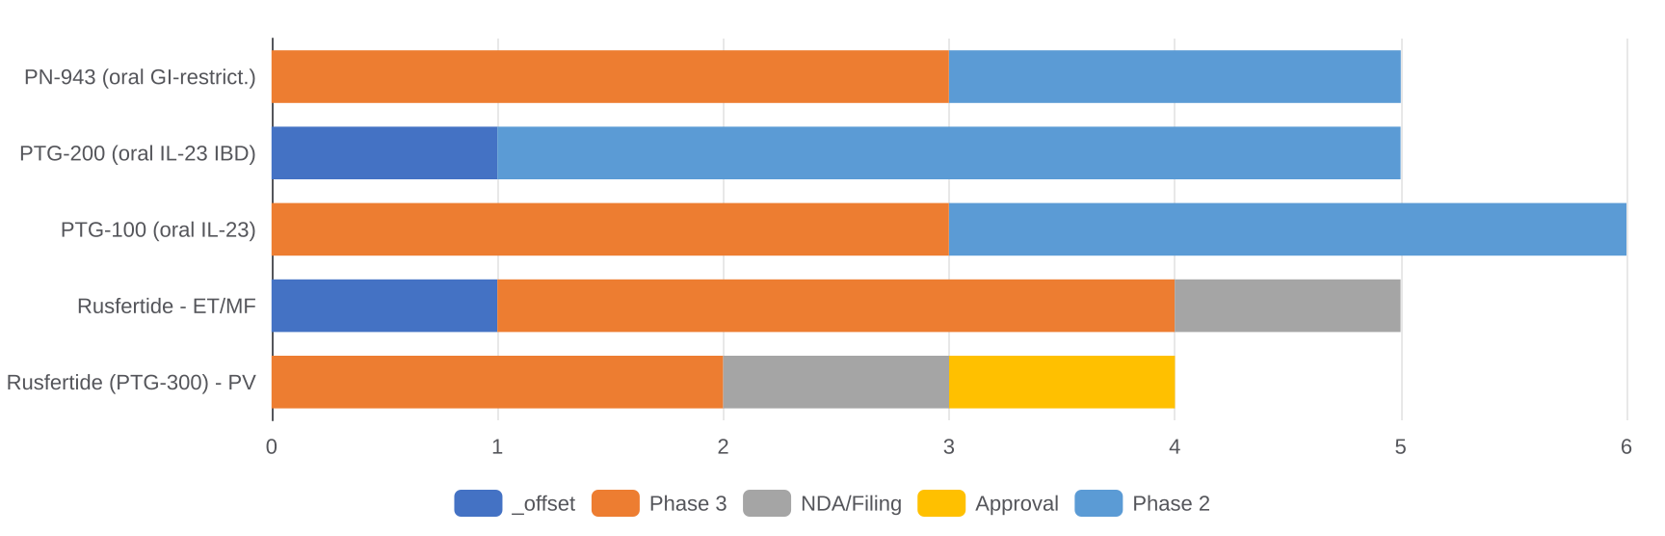
M&A LANDSCAPE
Protagonist: Full Pipeline Timeline
Development Timeline (Gantt-Style — H1’s from H1 2025)
Key Data Readouts & Catalysts
Competitive Landscape
Asset | Catalyst | When | Impact
Rusfertide | Ph3 ACTIVATE+ data | H1 2025 | Binary/high
Rusfertide | NDA submission | H2 2025 | High
PN-943 | Ph2b UC readout | H2 2025 | Medium
PTG-100 | Ph2 Crohn's data | H1 2026 | Medium
Rusfertide ET | Ph3 enroll complete | H2 2025 | Low-med
Competitor | Asset | Target | Stage
Incyte | Ruxolitinib | JAK1/2 | Approved
AbbVie | Upadacitinib | JAK1 | Approved
Celldex | Barzolvolimab | KIT | Phase 3
Disc Med. | Luspatercept | TGF-b | Approved
Blueprint | Avapritinib | PDGFRA | Approved
Source: Protagonist Therapeutics SEC filings, ClinicalTrials.gov. Timelines are estimates. Jan 2026.
47

Slide 48
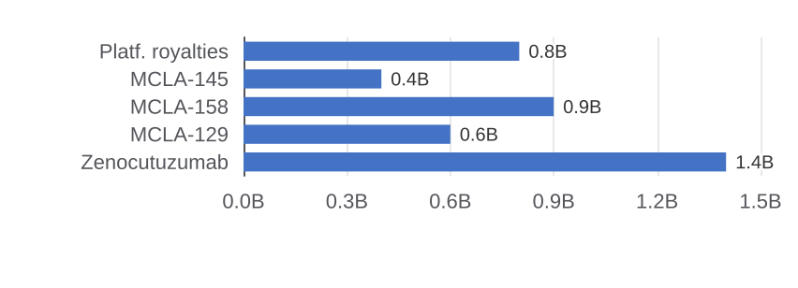
M&A LANDSCAPE
Merus N.V.: Multi-Specific Ab Platform
Company Snapshot
Why Merus Commands a Platform Premium
~$3.1B
$680M
Aug 2025
Biclonics platform: proprietary full-length bispecific antibodies
Zenocutuzumab: first-ever approved Rx for NRG1-fusion cancers
Lilly partnership ($1.5B deal 2024) = external platform validation
LGR5/EGFR (MCLA-158): Sanofi interested; stem-cell targeting moat
Market Cap
Cash
Zenoc. FDA PDUFA
NASDAQ: MRUS
Runway >3 years
NRG1+ NSCLC/PDAC
Biclonics Platform Value Drivers ($B)
Bispecific Antibody M&A Comps
Acquirer | Target | Value | Rationale
Roche | Genentech | $46.8B | Platform
AZ | Gracell Bio | $1.2B | CAR-T bispfc
JNJ | Ambrx | $2.0B | Bispfc ADC
BMS | Turning Point | $4.1B | Bispfc KIT
Lilly | Merus (part.) | $1.5B | Biclonics deal
M&A Valuation Framework
Our View
$4.1B
40–70%
$4.3–5.3B
Roche/AZ/BMS
Zenocutuzumab approval = derisked base
Lilly deal proves platform is real
MCLA-158 is the hidden gem asset
Roche is natural buyer; fits HER2 gap
rNPV (base)
Takeout premium
Implied EV
Best fit buyer
12% cost of capital
Platform scarcity
Plausible range
Bispecific pipeline gaps
Source: Merus N.V. SEC filings, ClinicalTrials.gov, Evaluate Pharma. Jan 2026.
48

Slide 49
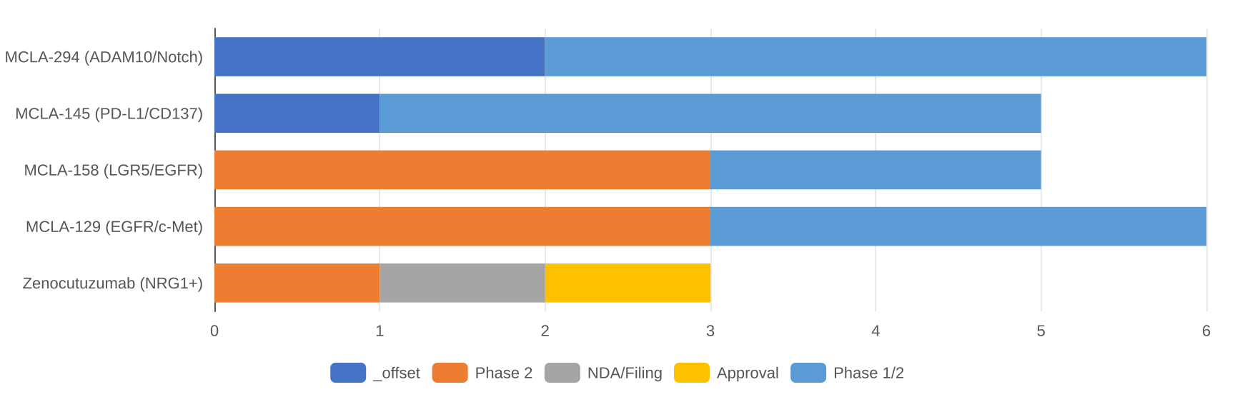
M&A LANDSCAPE
Merus: Full Pipeline Timeline
Development Timeline (Gantt-Style — H1’s from H1 2025)
Key Catalysts
NRG1-Fusion Competitive Landscape
Asset | Catalyst | When | Impact
Zenocutuzumab | FDA PDUFA date | Aug 2025 | High
Zenocutuzumab | PDAC launch data | H2 2025 | High
MCLA-129 | Ph1/2 dose-escalation | H1 2026 | Medium
MCLA-158 | Ph1/2 expansion data | H2 2026 | Medium
MCLA-145 | Ph1 safety readout | H1 2026 | Low-med
Company | Drug | Target | Status
Merus | Zenocutuzumab | HER2/HER3 | NDA filed
Relay Tx | RLY-2608 | PI3K | Phase 2
Daiichi/AZ | Patritumab | HER3 ADC | Phase 3
Lilly (MCLA-128) | Zenocutuzumab | NRG1 | Phase 2
Elevation | EP-100 | LHRH/EGFR | Phase 2
Source: Merus N.V. SEC filings, ClinicalTrials.gov. Timelines are estimates. Jan 2026.
49

Slide 50
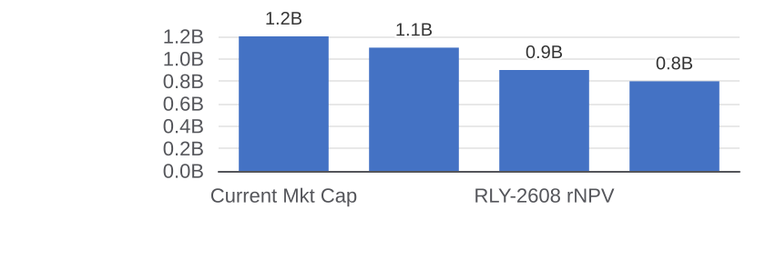
M&A LANDSCAPE
Relay Therapeutics: Precision Oncology
Company Snapshot
Why Relay Is an Undervalued Platform
~$1.2B
$475M
H1 2025
Conformational dynamics: targets mutant-selective binding pockets
RLY-4008: only allosteric FGFR2i; NDA filing H1 2025 for PDAC
RLY-2608: PI3Ka mutant-selective; avoids toxicity of pan-PI3Ki
ARCH-backed; founders = Stanford comput. biology / ML credibility
Market Cap
Cash
Lead catalyst
NASDAQ: RLAY
>2 yr runway
RLY-4008 NDA filing
Asset rNPV vs. Market Cap Disconnect ($B)
Precision Oncology M&A Comps
Acquirer | Target | Value | Rationale
BMS | Turning Point | $4.1B | RET/MET prec.
Pfizer | Array Bio | $11.4B | BRAF/MEK
Lilly | Prevail Tx | $1.0B | CNS precision
JNJ | Ambrx Bio | $2.0B | ADC platform
Roche | Spark Tx | $4.3B | Gene therapy
M&A Valuation Framework
Our View
$2.8B
50–80%
$1.8–2.2B
AZ / Roche
Most mispriced asset in our coverage
NDA filing = immediate re-rating event
RLY-2608 differentiates from IQVIA data
AZ is natural buyer; FGFR2 fits oncol.
rNPV (base)
Takeout premium
Implied EV
Best fit buyer
15% cost of capital
Depressed stock
Plausible near-term
FGFR/PI3K franchise
Source: Relay Therapeutics SEC filings, ClinicalTrials.gov, Evaluate Pharma. Jan 2026.
50

Slide 51
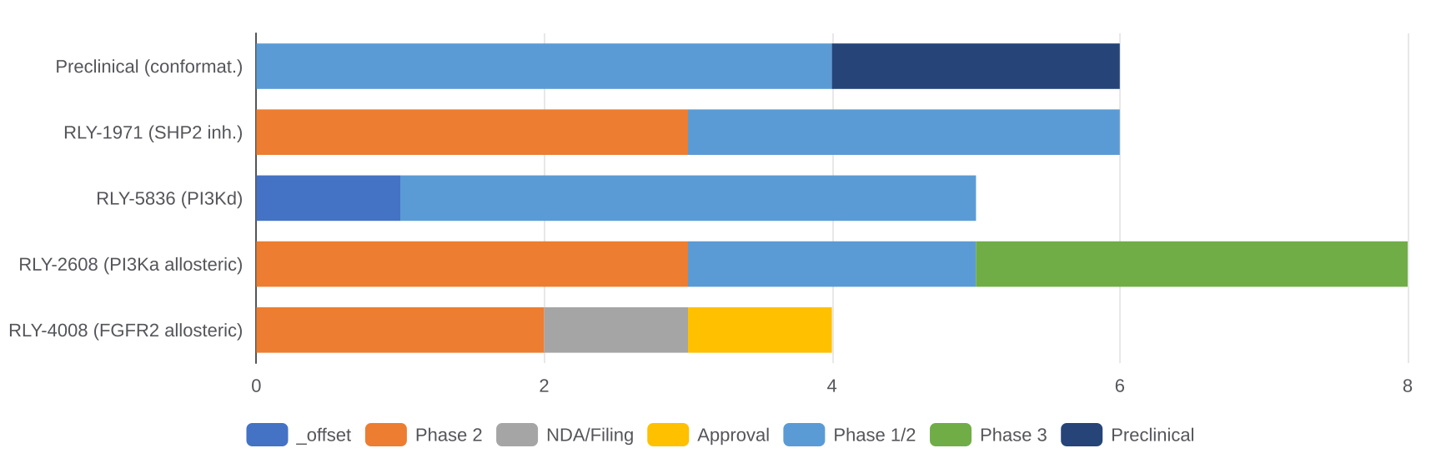
M&A LANDSCAPE
Relay Therapeutics: Full Pipeline Timeline
Development Timeline (Gantt-Style — H1’s from H1 2025)
Key Catalysts
FGFR2 & PI3Ka Competitive Landscape
Asset | Catalyst | When | Impact
RLY-4008 | NDA filing FGFR2+ PDAC | H1 2025 | High
RLY-4008 | FDA PDUFA | H2 2025 | High
RLY-2608 | Ph2 ORR readout | H2 2025 | High
RLY-2608 | Ph3 start (BC) | H1 2026 | Medium
RLY-5836 | Ph1 safety data | H1 2026 | Low-med
Company | Drug | Target | Status
Incyte | Pemigatinib | FGFR1-3 | Approved
JNJ | Erdafitinib | FGFR1-4 | Approved
AZ | Capivasertib | AKT1 | Approved
Novartis | Alpelisib | PI3Ka | Approved
Relay | RLY-2608 | PI3Ka mut | Phase 2
Source: Relay Therapeutics SEC filings, ClinicalTrials.gov. Timelines are estimates. Jan 2026.
51

Slide 52
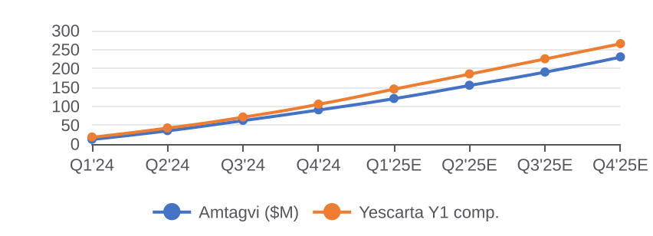
M&A LANDSCAPE
Iovance: TIL Cell Therapy
Company Snapshot
Why Iovance Is an M&A Candidate Now
~$3.4B
2024
$300M+
Amtagvi: first-in-history approved TIL cell therapy (mela., Feb 2024)
Expanding to NSCLC and H&N SCC — market >10x vs. melanoma alone
Manufacturing scale-up at Philadelphia site de-risks supply chain
BMS / Pfizer both lack solid-tumor cell therapy — obvious strategic fit
Market Cap
Amtagvi launch
2025E revenue
NASDAQ: IOVA
1st TIL therapy approved
Ramp quarter-on-quarter
Amtagvi Revenue Ramp vs. Yescarta ($M)
Cell Therapy M&A Comps
Acquirer | Target | Value | Modality
BMS | Celgene | $74B | CAR-T platform
Gilead | Kite Pharma | $11.9B | CD19 CAR-T
JNJ | Legend Bio (part) | $5.0B | BCMA CAR-T
AZ | Gracell Bio | $1.2B | CAR-T CN
Novartis | Tisagenlecleucel | In-house | CAR-T (Kymriah)
M&A Valuation Framework
Our View
$5.2B
30–50%
$4.4–5.1B
BMS / Pfizer
Only commercial TIL asset globally
NSCLC label = 10x melanoma addressable
Manufacturing IP is the real moat
BMS is the most natural acquirer here
rNPV (base)
Takeout premium
Implied EV
Best fit buyer
12% cost of capital
Revenue ramp de-risks
Plausible range
Solid tumor cell Rx gap
Source: Iovance Biotherapeutics SEC filings, ClinicalTrials.gov, Evaluate Pharma. Jan 2026.
52

Slide 53
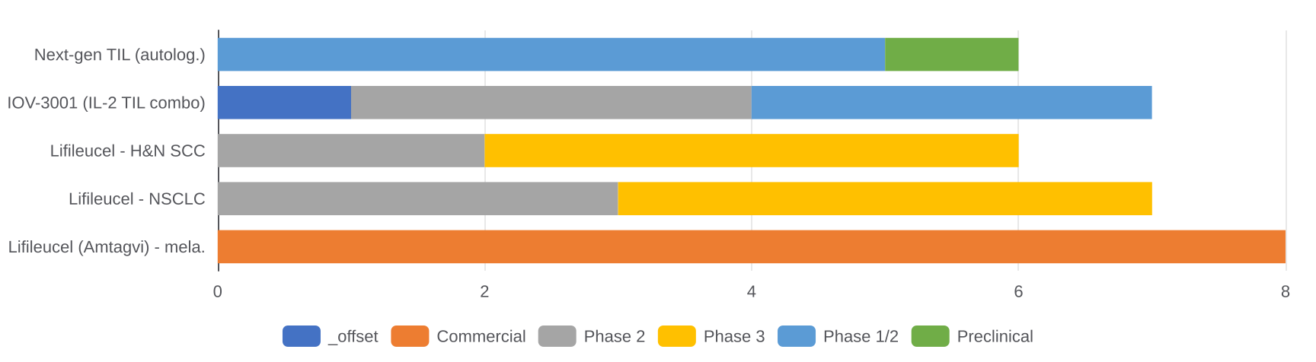
M&A LANDSCAPE
Iovance: Full Pipeline Timeline
Development Timeline (Gantt-Style — H1’s from H1 2025)
Key Catalysts
TIL / Solid Tumor Cell Tx Landscape
Asset | Catalyst | When | Impact
Amtagvi | Q1 2025 revenue print | Apr 2025 | High
Lifileucel NSCLC | Ph2 NSCLC ORR data | H2 2025 | V.High
Lifileucel H&N | Ph2 H&N data | H1 2026 | High
IOV-3001 | Ph1/2 combo data | H2 2026 | Medium
Amtagvi | EU approval decision | H1 2026 | Medium
Company | Asset | Target | Status
Iovance | Amtagvi | TIL (pan) | Approved
Instil Bio | ITIL-168 | TIL | Phase 2
Achilles Tx | NTRT | Neoantigen TIL | Phase 1/2
BioNTech | BNT221 | TIL | Phase 1/2
Adaptimmune | Afami-cel | MAGE-A4 TCR | Approved
Source: Iovance Biotherapeutics SEC filings, ClinicalTrials.gov. Timelines are estimates. Jan 2026.
53

Slide 54
09.
THEMES BEYOND GLP-1
54

Slide 55
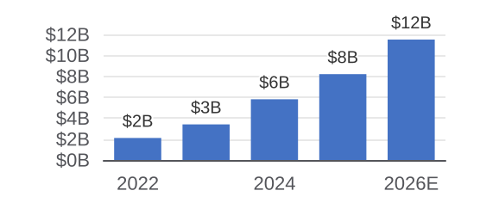
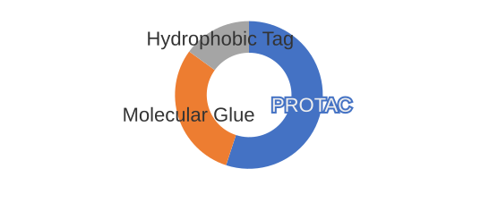
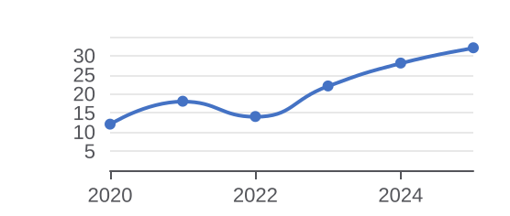
THEMES BEYOND GLP-1
Themes Beyond the GLP-1 Frenzy
The market is so focused on obesity/GLP-1 that several equally transformative platform opportunities are being underpriced.
Radiopharmaceuticals
Protein Degraders (PROTAC/Glues)
CNS Neuropsychiatry
Targeted alpha therapy (TAT) using actinium-225 and bismuth-213 delivering lethal radiation within millimeters of tumor
Novartis Lutathera/Pluvicto proving commercial model; Bristol-Myers RayzeBio deal validates category
Supply chain constraint = durable competitive moat; not easily replicated by Big Pharma
Pipeline expanding beyond PSMA prostate cancer to GRPR breast, SSTR2 NETs, FAPi solid tumors
Under-the-radar companies: Fusion Pharma (AZ acquired), RadioMedix, Ratio Therapeutics
Molecular glues can hit 'undruggable' targets that small molecules and antibodies cannot address
C3 Therapeutics, Kymera Therapeutics, Arvinas leading the field with Phase 2+ data
Bristol-Myers Squibb and Pfizer both acquired degrader platforms 2023–24
GSPT1, IKZF1/3, AR-v7 are validated glue targets with near-term clinical readouts
Oral bioavailability and CNS penetration distinguish best-in-class from science projects
AbbVie paid $8.7B for Cerevel; Biogen/Eisai Leqembi proving Alzheimer's is a real market
Muscarinic receptor agonism (M4) is the new SOC for schizophrenia — emraclidine, xanomeline
Psychedelic-adjacent: GABA-PAM, NMDA modulators — COMPASS, Atai Life Sciences navigating regulated path
Obesity and CNS are converging: GLP-1 receptors in the brain are driving neuroinflammation interest
Most undervalued: Rare CNS: Huntington's, ALS, Prader-Willi — small population, high WTP
Source: Company filings, ClinicalTrials.gov, PitchBook, Evaluate Pharma
55

Slide 56
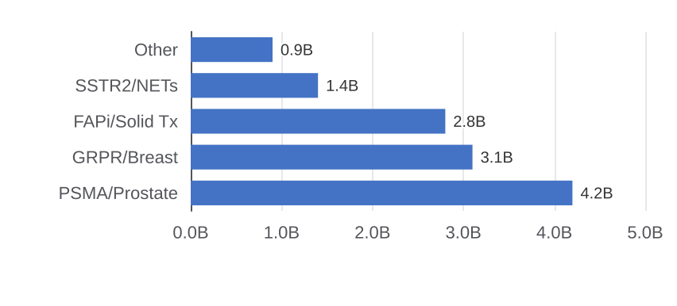
THEMES BEYOND GLP-1
Ratio Therapeutics: Next-Gen TAT
Company Snapshot
Why Ratio Is the Standout in TAT
Private
$135M
Ph1
Proprietary SARTATE chelator stabilizes Ac-225 vs competitors
Oak Ridge National Lab supply deal creates structural moat
PSMA-targeted TAT: 10–100x more potent than Lu-177
GRPR (breast) + FAPi (pan-solid) expand beyond prostate
Status
Raised
Lead program
Series B 2024
ARCH + OrbiMed led
RAT001 PSMA/Ac-225
TAT Market Size by Indication ($B, 2030E)
Radiopharm Competitive Landscape
Company | Isotope | Target | Status
Novartis | Lu-177 | PSMA/SSTR2 | Commercial
BMS/RayzeBio | Ac-225 | GRPR | Phase 2
AZ/Fusion | Ac-225 | PSMA | Phase 2
Ratio Tx | Ac-225 | PSMA/GRPR | Phase 1
RadioMedix | Ac-225 | PSMA | Phase 1
Investment Thesis & Key Metrics
Our View
~$600M
SARTATE
AZ / Lilly
2027–28
Chelator IP is the real defensibility
Ac-225 supply = structural bottleneck
GRPR breast data = 2026 inflection
AZ natural buyer post Fusion deal
Last valuation
Key differentiator
M&A fit
Exit horizon
Post Series B 2024
Proprietary chelator IP
TAT platform gap
Ph2 data = takeout
Source: Ratio Therapeutics, PitchBook, ClinicalTrials.gov, company press releases. Jan 2026.
56

Slide 57
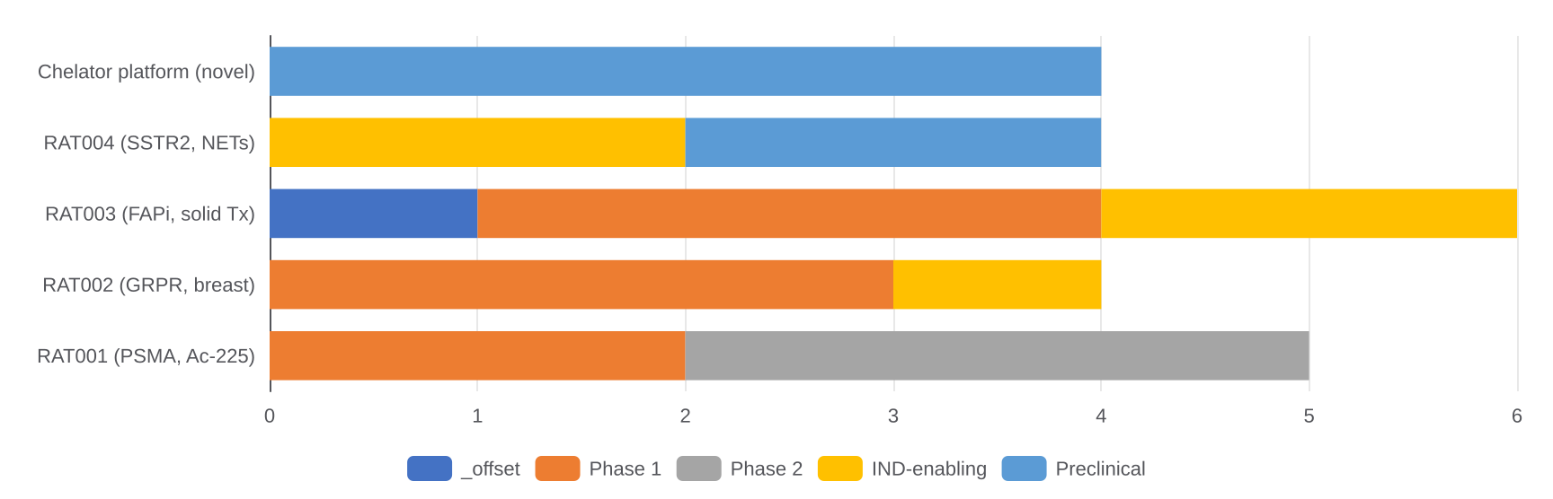
THEMES BEYOND GLP-1
Ratio Therapeutics: Pipeline Timeline
Development Timeline (Gantt — H1’s from H1 2025)
Key Catalysts
Ac-225 Supply Chain Dynamics
Program | Catalyst | When | Impact
RAT001 | Ph1 safety + dosing | H2 2025 | High
RAT001 | Ph1 ORR signal | H1 2026 | V.High
RAT002 | IND filing GRPR | H1 2026 | Medium
RAT001 | Ph2 enrollment | H2 2026 | High
RAT003 | IND filing FAPi | H1 2027 | Medium
Supplier | Capacity | Partner | Moat
Oak Ridge NL | ~1 Ci/yr | Ratio excl. | US DOE
TRIUMF (CA) | ~0.3 Ci/yr | Multi | Cyclotron
iThemba LABS | ~0.2 Ci/yr | Open | SA govt
NorthStar Med. | Scaling | Novartis | Reactor
Niowave | Pilot | TBD | Linear accel.
Source: Ratio Therapeutics, ClinicalTrials.gov. Timelines are estimates. Jan 2026.
57

Slide 58
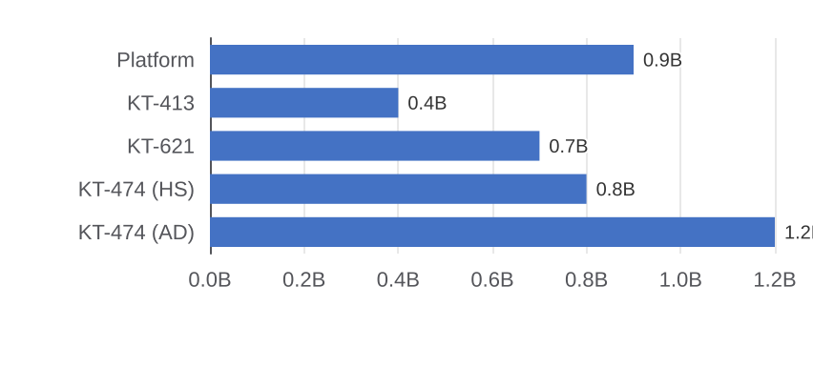
THEMES BEYOND GLP-1
Kymera Therapeutics: Targeted Degraders
Company Snapshot
Why Kymera Leads the Degrader Field
~$1.6B
$620M
$1.45B
Pegasus platform: E3-ligase-focused; >80 ligase-target combos
KT-474: IRAK4 degrader in Ph2 for AD + hidradenitis suppurativa
Sanofi $1.45B option deal — largest degrader partnership
STAT6 degrader (KT-621): undruggable target, IL-4/IL-13
Market Cap
Cash
Sanofi deal
NASDAQ: KYMR
>3 yr runway
IRAK4 partnership 2021
Degrader Pipeline Value Est. ($B rNPV)
Degrader Field Competitive Landscape
Company | Lead | Target | Stage
Arvinas | ARV-110 | AR (PROTAC) | Phase 3
Kymera | KT-474 | IRAK4 | Phase 2
C3 Bio | CFT8634 | BRD9 glue | Phase 1
Nurix | NX-5948 | BTK deg. | Phase 1
BMS | CC-92480 | IKZF glue | Phase 2
Investment Thesis & Key Metrics
Our View
$4.0B
60%
AbbVie/BMS
H1 2026
Sanofi deal = external validation done
KT-474 AD readout = binary re-rating
STAT6 is a \$2B+ undruggable unlock
Trading at deep discount to rNPV
rNPV (base)
Mkt cap discount
M&A fit
Key catalyst
12% cost of capital
vs. rNPV; undervalued
Immunology/oncology gap
KT-474 Ph2 AD readout
Source: Kymera Therapeutics SEC filings, ClinicalTrials.gov, Evaluate Pharma. Jan 2026.
58

Slide 59
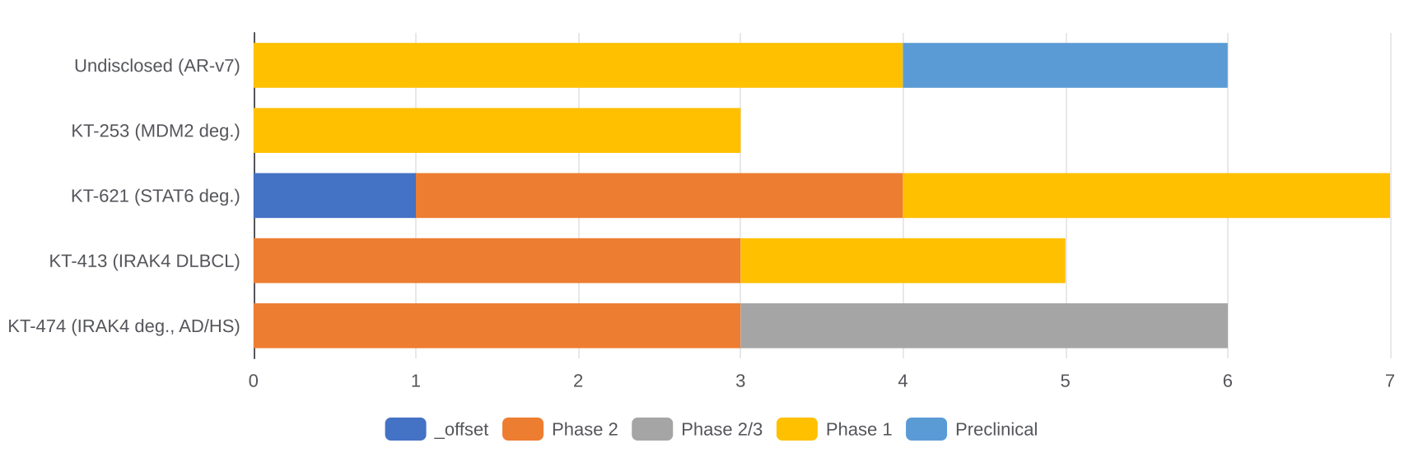
THEMES BEYOND GLP-1
Kymera Therapeutics: Pipeline Timeline
Development Timeline (Gantt — H1’s from H1 2025)
Key Catalysts
E3 Ligase Landscape (Platform Depth)
Program | Catalyst | When | Impact
KT-474 | Ph2 AD EASI score | H1 2026 | V.High
KT-474 | Ph2 HS IGA data | H2 2025 | High
KT-621 | Ph1 safety data | H2 2025 | Medium
KT-413 | Ph1 NHL ORR | H1 2026 | Medium
KT-253 | Ph1 dose escalation | H1 2026 | Low
Ligase | Kymera assets | Competitors | Drugged?
CRBN | KT-253 | BMS/J&J/Arvinas | Yes
DCAF16 | KT-474 | Nurix, C3 | Yes
VHL | Undiscl. | Arvinas | Yes
MDM2 | KT-253 | Ascentage | Partial
RNF4 | Preclin. | None | No
Source: Kymera Therapeutics SEC filings, ClinicalTrials.gov. Timelines are estimates. Jan 2026.
59

Slide 60
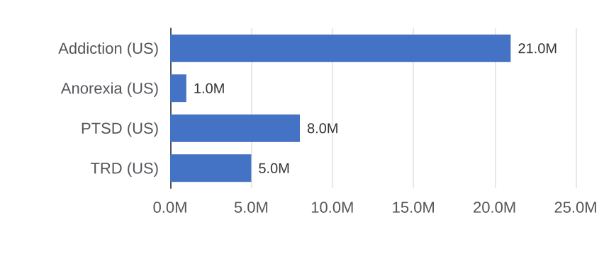
THEMES BEYOND GLP-1
COMPASS Pathways: Psychedelic Medicine
Company Snapshot
Why COMPASS Is the Bellwether CNS Startup
~$0.9B
$210M
Ph2b/3
First synthetic psilocybin in Phase 2b/3 for TRD globally
Ph2b: 29% remission at 25mg vs 7.6% placebo (p<0.001)
Strong IP portfolio with therapeutic use patents
FDA breakthrough for anorexia; expanding to PTSD
Market Cap
Cash
Lead program
NASDAQ: CMPS
~2 yr runway
COMP360 TRD
TRD Market Size & Addressable Patients
Psychedelic / Novel CNS Landscape
Company | Asset | Target | Stage
COMPASS | COMP360 | Psilocybin TRD | Ph 2b/3
Atai Life | PCN-101 | R-ketamine | Phase 2
Lykos Tx | MDMA-AT | PTSD | NDA filed
Perception | PCN-101 | 5-HT2A | Phase 2
Small Ph. | SPL026 | DMT | Phase 2
Investment Thesis & Key Metrics
Our View
$1.4B
$3.5B+
JNJ / AbbVie
FDA pathway
Ph2b data is unusually clean signal
Anorexia BT designation = optionality
JNJ neuroscience rebuild = strategic fit
Cash runway is the primary risk now
rNPV (base)
Upside case
M&A fit
Key risk
TRD alone, 15% CoC
PTSD + anorexia label
Neuroscience rebuild
Novel regulatory hurdle
Source: COMPASS Pathways SEC filings, ClinicalTrials.gov, Evaluate Pharma. Jan 2026.
60

Slide 61
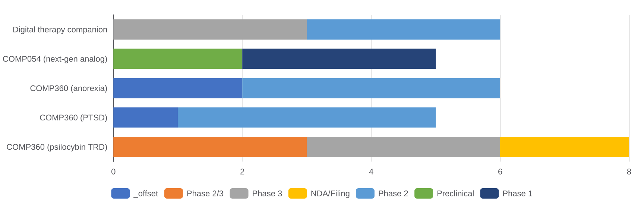
THEMES BEYOND GLP-1
COMPASS Pathways: Pipeline Timeline
Development Timeline (Gantt — H1’s from H1 2025)
Key Catalysts
Regulatory & Reimbursement Challenges
Program | Catalyst | When | Impact
COMP360 TRD | Ph2b/3 primary EP | H2 2025 | V.High
COMP360 TRD | NDA submission | H1 2028 | High
COMP360 PTSD | Ph2 ORR data | H1 2026 | High
COMP360 AN | Ph2 enroll complete | H2 2026 | Medium
COMP054 | Ph1 first-in-human | H1 2027 | Medium
Issue | Status | Probability | Mitigation
FDA REMS | Expected | High | Spravato model
DEA scheduling | Schedule I | Medium | NDA triggers
Payer coverage | Uncertain | Medium | Value-based Rx
IP durability | Strong | High | Polymorph + use
Clinic infra | Scaling | Medium | COMPASS network
Source: COMPASS Pathways SEC filings, ClinicalTrials.gov. Timelines are estimates. Jan 2026.
61

Slide 62
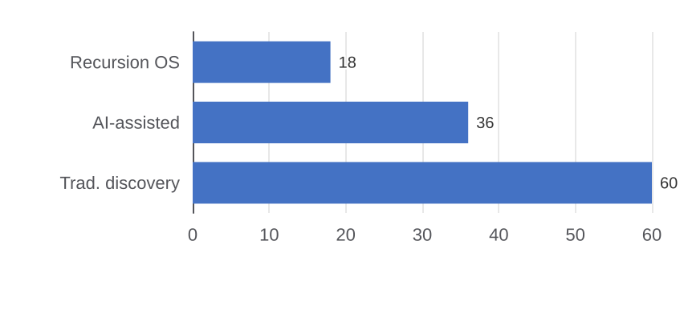
THEMES BEYOND GLP-1
Recursion Pharma: AI-Native Drug Co.
Company Snapshot
Why Recursion Is the AI Biotech Benchmark
~$2.1B
$560M
$50M
OS maps 50B+ cell images; largest phenomics dataset in pharma
Roche/Genentech paid $150M upfront for AI model access (2023)
Acquired Exscientia (2024): combines generative + phenomics AI
REC-994 & REC-2282 in human trials = AI pipeline is real, not hype
Market Cap
Cash
Nvidia stake
NASDAQ: RXRX
~2.5 yr runway
Strategic investor
AI Drug Discovery Cost Advantage
AI Pharma Competitive Landscape
Company | AI Method | Partner | Stage
Recursion | Phenomics | Roche/Nvda | Phase 2
Exscientia | Gen. design | Sanofi | Acquired
Insilico | Gen. design | Pfizer | Phase 2
Isomorphic | AlphaFold3 | Lilly/AZ | Discovery
BioNTech | mRNA + AI | In-house | Phase 2
Investment Thesis & Key Metrics
Our View
50B+ images
Dual
Roche / AZ
2025–26
AI hype real; pipeline must deliver
Exscientia merger = stronger gen. AI
Roche deal = strategic upside option
REC-994 is the make-or-break proof pt
OS data moat
Revenue model
M&A fit
Key catalyst
10x nearest competitor
Pipeline + AI licensing
AI platform acqui-hire
REC-994 Ph2 readout
Source: Recursion Pharmaceuticals SEC filings, ClinicalTrials.gov, PitchBook. Jan 2026.
62

Slide 63
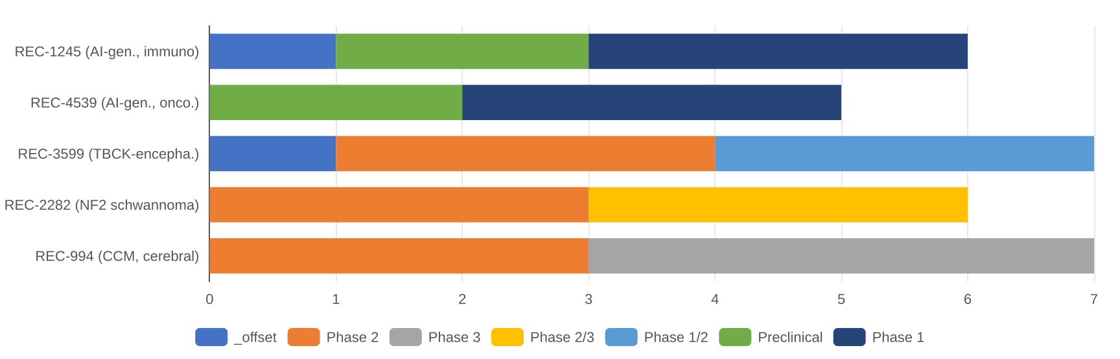
THEMES BEYOND GLP-1
Recursion Pharma: Pipeline Timeline
Development Timeline (Gantt — H1’s from H1 2025)
Key Catalysts
Recursion OS Platform Metrics
Program | Catalyst | When | Impact
REC-994 | Ph2 CCM primary EP | H2 2025 | V.High
REC-2282 | Ph2 NF2 ORR | H1 2026 | High
REC-3599 | Ph1/2 first-in-human | H1 2026 | Medium
REC-4539 | IND filing (AI-gen.) | H2 2025 | Medium
OS v3.0 | Model release + deals | H1 2026 | High
Metric | Recursion | Industry avg. | Edge
Cell images | 50B+ | ~1B | 50x data
Time to IND | 18 mo | 60 mo | 3.3x faster
Hit rate | ~22% | ~5% | 4x higher
Cost / cmpd | $500 | $5,000 | 10x cheaper
Active programs | 50+ | N/A | Breadth
Source: Recursion Pharmaceuticals SEC filings, ClinicalTrials.gov. Timelines are estimates. Jan 2026.
63

Slide 64
10.
INVESTMENT IMPLICATIONS
64

Slide 65
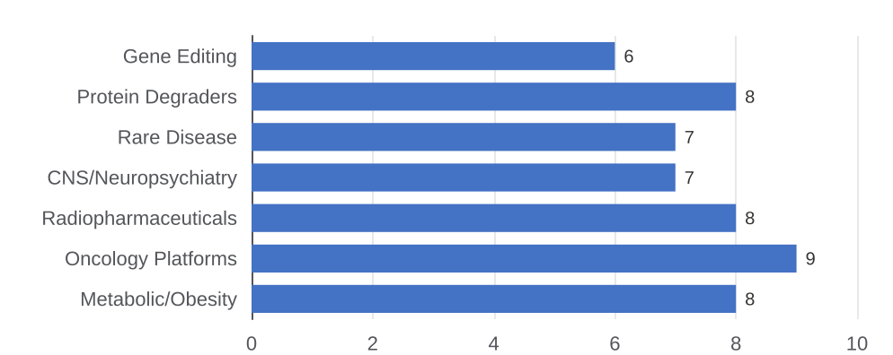
INVESTMENT IMPLICATIONS
Investment Implications & Key Takeaways
Framework for Evaluating Biotech Opportunities
The Five Contrarian Calls
Dimension | Strong Signal | Weak Signal
Platform vs. Asset | Modular, reusable platform | One drug, one indication
Acquirer Logic | Fits 2+ Big Pharma buyers | Only one plausible acquirer
Mechanism Validation | Phase 2 human PoC in hand | Preclinical only, animals
China Angle | Western rights to derisked asset | No China competition
Capital Efficiency | Lean burn, 18+ month runway | High burn, no near-term data
Allogeneic CAR-T will work: Precision BioSciences, Allogene — give it 18 months
China out-licensing is biggest alpha Western IB firms underserve today
ADC manufacturing: Lonza, Samsung Biologics are infrastructure plays
Radiopharm Ac-225 supply will be biotech's semiconductor shortage
Sector Allocation View: 2026
Near-Term Catalysts to Watch
Catalyst | Timeline | Impact
CagriSema Ph3 data | Q2 2026 | GLP-1 combo thesis
Lilly oral GLP-1 | H1 2026 | Oral form. race
BMS mol. glue PDUFA | Mid 2026 | Degrader signal
Ivonescimab NSCLC | H2 2026 | China ADC signal
FDA leadership set | Q1–Q2 2026 | Approval pace
Source: Investment Banking MD analysis; Evaluate Pharma; FactSet | This presentation represents a point-in-view, not investment advice
65

